Slide 1

WELCOME

Slide 2
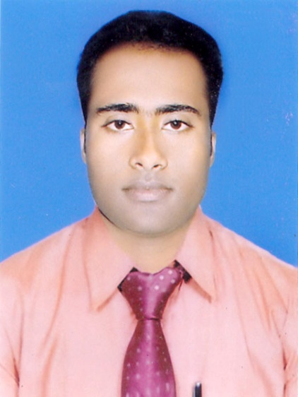
Teacher ‘s Identity
CHANDAN BISWAS
ASSISTANT TEACHER
ANDHA HIGH SCHOOL
E-mail: chandanb13@gmail.com

Slide 3
Class Identity
English-1st Paper
Class-Six
Lesson- 33
Too much or too little water

Slide 4
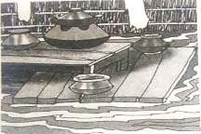
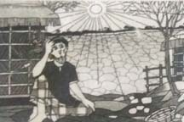
Look at the picture

Slide 5
Learning outcomes
After completing the lesson students will be able to-
*Read and understand the texts.
*Write a short paragraph.
*Answer the questions.

Slide 6
Vocabulary
Heavily
Flood
Occur
Rainfall
River
Water
Burst
– প্রচন্ডভাবে
বন্যা
- ঘটা
- বৃষ্টিপাত
- নদী
- জল,পানি
- বিস্ফোরণ

Slide 7
Bank
Dry
Underground
Sink
Cause
Suffering
People
তীর
-শুষ্ক
-ভূগর্ভস্থ
- ডুবা
- কারণ
-সহন, ভোগা
- লোকজন

Slide 8
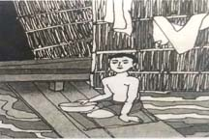
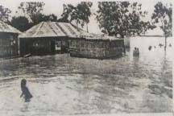
Look at the picture
Sometimes it rains so heavily that floods occur. Because of hheavy rainfall, river water bursts out of its banks and floods vast areas of land , towns and villages.

Slide 9
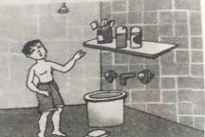
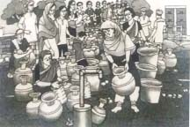
Look at the picture
Sometimes we really are short of water. This can happen if there is no rainfall for a long period of time. Sometimes rivers dry up, or the water level underground may sink very low. If there is too little water, that causes a lot of suffering to the people.

Slide 10
EVALUATION
1* Write a few sentences about how people suffer if there is too much water.
Sometimes it rains so heavily that floods occur. Because of hheavy rainfall, river water bursts out of its banks and floods vast areas of land , towns and villages.
2* Write a few sentences about how people suffer if there is too little water.
Sometimes we really are short of water. This can happen if there is no rainfall for a long period of time. Sometimes rivers dry up, or the water level underground may sink very low. If there is too little water, that causes a lot of suffering to the people.

Slide 11
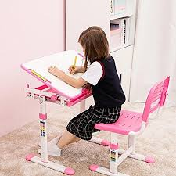
Home work
* Write a short paragraph about Too
much or too little water.

Slide 12

Thank you
everybody

