Slide 1

WELCOME

Slide 2

Teacher ‘s Identity
CHANDAN BISWAS
ASSISTANT TEACHER
ANDHA HIGH SCHOOL
E-mail: chandanb13@gmail.com

Slide 3
Class Identity
English-1st Paper
Class-Six
Lesson-24
Aesop’s fable

Slide 4

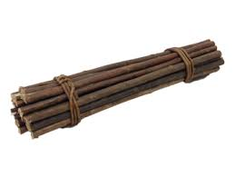
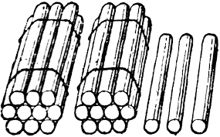
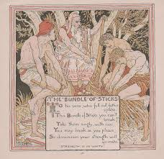
Look at the picture

Slide 5
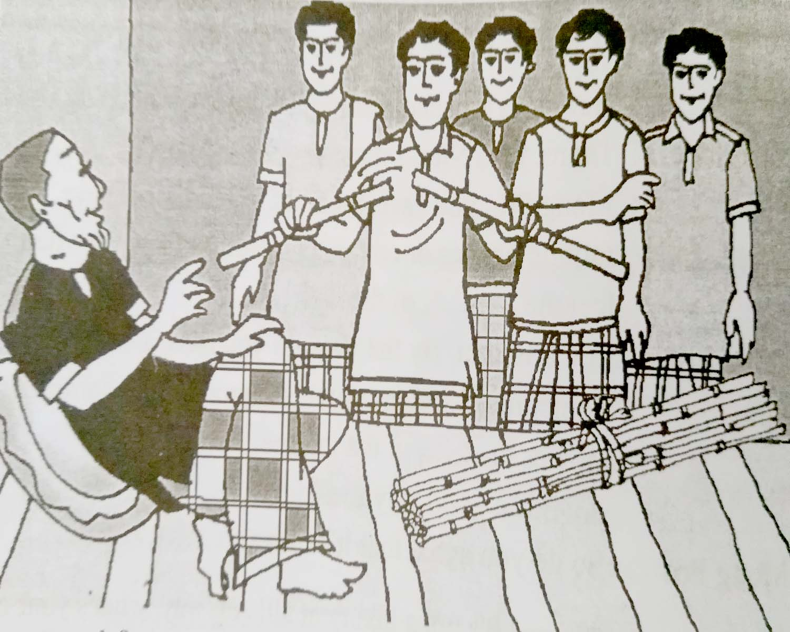
The old man and his sons

Slide 6
Learning outcomes
After completing the lesson students will be able to
*Read and understand the texts.
*Understand and enjoy stories and poems.
*Answer the questions.

Slide 7
Vocabulary
Fable
Slave
Servant
Bundle
Stick
Together
Break
– উপকথা
ক্রীতদাস
- দাস
- পাঁজা
- লাঠি
- একসঙ্গে
- ভাঙ্গা

Slide 8
Might
Smile
Untie
Moment
Affectionately
Unity
Strength
শক্তি
-হাসি
-বন্ধন ন্মুক্ত করা
- মুহূর্ত
- আদর করে
- ঐক্য
- শক্তি

Slide 9
Read the story
Long ago and far away , there was an old farmer who had seven sons. One day, the old farmer was lying on his bed and he thought that he would not live much longer.He called his sons before him. He told a servant to bring in a bundle of seven sticks tied together.He handed the bundle to his oldest son and saod to him,`Son,now break the bundle.’’The son tried with all his might, but he could not break the bundle.One by one ,the other brothers tried.None of them was strong enough. The father smiled,`Now ,my sons,untie the bundle. Each of you,take a stick and try to break it. This time they had no difficulty breaking the sticks. In a few moments all the sticks were broken.The old man looked at his sons affectionately and said ." Remember,in unity there is strength."

Slide 10
EVALUATION
1* How many sons there was the old farmer ?
Ans: The old farmer had seven sons.
2* What did the farmer think ?
Ans: The farmer thoght that he would not live much longer.
3* What is morality of the story ?
Ans: The morality of the story is ‘’unity is
strength.”

Slide 11
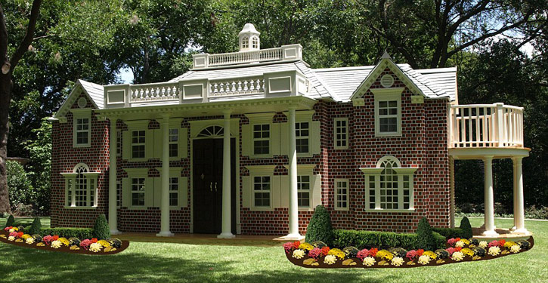
Home work
* Complete the story about Unity
there is strength.
*Long ago and far away , there was an old farmer who had seven sons. One day, the old farmer was lying on…………..

Slide 12

Thank you
everybody

