Slide 1
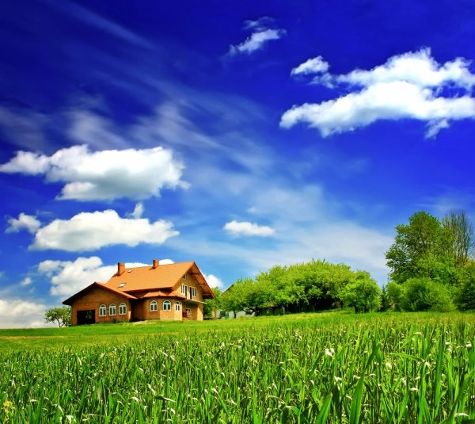

Slide 2
WELCOME
TO ALL

Slide 3
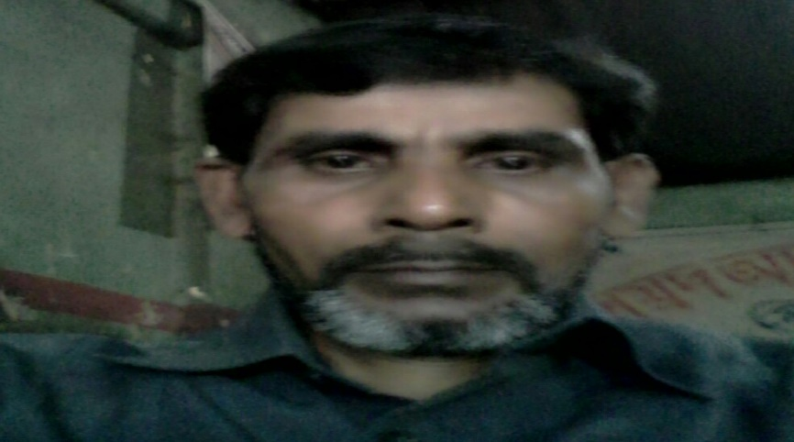
MD ABUL KASHEM
ASSISTANT TEACHER
LAKESHWOR DAKHIL MADRASA
CHATAK SUNAMGONJ
MOBILE 01786498922

Slide 4
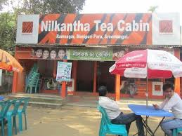
LESSON INTRODUCE
IT WAS A GREAT DAY
LESSON 2-3
UNIT-21
CLASS-FIVE
TIME-50 MINUTES
DATE-30/11/2019

Slide 5
THINK ABOUT THE PICTURES AND SAY

Slide 6
What did you see in the picture ?

Slide 7
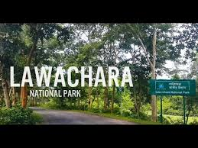
What is the name of this park ?

Slide 8
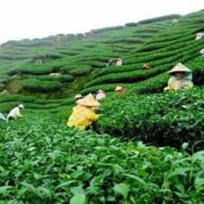
What did you see in the picture ?

Slide 9
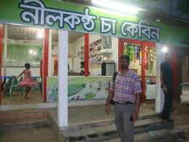
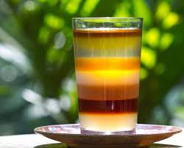
Did you drink tea ?

Slide 10
Word meaning
পাহাড়
Hill
Drink tea
চা পান
Visit
বেড়ানো
Forest
বন
Interesting
আনন্দদায়ক

Slide 11
Correct Pronounciation
Nilkantha Tea
Cabin
Shreemangal
Flavour
Camporee

Slide 12
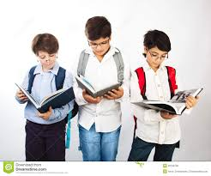
GROUP WORK
1.What did you see ?
2.Where did you go ?
3.Did you eat or drink something there ?
4.What did you do there ?

Slide 13
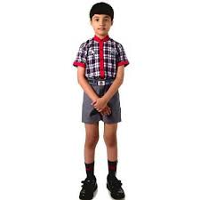
EVALUATION
1.Where did you go ?
2.Who did you go with ?
3.How did you get there ?

Slide 14
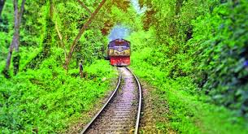
HOME WORK
Write a paragraph in your own words about it was a great day .

Slide 15
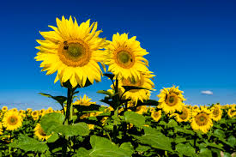
THANK TO ALL

