Slide 1
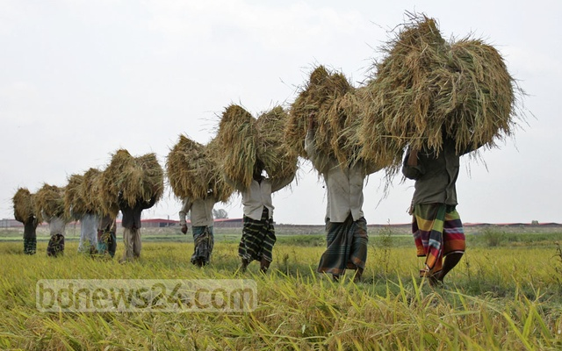
WELCOME

Slide 2
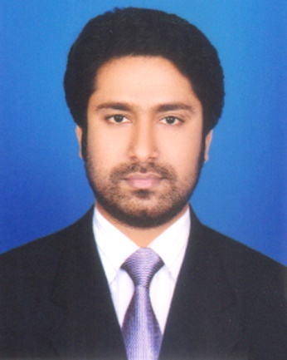
Presented by
M Humayun Kabir
English Teacher
Bhayeta Abdul Quddus Dakhil Madrasah, Tangail Sadar
Cell : 01727-425565 ; 01924-320532
E-mail : hkabir082009@gmail.com

Slide 3
Lesson Identity
Past Simple
Class Six
Unit Six
22 October 2019

Slide 4
Learning outcomes
After we have studied this lesson, we will be able to
know about the Past Simple Tense.
make the questions and their answers on Past Simple Tense
give the name of sentences and
use them properly.

Slide 5
Let’s Check Our V1,2,3
Recite আবৃত্তি করা recited recite
Read পড়া read read
Study অধ্যয়ন করা studied studied
Learn লেখা learned / learnt learned / learnt
Teach শেখানো; শিক্ষা দেওয়া taught taught

Slide 6
11 WH Words
What - কী ?
Whom - কাকে ?
How - কীভাবে ?
Where - কোথায় ?
When - কখন ?
Why - কেনো ?
Who - কে ?
Who - কে কে / কারা ?
Which- - কোন- টি ?
Whose- - কার- টি ?
WH Prepositions - WH Prepositions ?

Slide 7
Simple
Present Simple : I recite a poem.
Past Simple : I recited a poem.
Future Simple : I shall recite a poem.
V1 (s/es)
V2
Shall / will V1

Slide 8

H Kabir
H Kabir

Slide 9
Let’s Start our Today’s Topic

Slide 10
TOPIC
Past Simple : (Part-A)
Subject : English 2nd Paper
Lesson : 6.2 (Part-A)
Period : 3rd
Time : 40 minutes
Date : 22 October 2019

Slide 11
Past Simple
1. I
recited
a poem. =
আমি একটি কবিতা আবৃত্তি করেছিলাম।
2. I
didn’t
recite
a poem. =
আমি একটি কবিতা আবৃত্তি করিনি ।
3.
Did
I
recite
a poem ? =
আমি কি একটি কবিতা আবৃত্তি করেছিলাম ?
4.
Didn’t
I recite a poem ? =
আমি কি একটি কবিতা আবৃত্তি করিনি ?
5.
What
did I recite ? =
আমি কী আবৃত্তি করেছিলাম ?
6.
What
didn’t I recite ? =
আমি কী আবৃত্তি করিনি ?

Slide 12
Let’s Try to Learn from the Video

Slide 13
Let’s Name these 6 Sentences
According to
Primary Sentence (Structure)

Slide 14
01. Affirmative
(হ্যাঁবোধক)
02. Negative
(নাবোধক)
03. Interrogative
(প্রশ্নবোধক/ হ্যাঁবোধক প্রশ্ন)
04. Negative-Interrogative
(নাবোধক-প্রশ্ন)
05. WH Interrogative
WH (প্রশ্নবোধক/ হ্যাঁবোধক প্রশ্ন)
06. WH Negative-Interrogative
WH (নাবোধক-প্রশ্ন)

Slide 15
Assessment-1
Dear Students ! Tell me-
How many questions are there ? Who are they ?
Answer those questions.

Slide 16
Let’s Build up our Career. But how… ?
Let’s Get by Heart and Practise these 6 Sentences
With 101 Verbs (V123)

Slide 17
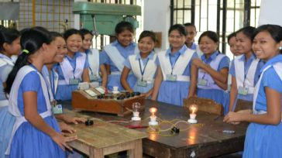
Group Work
Make 6 sentences using Past Simple
with following directions-
Learn
Eat
Teach
Write
Draw

Slide 18
Assessment-2
Open your Text Book and find out the
Past Simple Tense.

Slide 19
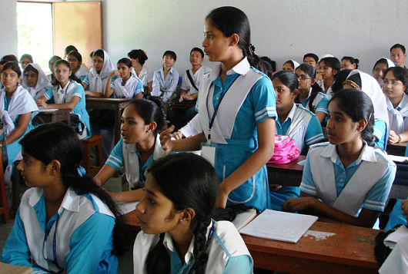
Individual Work
Make Past Simple with following verbs using objects.
Do
Take
Drink
Like
Invite

Slide 20
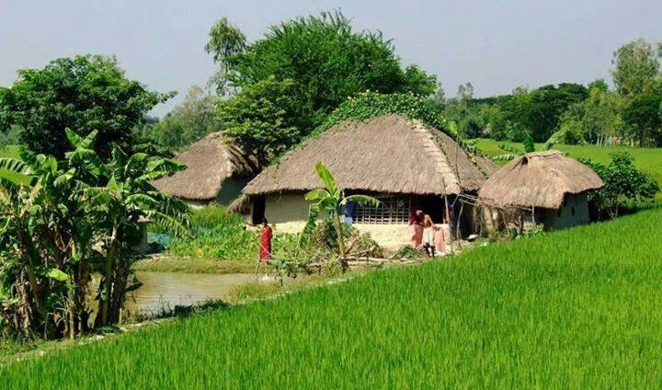
Home Task

Slide 21
Assignment
Try to follow up our class at a glance and
Make a note on
Past Simple Tense.

Slide 22

Thank You All
May Allaah swt learn and expert in the Past Simple Tense.

