Slide 2


WELCOME
Hello!
How are you today?

Slide 3


^{Teacher’s Introduction}
^{Inoon Nahar}
^{Assistant teacher}
Haturpara government primary school,
^{Kahaloo, Bogura.}

Slide 4

^{Lesson’s Introduction}
^{Subject: English}
^{Class : Four}
^{Unite: 39}
^{Lesson: 1}
Lesson part: Occupations (A,B,C)
^{Time: 40 min}

Slide 5
Learning outcomes
3.1.1 To ask and answer simple WH questions. .(Speaking)
6.2.1 Talk about people, objects, events etc.(Speaking)
1.4.1 Read words, phrases and sentences in the text.(Reading)
3.1.1 Write words, phrases and sentences using non-cursive capital and small letters.(Writing)

Slide 6
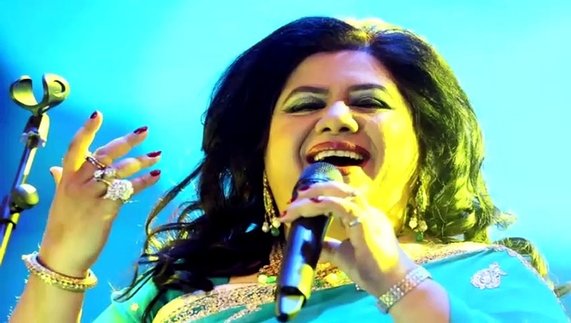
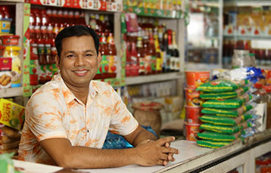
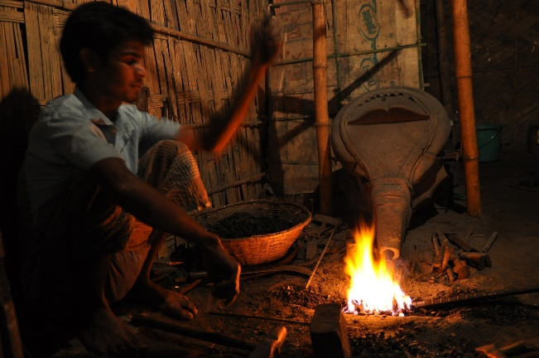
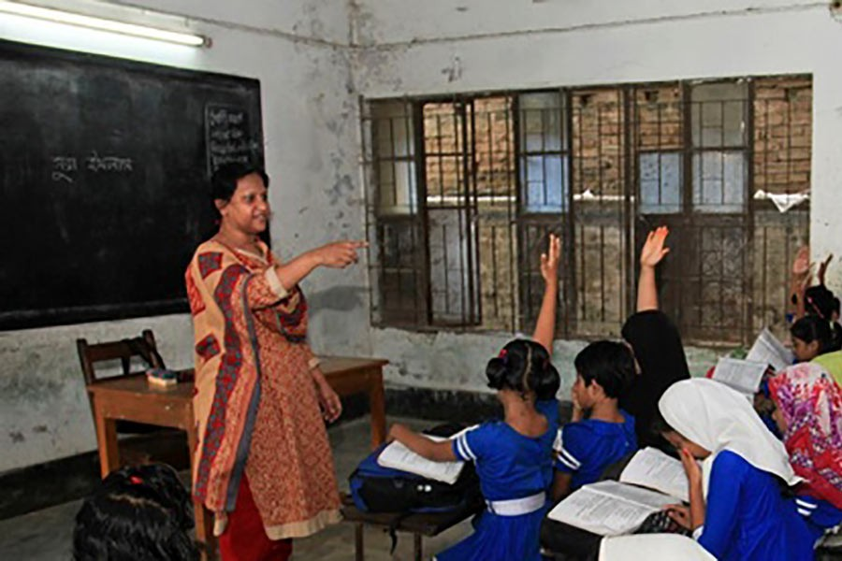
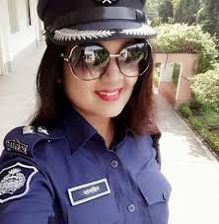

Let`s see some pictures.
What do you see in this pictures?

Slide 7
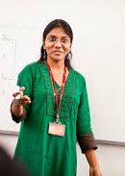

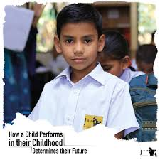
Ask the students
How many members of your family?
2. Who does what?
The name of our lesson is
I have 6 family members.
My father is a teacher.
The work we earn for a living is called a occupation.

Slide 8
Open your book page no 78

Slide 9
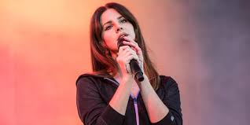
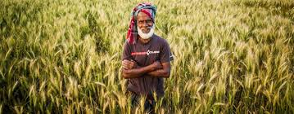
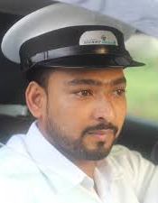

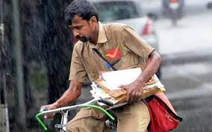
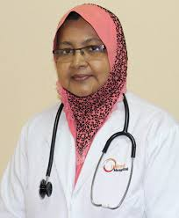
Look and say
singer
farmer
driver
photographer
postman
doctor

Slide 10
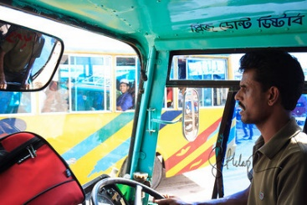


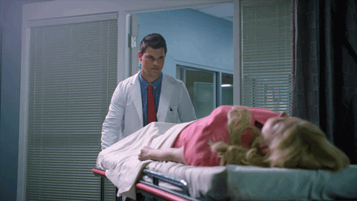
A singer sings song.
A postman brings letters to people.
A farmer grows food.
A photographer takes photos.
A driver drives a car or bus.
A doctor helps sick people.

Slide 11
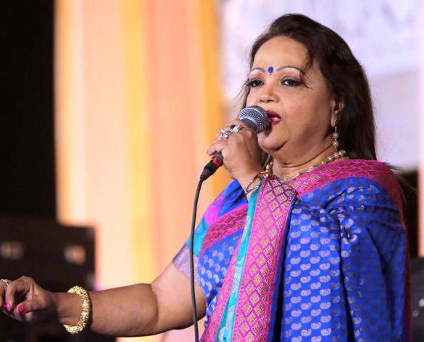
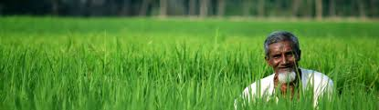


Look and match
farmer
photographer
singer
driver
doctor
postman

Slide 12

Pair work
Point to a picture in Activity A.
Say the name of the occupation.

Slide 13
Chain drill
What do you want to be when you will grow up?

Slide 14
Group work
Answer the questions
1 Who grows food?
2 Who helps sick people?
3 Who brings letters to people?
Group- A
1 Who takes photos?
2 Who drives a car or bus?
3 Who sings song?
Group- B

Slide 15


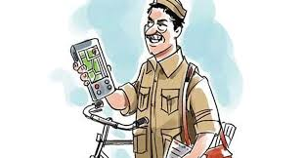
Look and match.
Write the correct word.
postman
singer
photographer

Slide 16
Answer the questions.
Who is farmer?
Farmer grows food.
Who is doctor?
Doctor helps sick people.
Who is postman?
Postman brings letters to people.
Who is photographer?
Photographer takes photo.
Who is driver?
Driver drives a car or bus.
Who is singer?
Singer sings song.

Slide 17

^{Feedback}
I’ll involve the advanced students to help the weaker students to understand better. If need I will help them.

Slide 18
Home work
Write three sentences about a occupation.

Slide 19
Thank you everyone!
Good bye

