Slide 2
MD. KOWSER ALI
ASISSTANT TEACHER
DURLOVPUR GOVT. PRIMARY SCHOOL
HORINAKUNDU, JHENIDAH.
kowser.gps@gmail.com
Sub: English
Class: Two
Lesson : Shapes and Colors
Parts of the lesson: Activity-C
Page No-43

Slide 3
Safety environment by greetings song.
Hello! Hello! How are you?
I’m well, I’m good.
I’m great, I’m wonderful.
Hello! Hello! How are you?
I’m fine! I’m great today.

Slide 4
Checking homework and justify the previous lesson.

Slide 5
Our today’s lesson is too--
Shapes and colors
Activity-C

Slide 6
LEARNING OUTCOMES
By end of the lesson students will be able to-------
Speaking: 1.1.2 say simple words and phrases with proper sounds and stress.
Reading: 1.4.1 read words and phrases with the help of visual clues and simple
sentences. ( about 30 new words)

Slide 7
Listen and say.
What shape have three sides?
What shapes have four sides?
What shape is round?
What shapes have straight sides?

Slide 8
Open your English book at page-43 and see the Activity-C.
SGW
Exchange your books and check the text of other group.

Slide 9
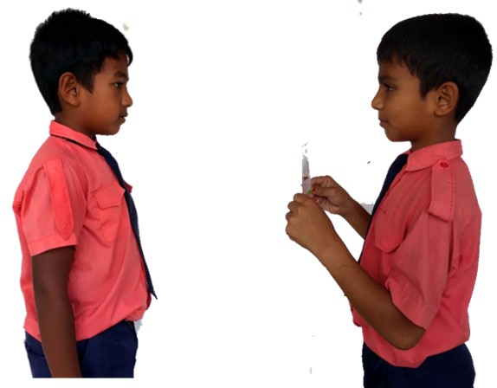
Pair work.
What shape have------sides?
One more

Slide 10
Read and say.
a blue circle.
an orange triangle.
a green square.
a yellow rectangle.
Identifying weak students and taking to cure.

Slide 11
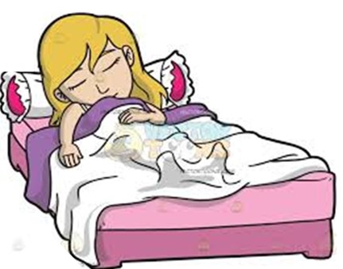
One day one word
Do you understand the picture?
sleep
ঘুমানো
Spell out the word - SGW

Slide 12
Find out the letters that are made by the word--------.
s
n
l
e
a
v
e
b
p
d
Find out the correct word-------.
sleep
seelp
sleap
slepe

Slide 13
Say the missing letter.
sle-p
s-eep
slee-
sl-ep
Write the word to your notebook.
তারিখঃ ০০/০০/০০
sleep
স্লিপ
ঘুমানো

Slide 14
Homework
Page 42 will be well read and written.

Slide 15
That’s all for today. Goodbye. See you tomorrow.

