Slide 1
WELCOME

Slide 2
Introducing
Name: Md. RAFIQUL ISLAM
Designation: Assistant teacher
Nukali Multilateral High School.
Shahzadpur - Sirajgonj.
Mobile no-01723211368
E-mail-itparkcomputer15@gmail.com

Slide 3
Lesson introducing
Class: VIII
Subject: English (First paper).
Unite: Two
Time: 40 minutes
Date:

Slide 4
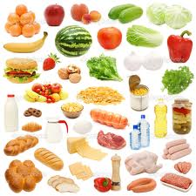
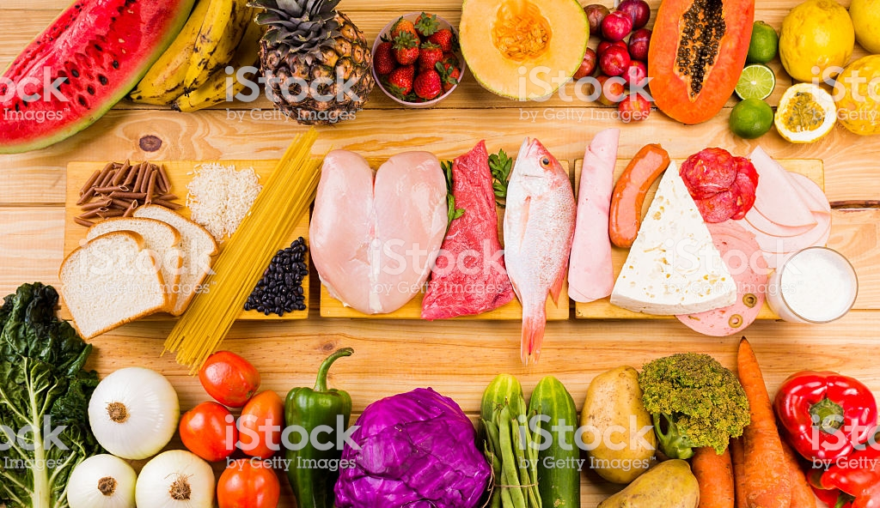
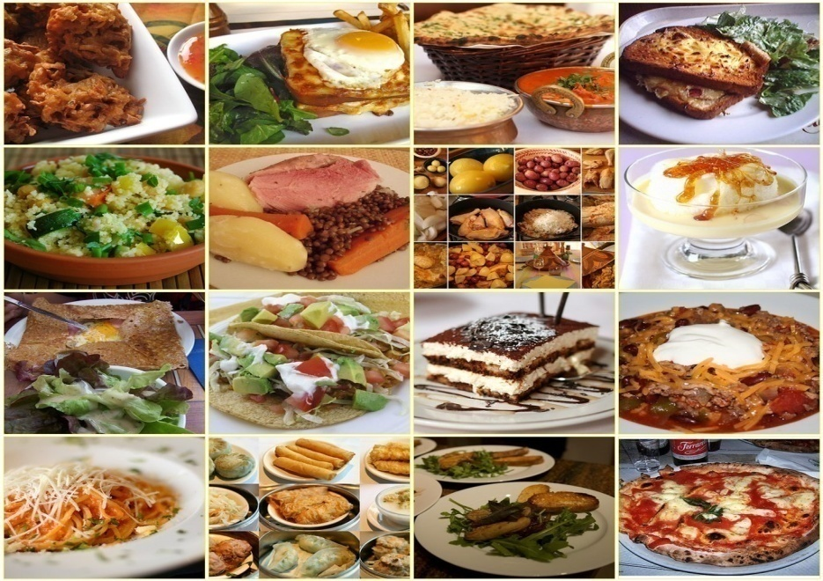
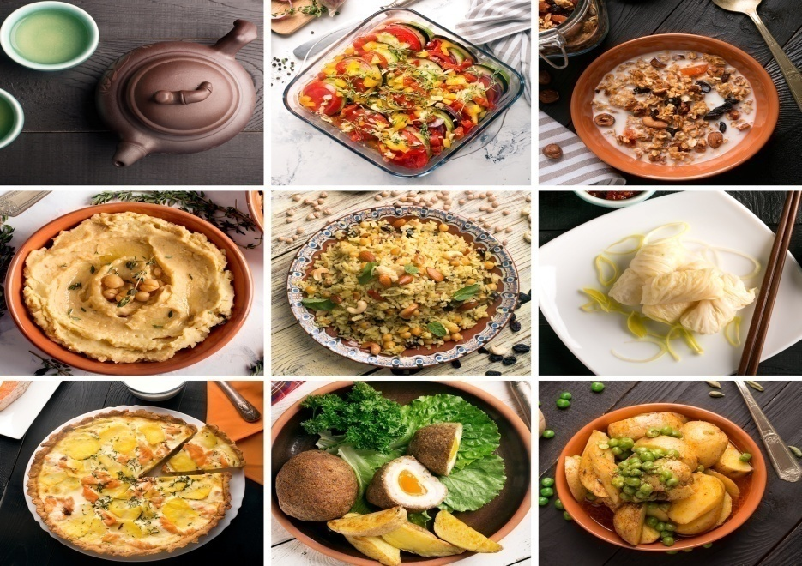

Slide 5
Lesson introducing
Food and Nutrition
1) Good food.
2) Kinds of food.

Slide 6
Key words
Nutritious,Substances,Physical structure,
Carbohydrate,Protein,Vitamins,Minarals.

Slide 7
LEARNING OUTCOME :
After completing the lesson
students will able to
1) Read and understand Text.
2) Practice with sound.
3) Know the name of verities
kinds of foods.

Slide 8
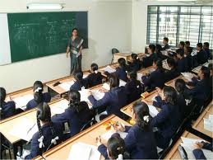
1)Good food
2)Kinds of food

Slide 9
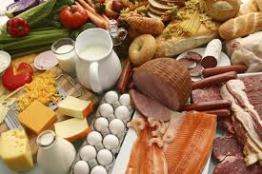
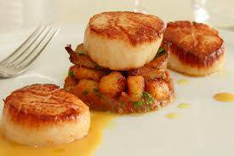
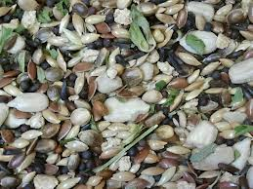
All Kinds Of Food
Carbohydrate
Protin
Vitamin

Slide 10
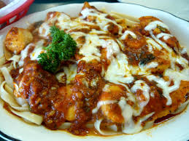
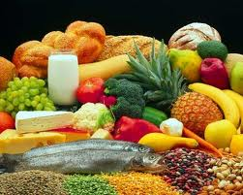
Fat
Minerals

Slide 11
Individual work
1) How many kinds of food?
2) Write down the name
of foods.
3) Write down which food has
most carbohydrate?

Slide 12
Evaluation
1)What do we eat food?
2)What is Ms Rehana taking about?
3)What is mean by nutritious food?
4)Does everybody need the same
amount of food? Why?

Slide 13
Home work
1)Draw the picture which foods have so much vitamin?
2)Draw the picture which foods have a lot of carbohydrate?

Slide 14
THANK YOU

