Slide 1
Welcome to my class

Slide 2
Teacher’s Introduction
Cell:01630351218
Tangina Akther
Dolahazara Islamia Arabia Dakhil Madrasa
Assistant Teacher(English)

Slide 3
Class: Six
Subject: English
Time: 40

Slide 4
Look at the pictures
Animal
Snake
Giraffe
Tiger
Zebra

Slide 5
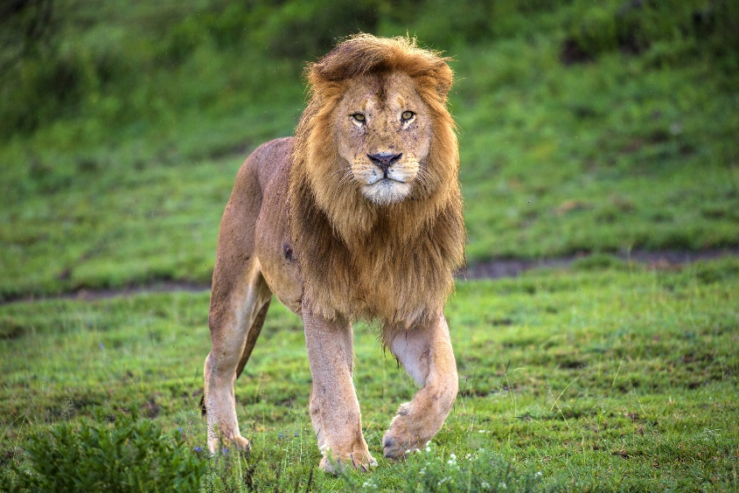
Look at the picture
Lion: Mane
Do you know the animal? What is it’s name and identifying mark?

Slide 6
Today’s Lesson
The Lion’s Mane
Lesson:23

Slide 7
Learning outcomes
Students can -
Know the activities of lion
Know new word’s meaning
Ask and answer question

Slide 8
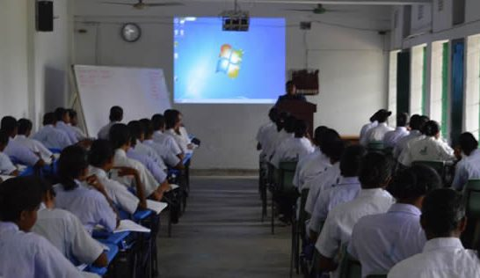
Silent Reading(go to page no.65)

Slide 9
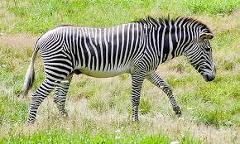
Zebra’s Suggestion
“Flap it up. That will suit you?” the Zebra said.

Slide 10
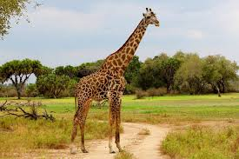
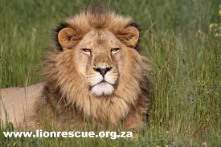
Giraffe’s suggestion
“Yes, it will even look better with a bit of color to match your moustache, “ the Giraffe added.

Slide 11
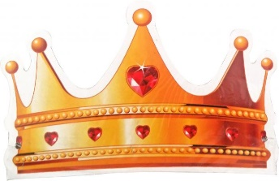
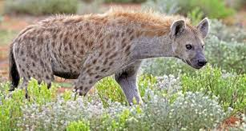
Hyena’s suggestion
“I know a paper crown is what you need!” cried Hyena.

Slide 12
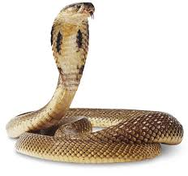
Snake’s Remark
“If a king is a wise king, nobody cares about his hair style.”

Slide 13
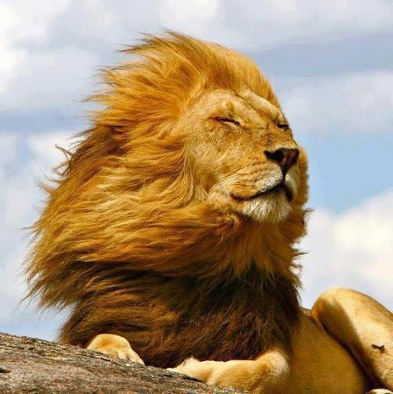
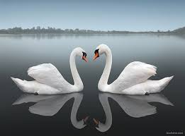
Key Words:
Long hair on the neck of a lion.
Mane
Reflection
Mirror image.
Raise
Lift or move upwards.
Crown
A cap of a king or a queen.

Slide 14
Group Work
A. What did the lion see into the river?
B. Where was the lion sitting?

Slide 15
Evaluation
Fill in the gaps:
Once there(a) …….a lion. He(b)………to change his hair(c))……….So, the animals of the(d) …… Suggested him in different (e)……
Answer:
(a) was
(b) wanted
(c) style
(d) jungle
(e) way

Slide 16
Home Work
What is the moral of the story?

