Slide 1
Welcome to my class

Slide 2
Introduction
Ramendra Nath Pramanik
Assistant Head Master
Kasba High School
Paba, Rajshahi
Mobile: 01716437772
E-mail: ramenpr81@gmail.com
Sub: English grammar and composition
Class: Nine
Unit: 8
Time: 50 Min
Date: 07/11/2019

Slide 3
Lets watch a video

Slide 4
The video is about …………
Preposition

Slide 5
Today’s topic:
Using the preposition of movement

Slide 6
Learning outcome
By the end of this lesson SS will be able to –
tell the name of Preposition.
do the proper use of preposition.
explain about something.
write a paragraph

Slide 7
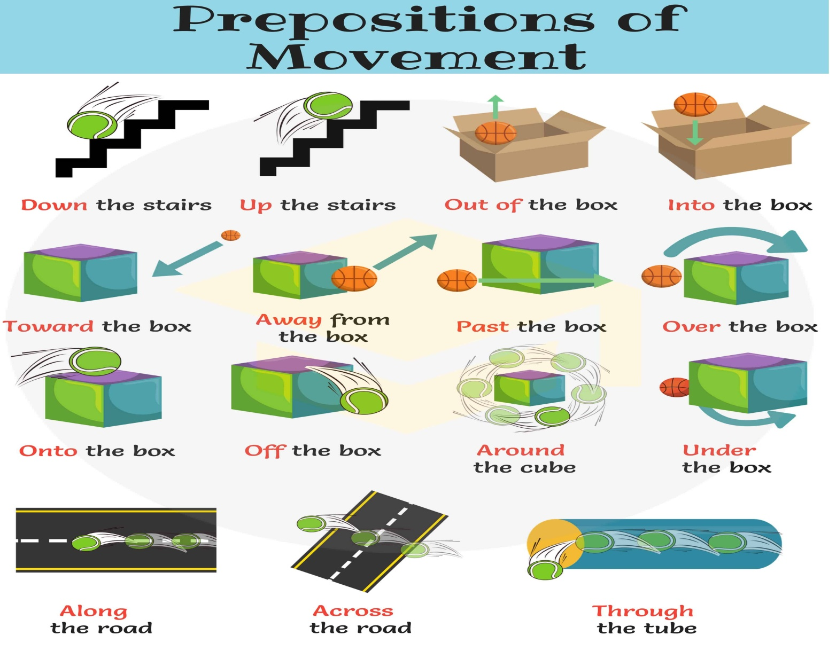
Look at the picture below:

Slide 8
Individual work
5 min
Fill in the gaps with appropriate prepositions:
Mr. Ratul gets (..a..) from sleep at 6 am. Then he enters (..b..) the bathroom. After bath he wears dress and comes(..c..) to ground floor for breakfast. Then he goes (..d..) of the home. At first he (..e..) the road and gets on the bus.

Slide 9
10 min
Group work
Write a short paragraph about your class room using the following prepositions:
into, out of, beside, at, onto, of, from etc.

Slide 10
5 min
Evaluation
Answer the questions orally-
1. What is preposition?
2. Make a sentence using “across”.
3. Where do we use “into”?
4. Kamal comes …..of the room and gets….a rickshaw.

Slide 11
Home task
Write a paragraph about your school.

Slide 12
Thank you.

