Slide 1
Welcome

Slide 2
Teacher’s Introduce
Laily Akter
Assistant Teacher
Fulgaon Govt. Primary School
Laksam, Comilla.

Slide 3
Lesson Introuduce
Class:Five
Subject: English
Unit: 10
Time: 60 minutes

Slide 4
Let’s watch a video.
https://www.youtube.com/watch?v=2tdLqOCxojg
What do you see in the video?
A town.

Slide 5
Lesson Declaration
My Home district.
(My home district is..............Temple of Chandrabati.)

Slide 6
Learning outcomes
Students will be able to:
Listening: 4.2.1 understand and enjoy simple stories.
Speaking: 3.1.1 ask and answer wh questions.
Reading: 5.1.1 read silently with understanding paragraph.
Writing: 10.2.1 write short and simple composition on familiar objects such as people place and events.

Slide 7
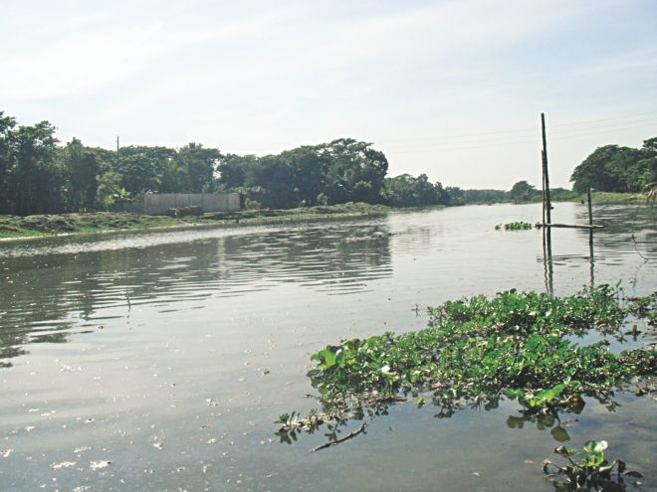
What do you see in the picture?
The river Narasunda.

Slide 8
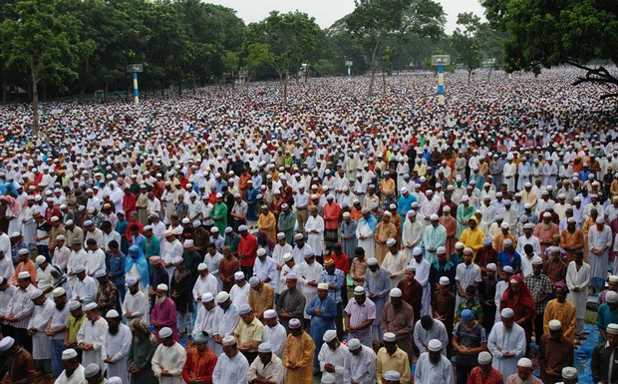
What do you see in the picture?
Solakia Eid Ground.

Slide 9
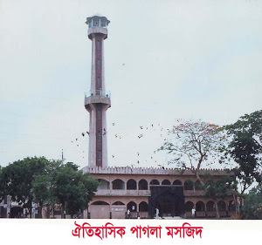
What do you see in the picture?
The Pagla Mosque.

Slide 10
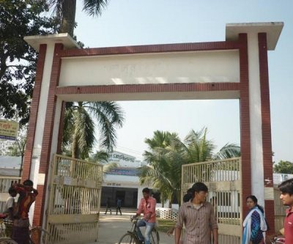
What do you see in the picture?
Govt. Gurudayal College.

Slide 11
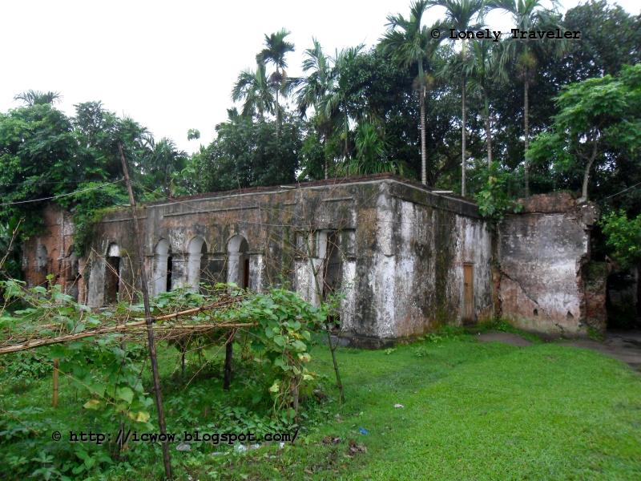
What do you see in the picture?
The fort of Isah Khan at Jangal Bari

Slide 12
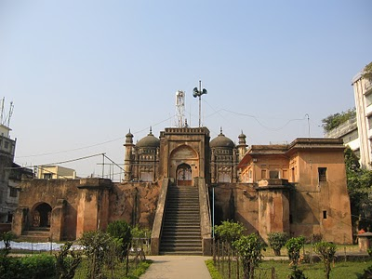
What do you see in the picture?
Shah Muhammad Mosque.

Slide 13
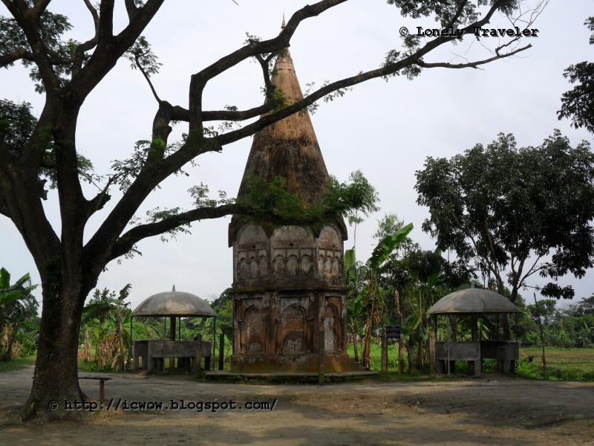
What do you see in the picture?
The Shiva Temple of Chandrabati.

Slide 14
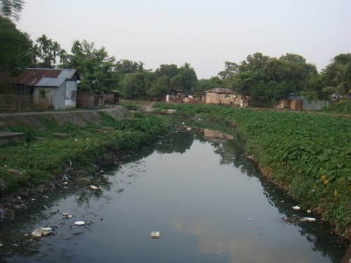
What do you see in the picture?
Fuleshwari River.

Slide 15
Municipality area is 10 square km.
District headquaters
145 km. from Dhaka
1745 villages
Kishoreganj
8 municipalities
108 unions
13
upazilas

Slide 16
Solakia Eid Ground.
Shiva Temple of Chandrabati
Govt. Gurudayal College.
Famous places of Kishoreganj
Isah Khan fort of Jangal Bari.
Shah Muhammad Mosque.
Pagla Mosque.

Slide 17
New words
Headquarters
Center
Landlord
Landowner
Celebrate
Make happy
Well-known
Famous
Fort
Castle/Tower
Temple
Holy place

Slide 18
Now open your English book at page number 48. Listen to me carefully and put your finger under the line.
Read the text silently.

Slide 19
Group work
Narsunda Group
Write 5 sentences about important places of Kishoreganj.
Fuleshwari Group
Write 5 sentences about your home district.

Slide 20
Evaluation
1.How far is Kishoreganj from Dhaka?
2.How was the place named Kishoreganj?
3.What is the area of Kishoreganj town?
4.How many upazilas and villages are there in kishoreganj district?
5.Make a list of two important places in kishoreganj?
6.Write two famous mosque name of Kishoreganj?

Slide 21
Thank you everybody. See you next class.
Goodbye students.

