Slide 2
Welcome everybody

Slide 3
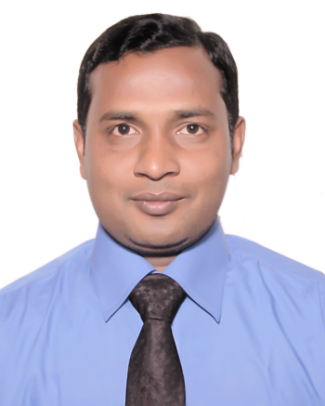
Identity
Teacher identity
Md.Akhtaru jjaman .
Assistant teacher .
Mollapara Govt Primary School .
Bochagonj, Dinajpur.
Lesson Identity
Class :Four .
Sub:English .
Unit:14 .
Lessons:Mita is in…..five o.clock.
Time:4o minutis

Slide 4
Learning Outcome
The students will be able to
4.2.1.Enjoy and understand simple stories. 8.1.1.Take part conversations on simple topics. 5.1.2.Read with understanding.

Slide 5
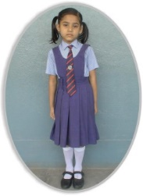
Lets we watch picture

Slide 6
Mita s day

Slide 7
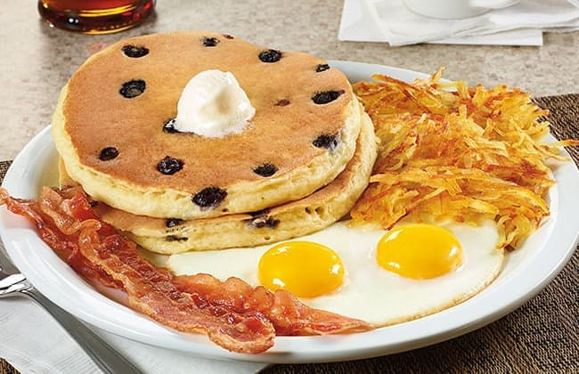
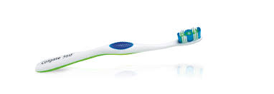
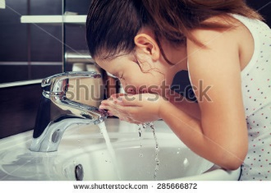
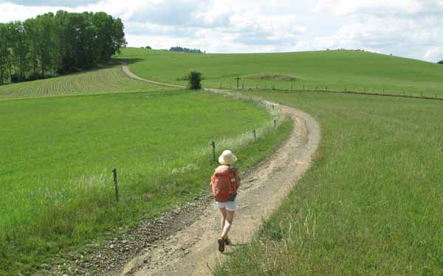
New Words
Breakfast
Morning milk
Brush
Paint brush
Wash
Clean up
step
walk

Slide 8
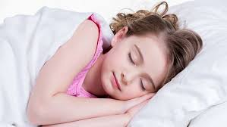
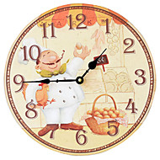
Mita is in Class 4.She gets up at six o.clock.

Slide 9
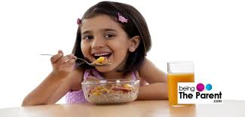
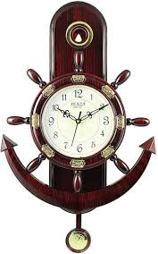
She has breakfast at seven o.clock.

Slide 10
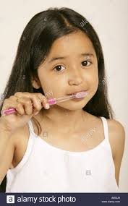
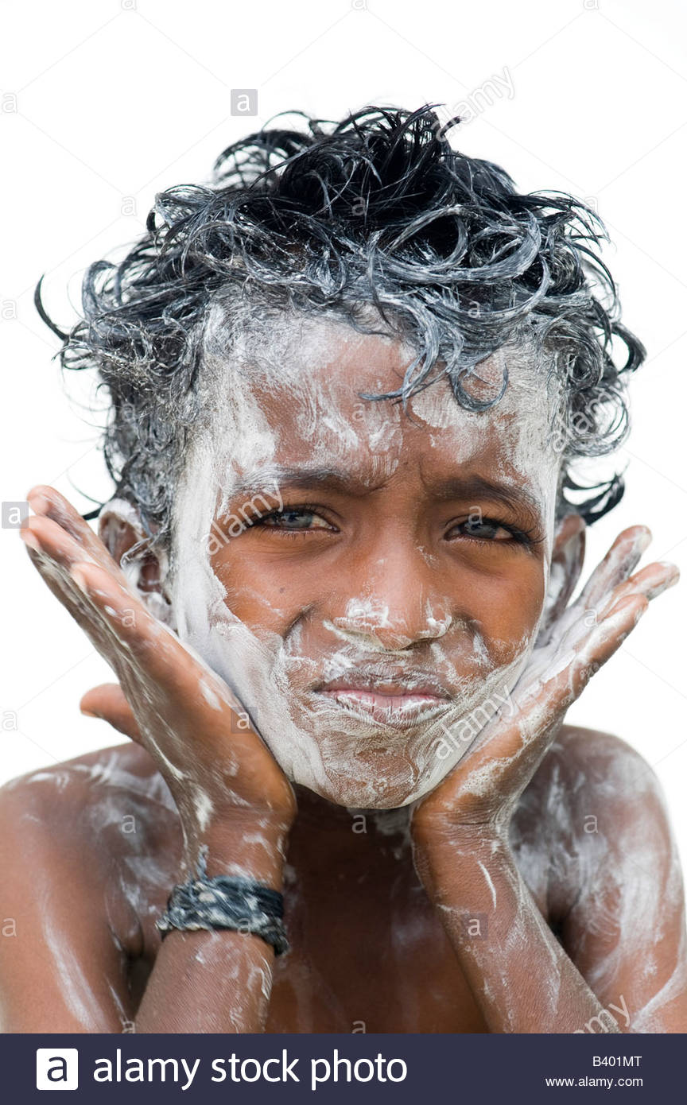
Then,she brushes her teeth and washes her fase.

Slide 11
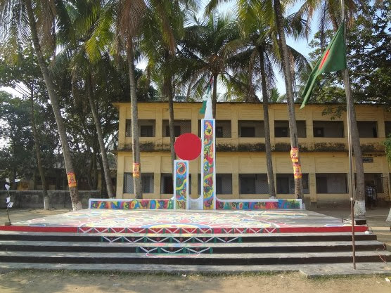
She gose to school at nine o.clock.

Slide 12
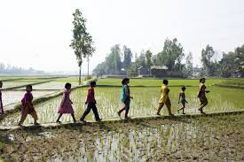
She walks to her school.After school,at three o,clock.

Slide 13
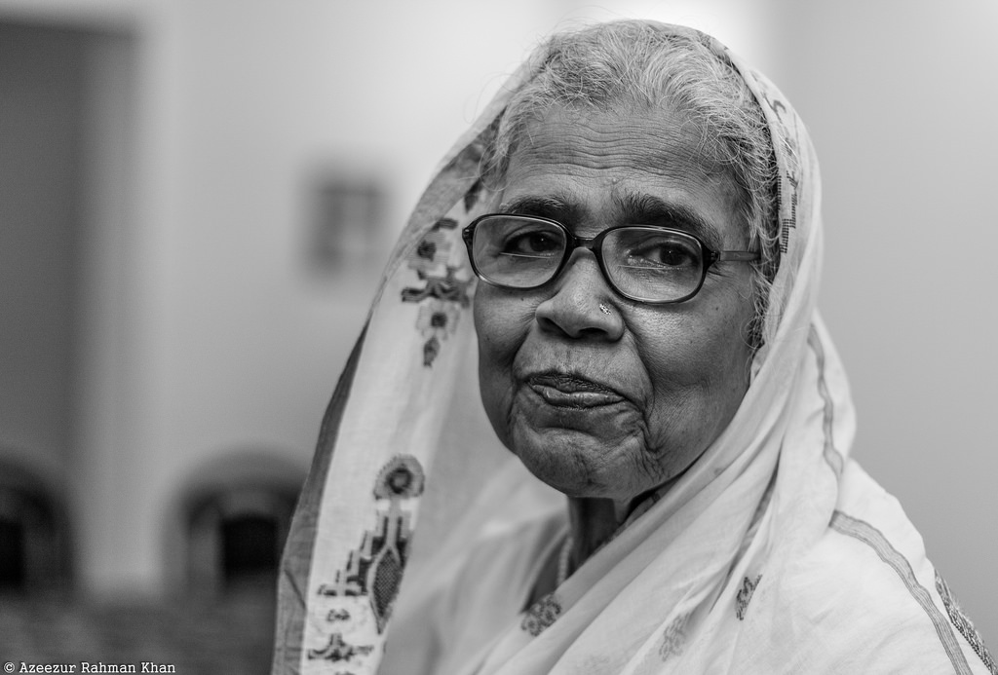
She visits her grandmother.

Slide 14
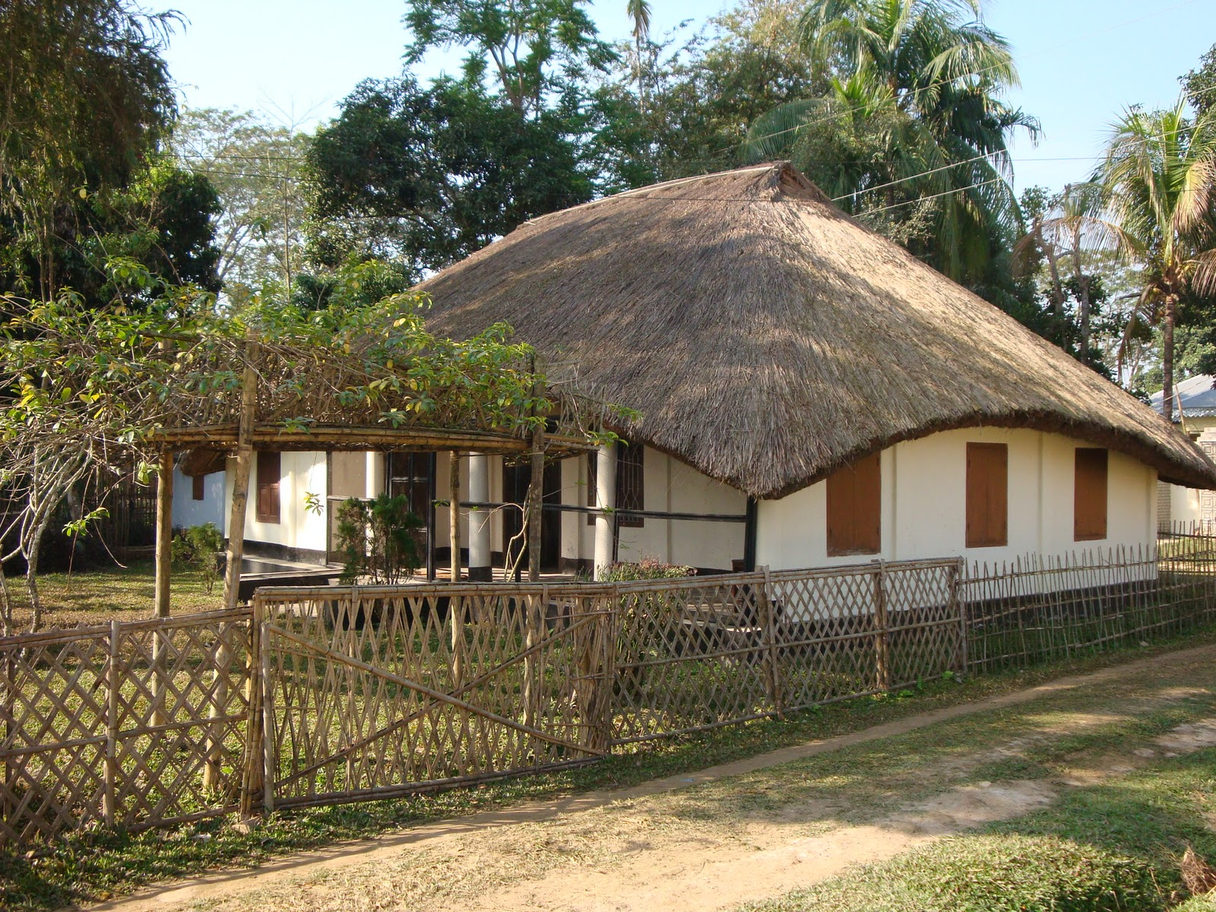
Then,Mita returns home at five o.click.

Slide 15
Dear students please open your book at page-28
Ideal reading

Slide 16
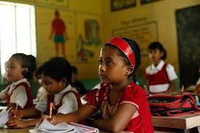
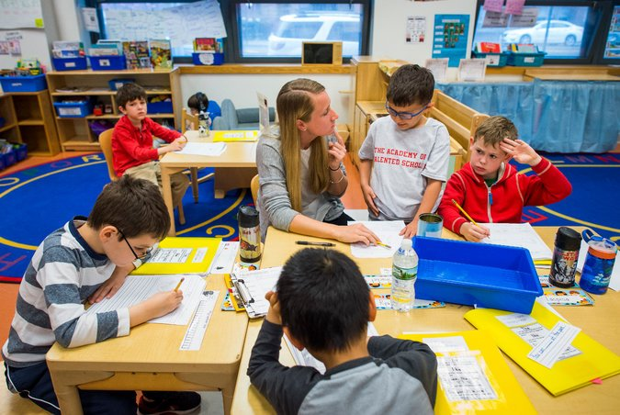
*Four students make a group and read the passage.

Slide 17
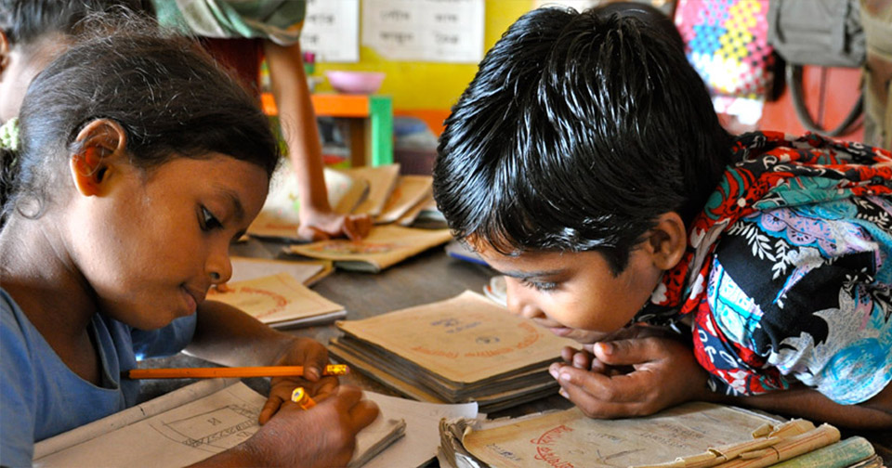
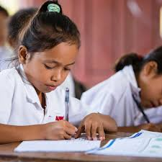
* P.W. Two students make a group and read the passage.

Slide 18
Evaluation
Ask and Answer
1.What time do you get up? 2.When do you have breakfast? 3.what time do you go to school?

Slide 19
Thank you everybody

