Slide 1
Welcome to our English class

Slide 2
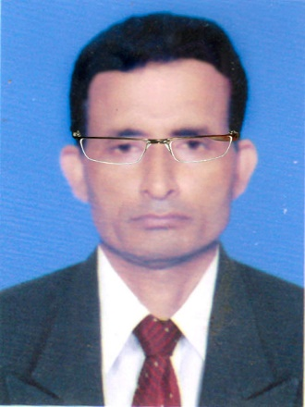
Identity
Manik Chandra Majumder
Senior Teacher (English)
Gazirhat High School
Senbag, Noakhali
Mobile No: 01717155169
Email: manikmajumder01@gmail.com
Class: Eight-Ten
Subject : English 1st paper
Time : 50 Minutes
Date : 00/00/2019

Slide 3
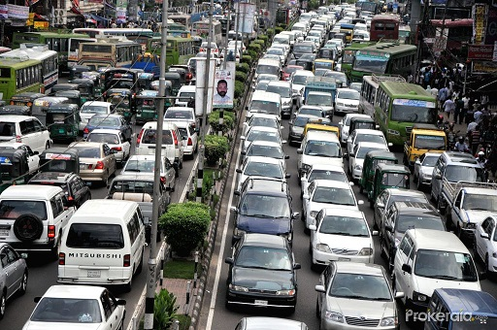
What is the picture about?
About traffic jam

Slide 4
Observe the Video and think about our lesson.
https://www.youtube.com/watch?v=DN7JYFJPSGg
Can you guess about our today’s lesson?

Slide 5
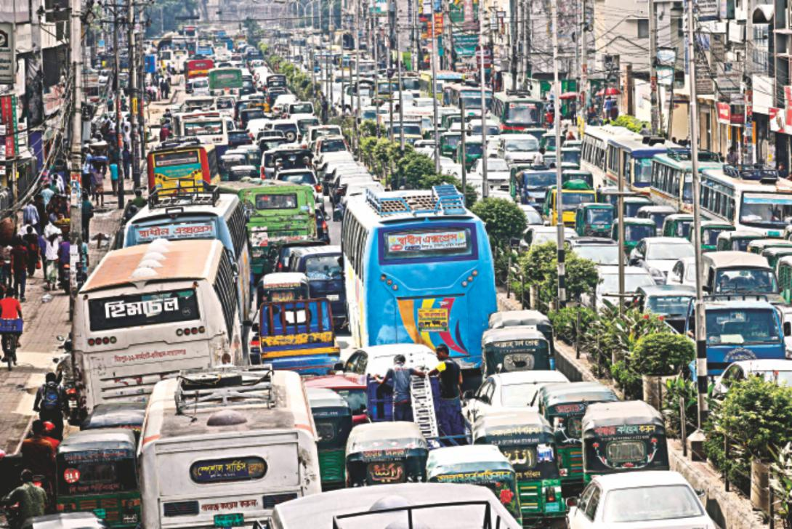
So dear our today’s lesson is…..
Traffic Jam
(Paragraph)

Slide 6
Learning outcomes
After the end of the lesson, Students will be able to…..
ask and answer questions about Traffic Jam,
tell about it’s causes,
narrate about it’s effects,
suggest possible solution,
Write paragraph.

Slide 7
Before writing this paragraph you have to think over the following questions..
a) What is traffic jam?
b) Where does it occur?
c) Who are the worst sufferers of traffic jam?
d) Why does traffc jam occur?
e) Where does it occur frequently?
f) What are the effects of traffic jam?
g) How can we solve the problem?

Slide 8
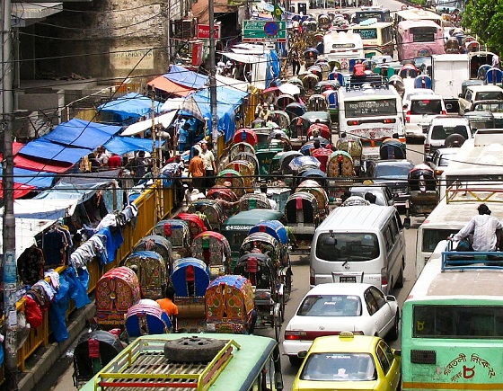
What is traffic jam ?
Traffic jam is a blockade of vehicles on the roads and streets. When a large number of vehicles block on roads and cannot move front or back for time being is called traffic jam.

Slide 9
Where is it a common affair?
It is a common affair in big cities and towns in our country like Dhaka, Chattogram and almost all the district towns.

Slide 10
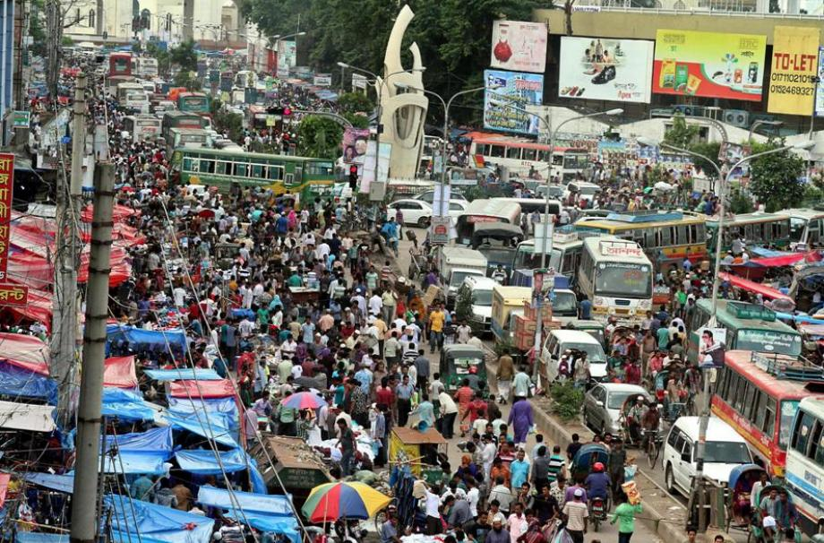
Who are the worst sufferers of traffic jam?
All classes of people have to suffer this problem. Specially the city dwellers have to suffer it much.

Slide 11
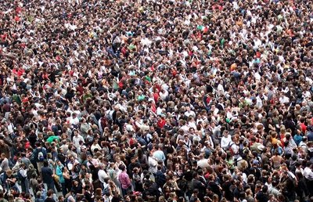
What are the causes of traffic jam?/ Why does it occur?
There are many causes for traffic jam.
Density of population……..

Slide 12
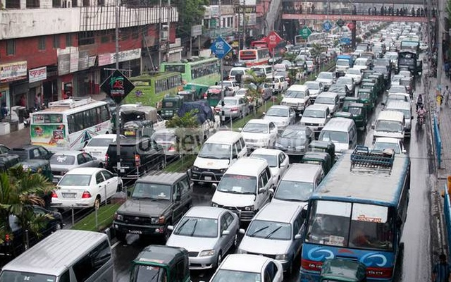
Enormous increase of vehicles……….

Slide 13
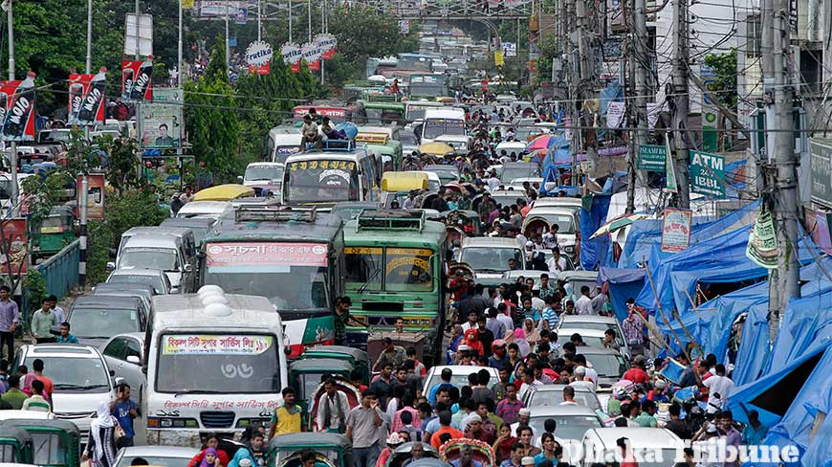
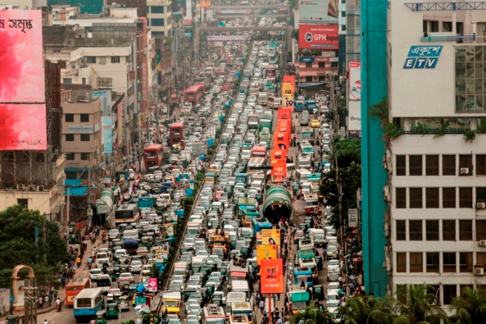
Insufficient roads and streets
Narrow roads and streets,

Slide 14
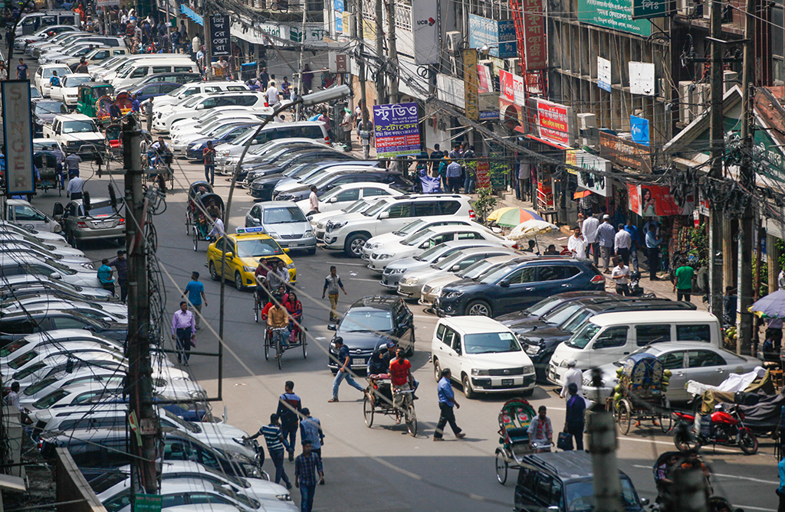
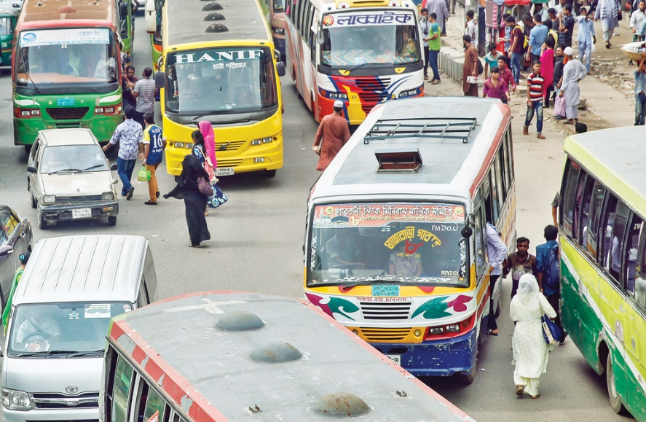
Illegal perking…..
Over taking tendency of drivers…

Slide 15
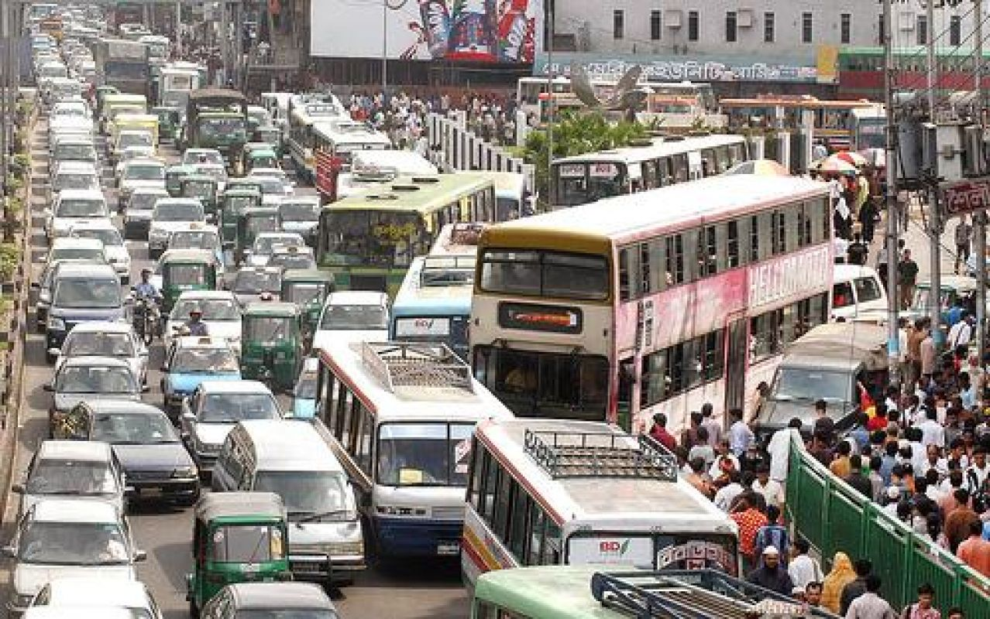
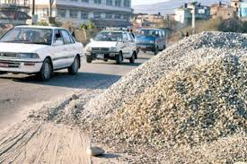
Whim of drivers…..
Keeping construction materials on roads

Slide 16
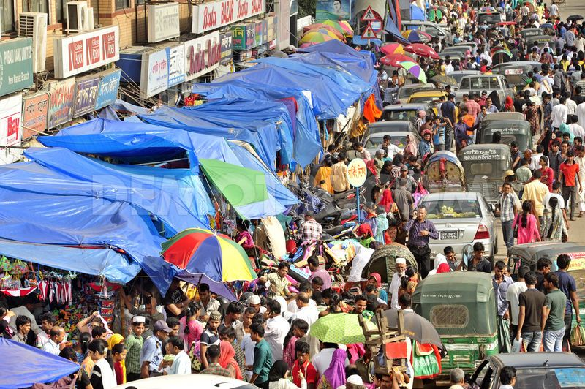
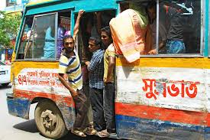
Occupying footpath…
Invalid and unlicensed vehicles

Slide 17
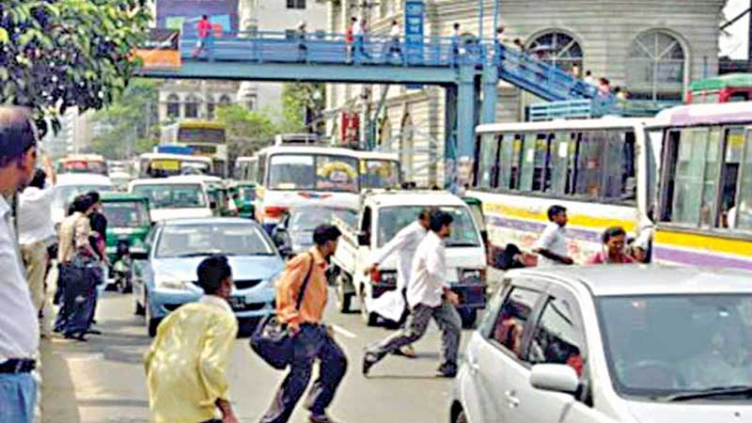
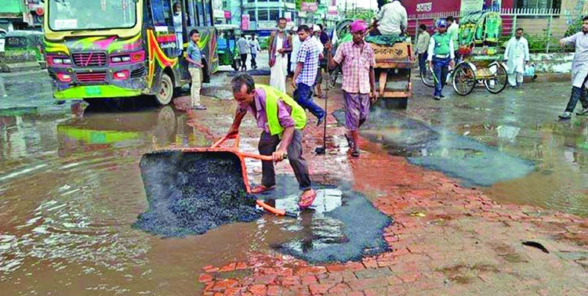
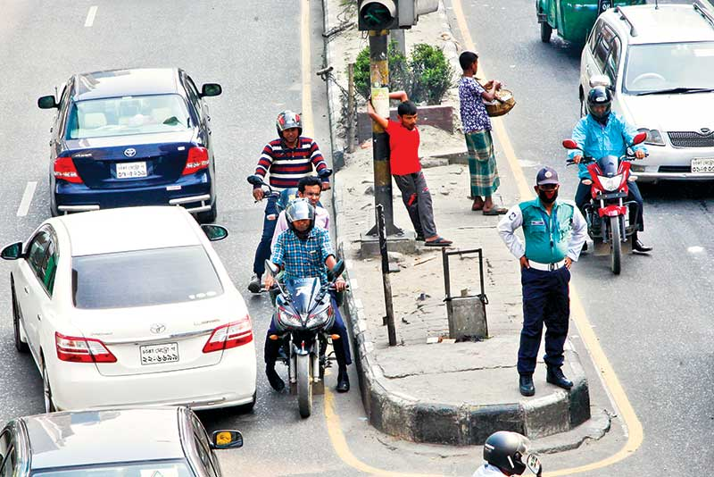
Disobeying traffic rules
Poor and unplanned road construction
Old traffic control system and insufficient traffic police

Slide 18
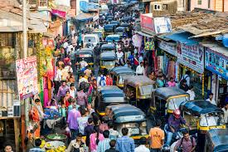
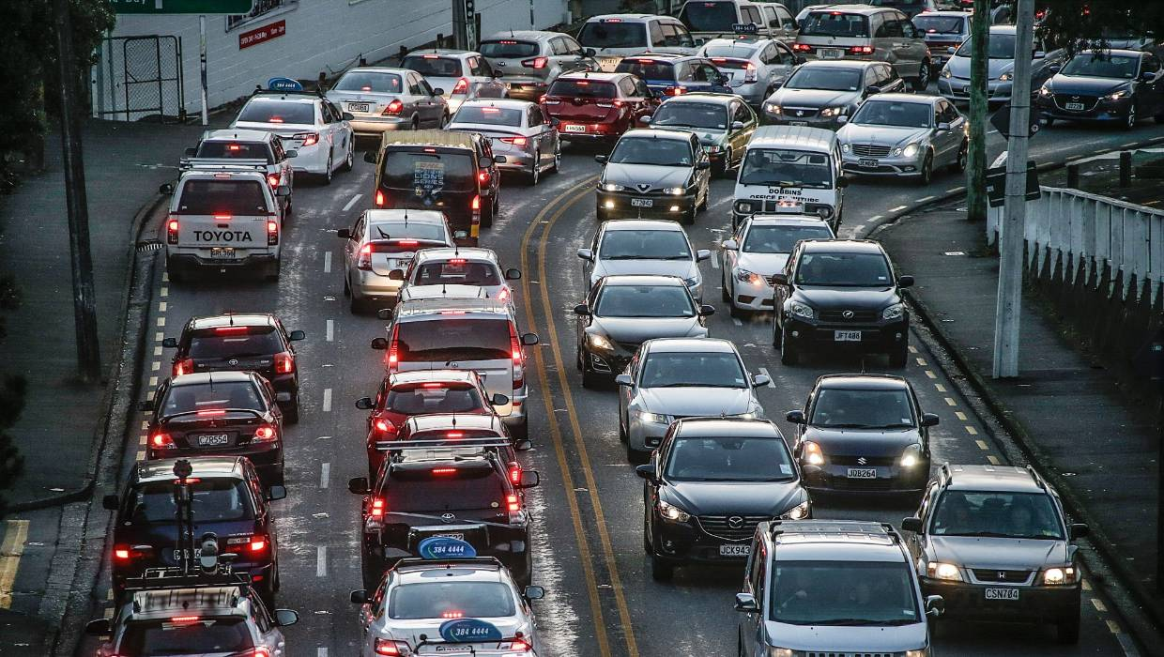
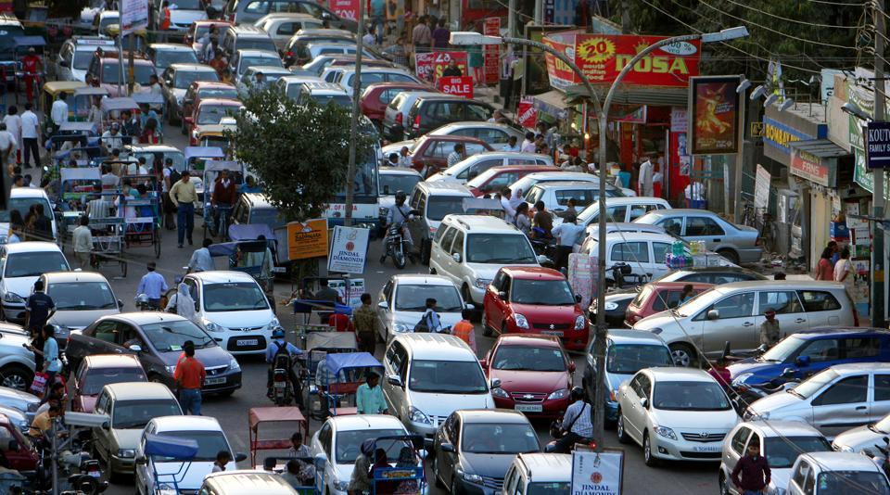
Where does it occur frequently?
It frequently occurs in…..
market place
turning of road
busiest point of road

Slide 19
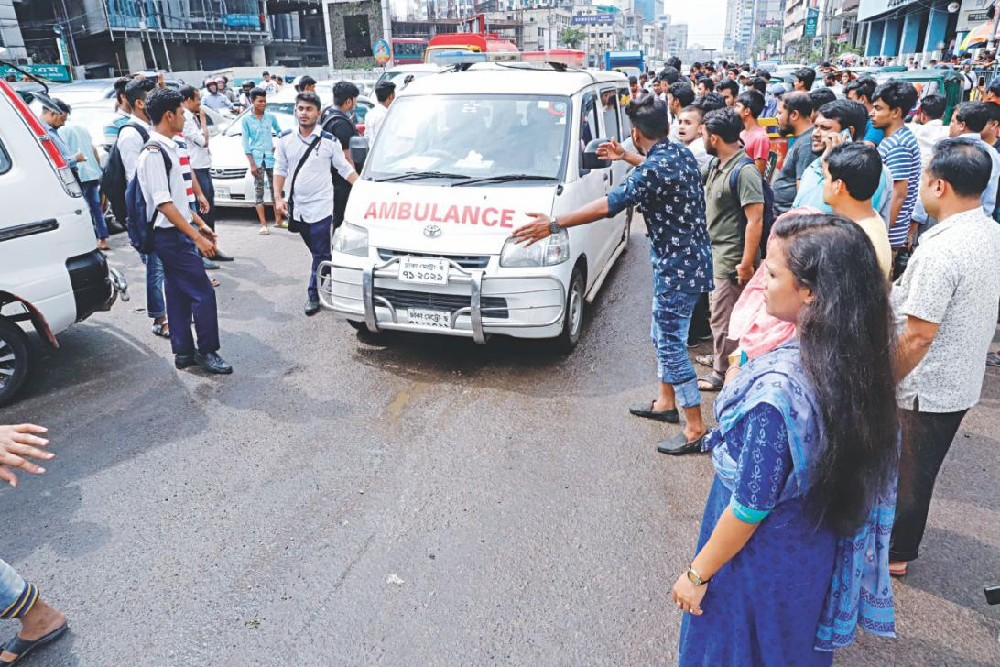
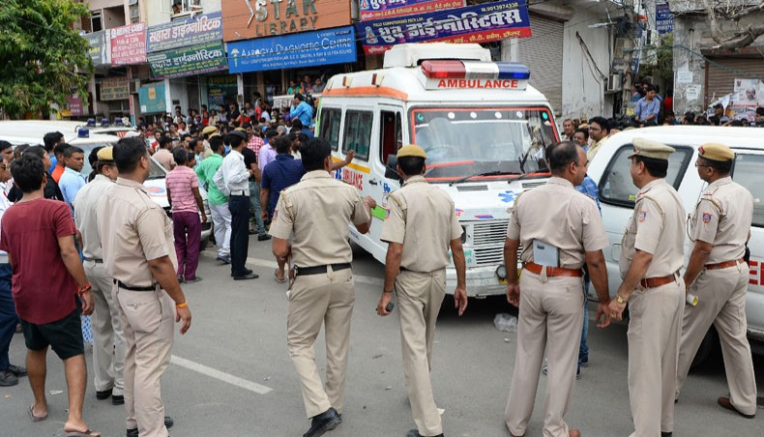
What are the effects of traffic jam ?
It causes untold sufferings to the people . Office goers cannot go to offices. Students cannot go to schools or colleges. It causes great sufferings to the…..
Office goers
school college going students
Ambulance carrying dying patients.
In a word, It kills our valuable time and hampers our works.

Slide 20
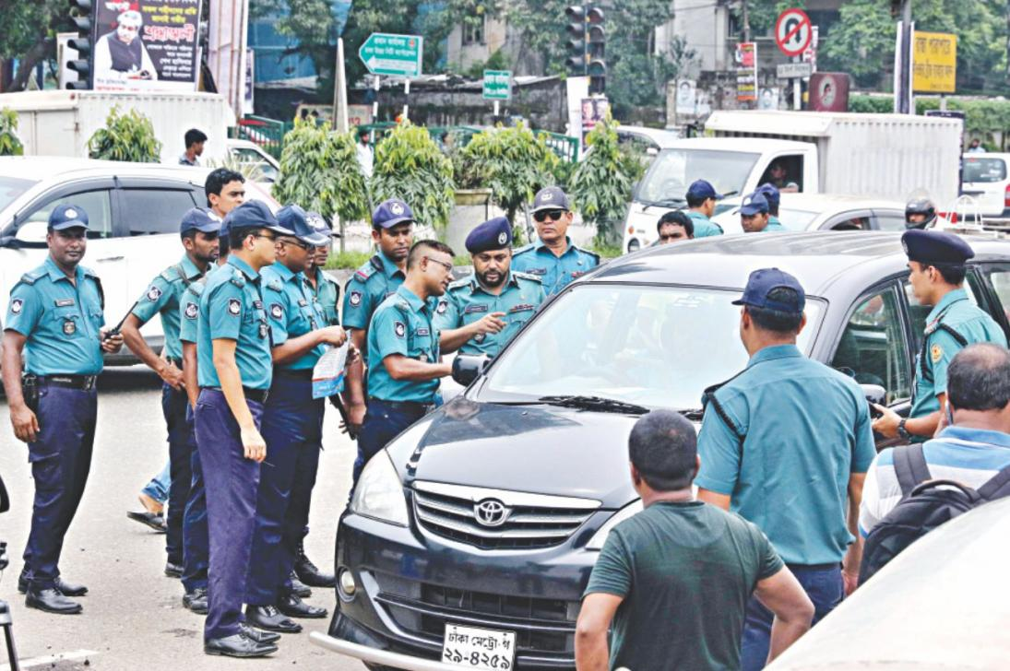
How can we solve these problems?
In order to solve these problems our government should take necessary steps.
The number of traffic police should be increased and more traffic police should be engaged in the busiest point of the road..

Slide 21
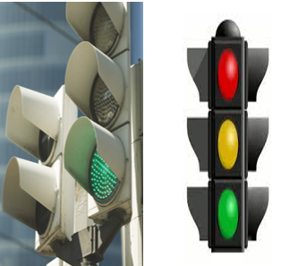
Our traffic controlled system should be modernized..
Specious and two ways road should be constructed..

Slide 22
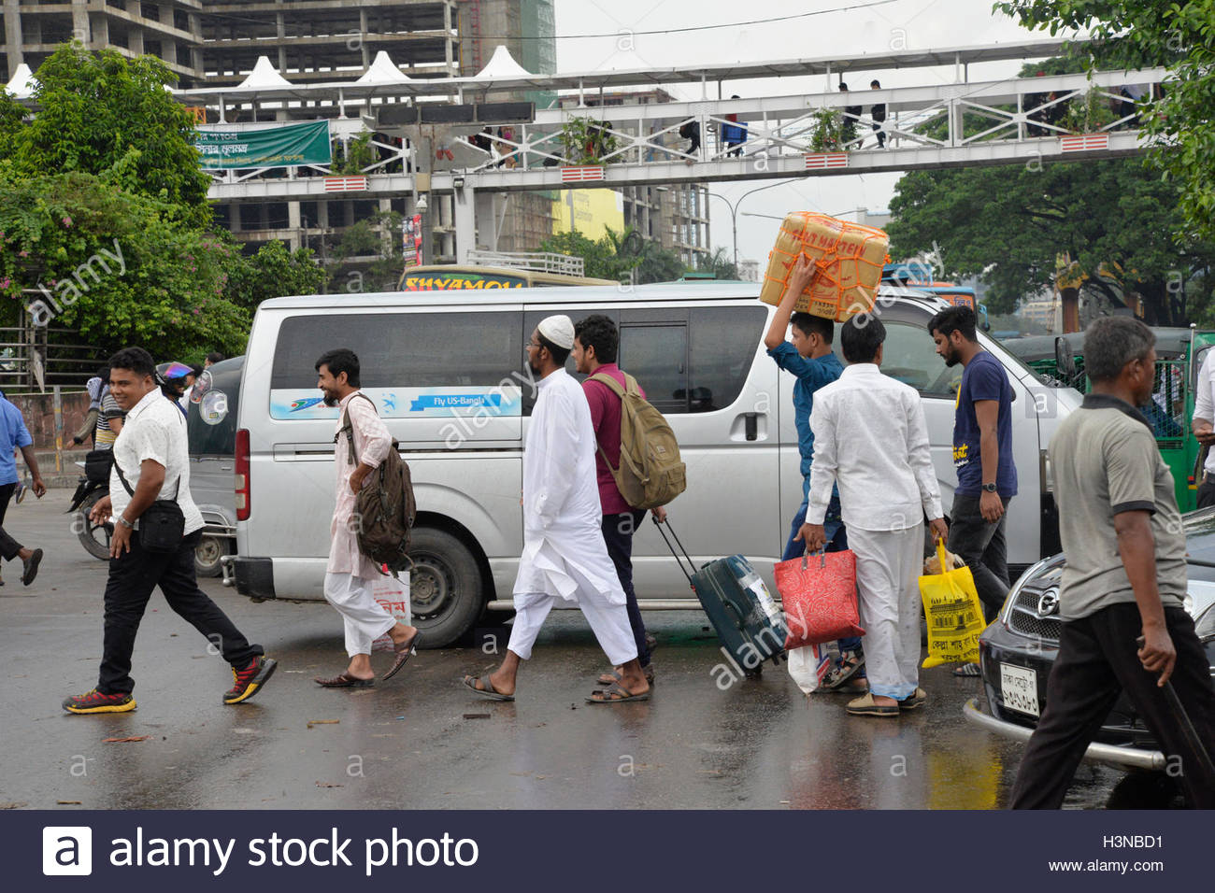
In this regard public awareness is very necessary..

Slide 23
Individual work (Oral Test)
a) How can you define traffic jam?
b) Where is it seen frequently?
c) Who are the worst sufferers of traffic jam?

Slide 24
Group work
Group-Padma
Group-Meghna
Group-Jhmuna
Suggest about the solution of traffic Jam.
Find out the causes of traffic Jam.
Find out the effects of traffic Jam.

Slide 25
Evaluation
Answer the following questions in short.
a) What is a traffic jam?
b) Where and why is it caused?
c) What are the problems of a traffic jam?
d) What should we do to get rid of traffic jam?

Slide 26
Home work
Write a paragraph on ‘Traffic Jam’.

Slide 27
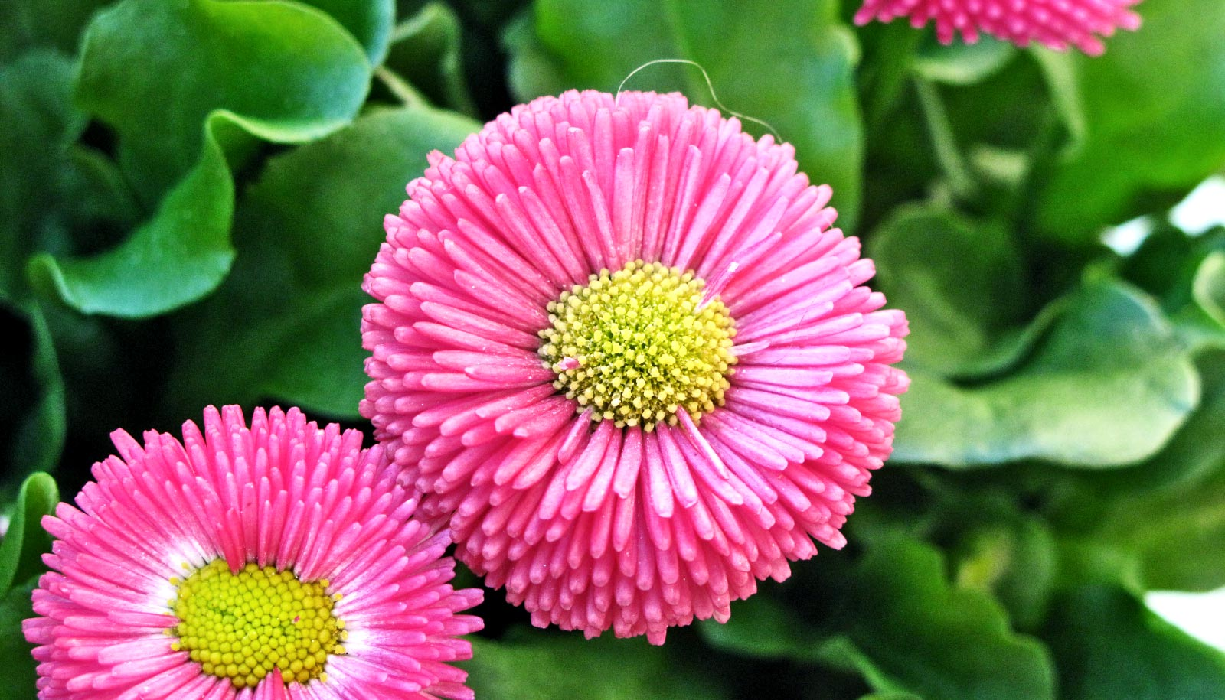
Good Bye

