Slide 1
welcome

Slide 2
TEACHER’S INTRODUCTION
Md.Soriful Islam
Assistant teacher
Chowrapara Fazil Madrasha
Niamotpur, Naogaon.
soriful03@gmail.com

Slide 3
LESSON INTRODUCTION
Class : Six
Subject : English 2nd paper
Time : 45 min.
Date : 10/11/19

Slide 4
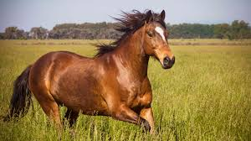
Look at the picture
Horse runs fast.
He reads a book.
What are these?

Slide 5
Our today’s topic
Sentence

Slide 6
Learning outcome
Students will be able to
1. definition of Sentence.
2. classification of Sentence.
3. make the sentence.

Slide 7
Look at the picture
I have a pen . Do not run in the sun .
May Allah bless you .He is poor ,but honest.
Alas! I’m undown
Those are sentences
Do you know what is sentence?
A sentence is a word or group of words that must expresses a complete idea
Or sense or meaning and that may consists of a subject and a verb.

Slide 8
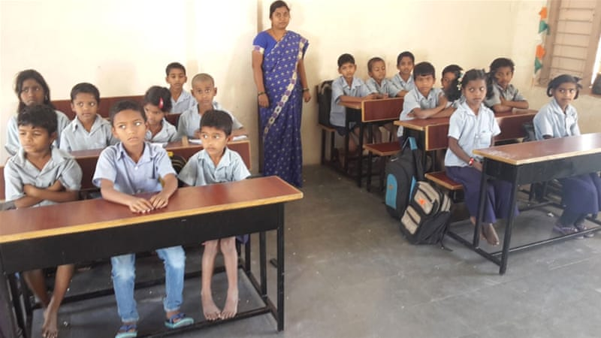
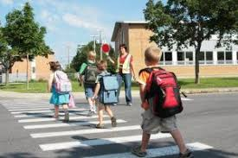
Look at the picture
Monira teaches the student.
There are going to school
Those are Assertive sentence
What is assertive sentence?
An assertive sentence is a simple/general statement or assertion, either affirmative or negative.

Slide 9
Look at the picture
Where do you live?
Do you take it?
Those are Interrogative sentence
What is interrogative sentence?
An interrogative sentence asks question about a person or thing(s).
It always ends with a note of interrogation a.k.a. question mark (?).

Slide 10
Look at the picture
Go out.
Take it.
Those are Imperative sentence
What is imperative sentence?
A sentence that expresses a request, command, order,
advice, suggestion, etc. is an imperative sentence.

Slide 11
Look at the picture
May Allah bless us .
Wish you all the best
Those are optative sentence
What is optative sentence?
The sentence which expresses a prayer, keen wish, curse etc.
Is called an optative sentence.

Slide 12
Look at the picture
Hurrah! Our cricket team has won the series.
Alas! He has failed the competition.
Those exclamatory sentence
What is exclamatory sentence?
Exclamatory is a sentence which expresses strong/sudden
feeling or emotion like surprise, pain, delight, anger, disgust, etc

Slide 13
Individual work
What is sentence?
A sentence is a word or group of words that must expresses a complete idea
or sense or meaning and That may consists of a subject and a verb.

Slide 14
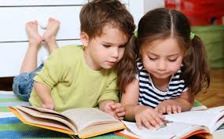
Pair work
How meny kind of sentence? Give example.
Ans; Five kind of sentence.
Assertive sentence, Interrogative sentence, Imperative sentence, optative sentence, exclamatory sentence.

Slide 15
Group work:
Questions: Identify the sentences
I have a pen .
Do not run in the sun .
May Allah bless you .
He is poor ,but honest.
Alas! I’m undown
Asertive sentence
Interrogative sentence
Imperative sentence
optative sentence
Exclamatory sentence

Slide 16
Home Work
Write a paragraph within 15th sentences

Slide 17
Thanks to all

