Slide 1
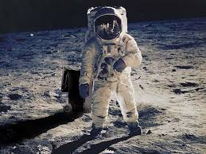
Welcome to Multimedia Class

Slide 2
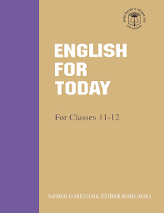
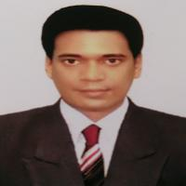
Identity
English 1st Paper
Class : 11-12
Unit : 1
Lesson : 3
Time : 50min
Mir Mamunur Rahman
Teacher
Govt. Shahid M. Monsur Ali Degree College
Altafnagar, Dupchanchia,Bogura

Slide 3
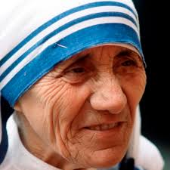
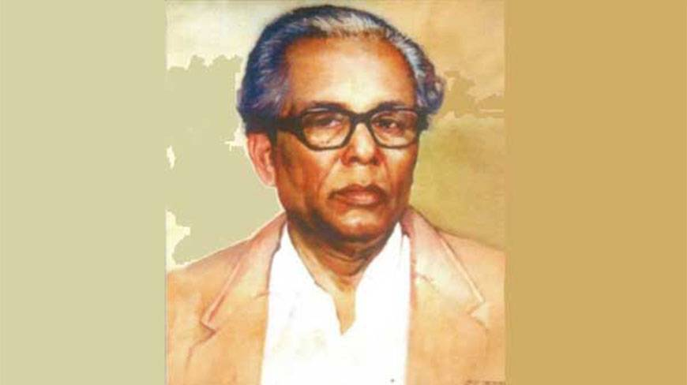
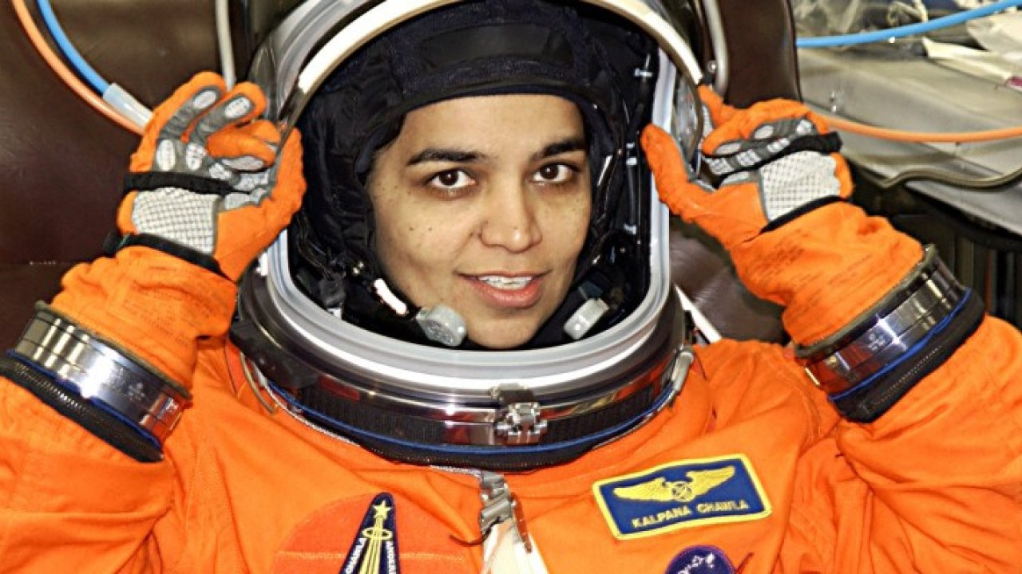
Look at the following pictures
Mother Teresa
Zainul Abedin
Kalpana Chawla
Why are they famous for ?
Who is an astronaut out of them ?

Slide 4
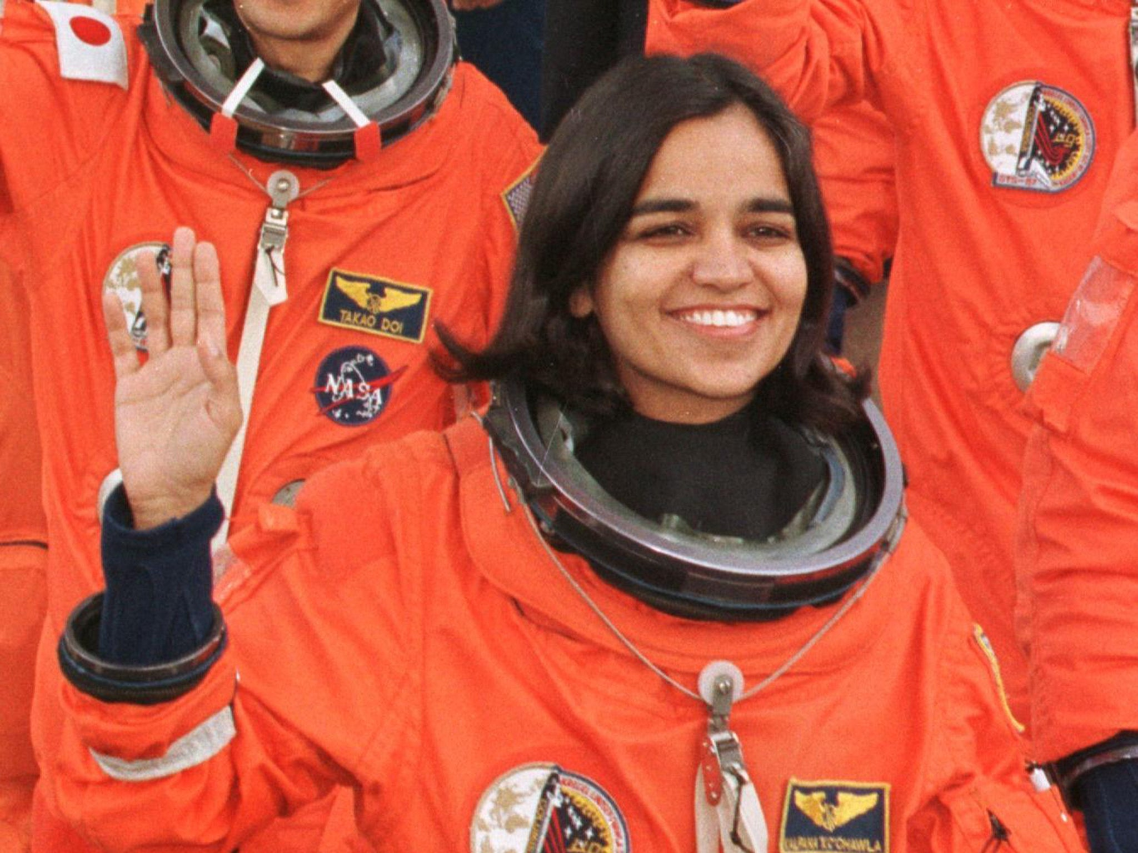
Today our topic is
Two Women
“ Kalpana Chawla”
Unit : 1
Lesson : 3
Page no : 12-13
Time :50 mins.

Slide 5
Learning Outcomes
After we have studied this TEXT , we will be able to
Infer meanings from the context
Answer the questions
Complete the flow-chart
Choose the best answer
Write a paragraph on “The achievement of a famous woman”

Slide 6
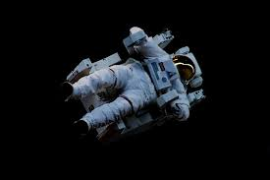
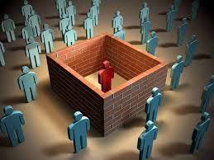
Key Words
Astronaut (N.)
Space person
Disintegrate (V.)
Separate

Slide 7
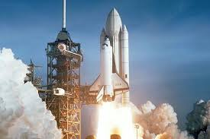
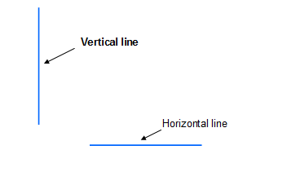
Key Words
Space shuttle (N.)
Space ship
Vertical (Adj.)
Straight up

Slide 8
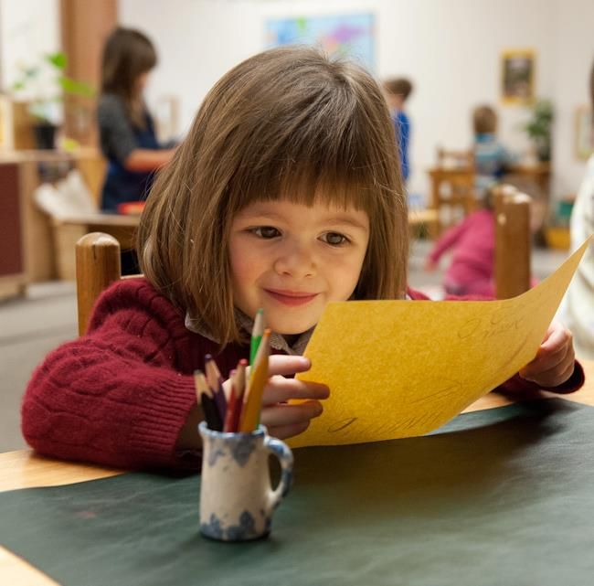
Individual Work
Read the text silently & answer the questions that follow

Slide 9
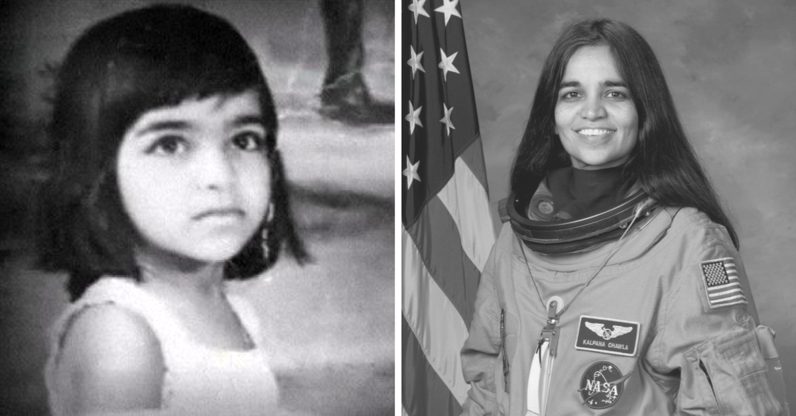
Birth of Kalpana Chawla
Chawla was born in Karnal , India , on 17 March , 1962 .

Slide 10
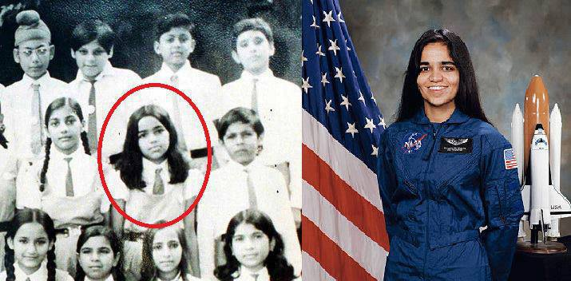
Secondary Education of Chawla
Chawla completed her earlier schooling at Tagore Baal Niketan Senior Secondary School , Karnal .

Slide 11
Education of Kalpana Chawla

Slide 12
Pair Work
1. Q . What do you know about the birth of Kalpana Chawla ?
1. Ans: Chawla was born in Karnal , India , on 17 March , 1962 .
2. Q . Where did Chawla complete her earlier schooling ?
2. Ans: Chawla completed her earlier schooling at Tagore Baal Niketan Senior Secondary School , Karnal .
3. Q . From where Chawla completed her graduation ?
3. Ans: From Punjab Engineering College , India , in 1982 .
4. Q . When did Chawla do her Ph.D. Degree ?
4. Ans: Chawla did her Ph.D. in Aerospace Engineering in 1988 from the University of Colorado .

Slide 13
Master’s Degree of Chawla
Obtained Master’s Degree in Aerospace engineering in 1984 .

Slide 14
U.S. citizenship of Chawla
Chawla got U.S. citizenship in 1991

Slide 15
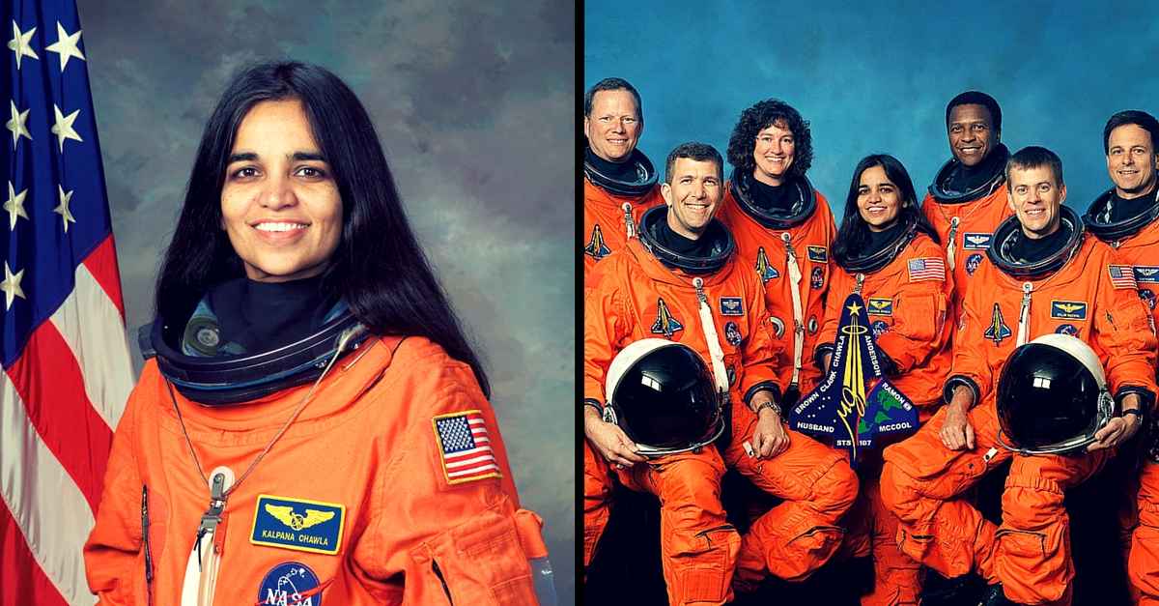
Chawla as a NASA astronaut
Chawla started her career as a NASA astronaut in 1995

Slide 16
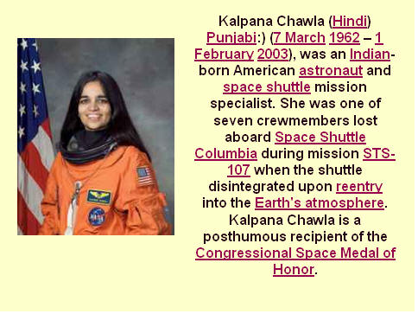
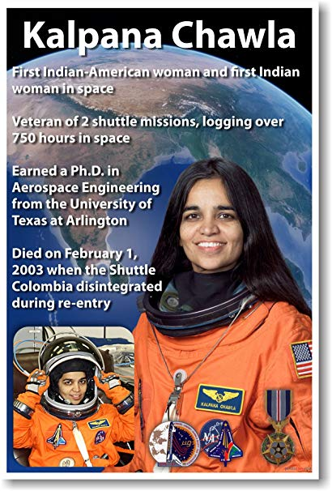
Death of Chawla
Died after a 16 day scientific mission in space on 1 February 2003

Slide 17
Group Work
Read the text silently & make short notes in each of the boxes in the flow-chart showing the life history of Kalpana Chawla .
1. Born on 17 March 1962 in Carnal , India
2. Graduated in Aeronautical Engineering in 1982
3. Obtained Master’s Degree in Aerospace engineering in 1984
4. Got U.S. citizenship in 1991
5. Started her career as a NASA astronaut in 1995
6. Died after a 16 day scientific mission in space on 1 February 2003

Slide 18
Evaluation
1. Chawla was selected in 2000 for ----- mission . (a) STS 87 (b) STS 107 (c) CFD (d) STS 100
2. When did she start her last mission ? At the age of (a) 42 (b) 40 (c) 41 (d) 43
3. In her first space mission , Kalpana travelled for------ (a) 10.67 million miles (b) 6.5 million miles (c) 250 times around the Earth (d) about 15 days
4. What does the word complete in the passage refer to ? (a) realize (b) finish (c) attain (d) obtain

Slide 19
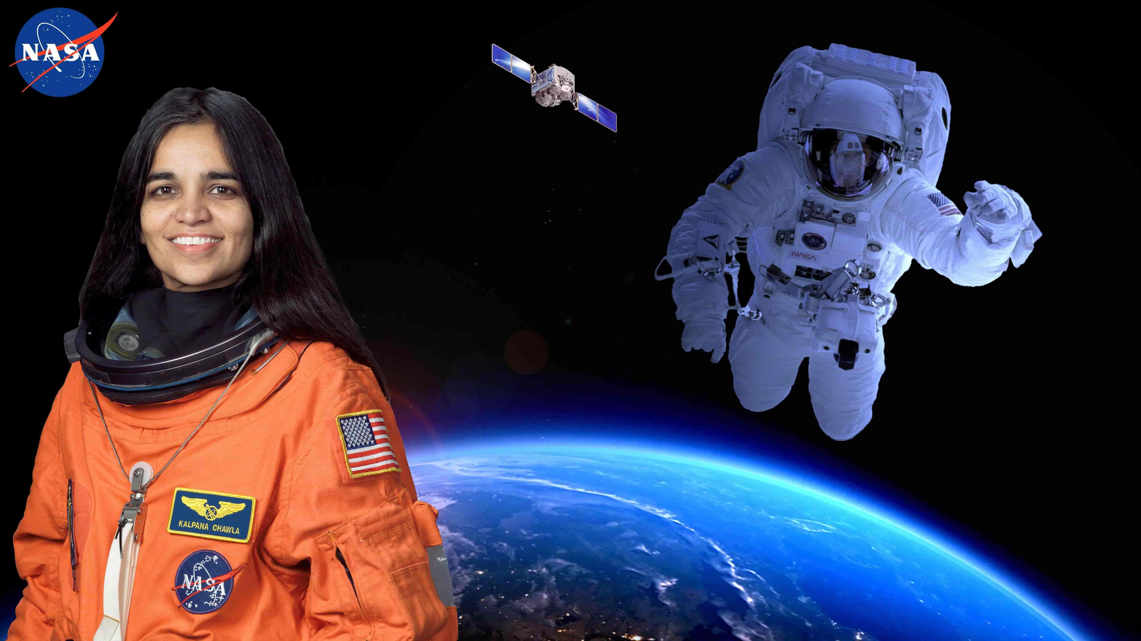
Home Work
Write a paragraph on “ The Achievements of a famous Woman ”

Slide 20
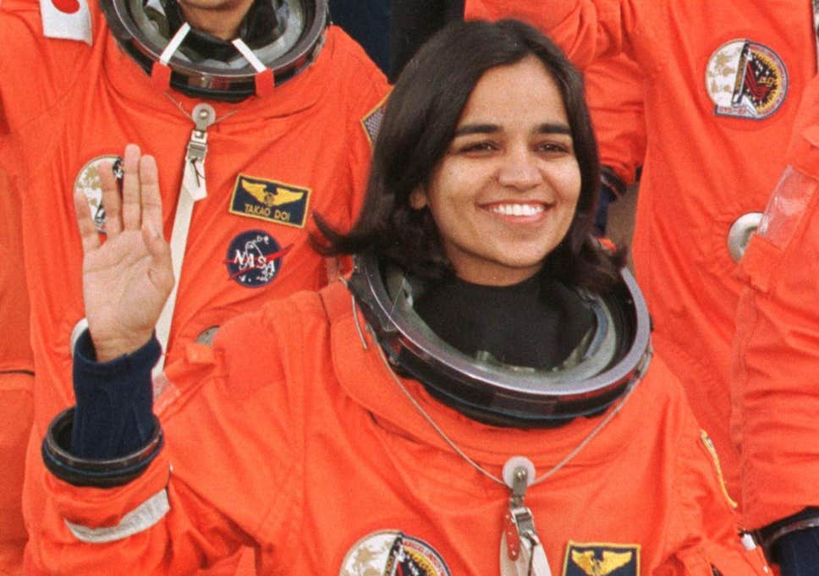
No more Today
See you Tomorrow

