Slide 1
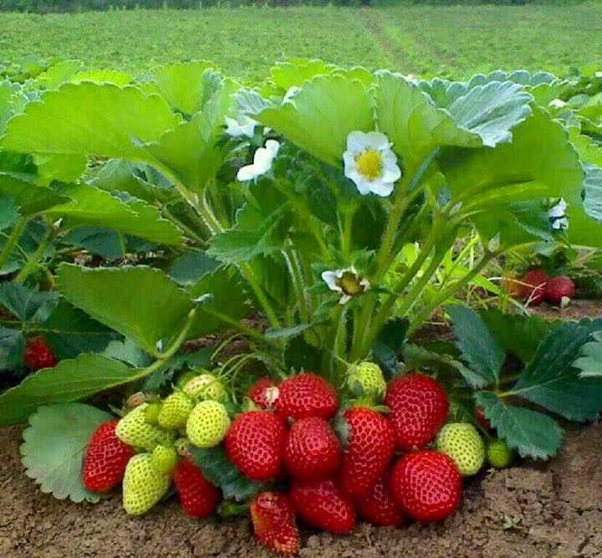
WELCOME TO ALL

Slide 2
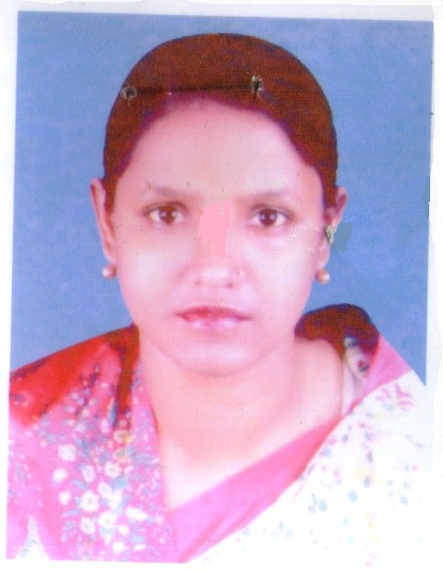

Presented by:
Aliza Begum HeadTeacher
Pallimangal Govt. Primary School.
Dakshin Surma, Sylhet.

Slide 3
Learning outcome :
Student will be able to –
Listening :
3.3.1 –understand questions about objects around them
3.4.1-understand and enjoy simple stories
Speaking:
6.1.2-say what others are doing
Reading:
1.7.1-read paragraps,diologues,letters and other objects
Writting:
10.1.1-to write a short piece of composition
8.1.1-to make sentence using following instructions

Slide 4
Lets enjoy a video

Slide 5
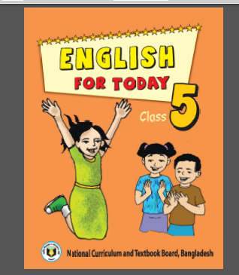
Todays Lesson
Class : Five
Unit :14
Lesson :1-2
Number Of the page : 54

Slide 6
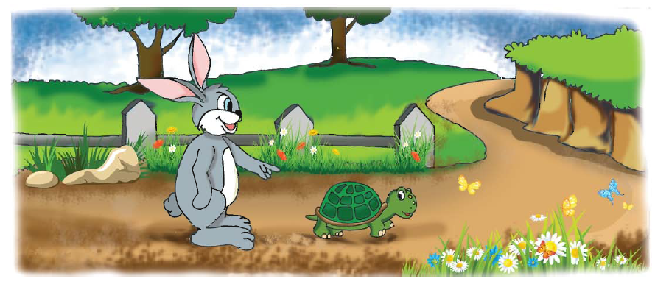
Lets see the picture and tell me about the picture.

Slide 7
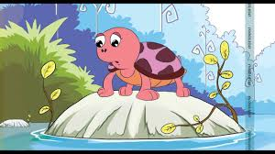
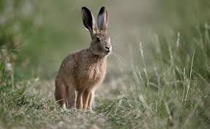
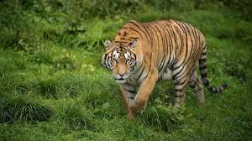
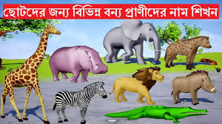
Some questions more
Do you go to any forest?
Can you say the name of some animals living in the forest?
Let’s see some more pictures

Slide 8
Do you take part in a race?
If you take part, please say your experience
Today we are going to listen and read a story-
The hare and the tortoise

Slide 9
Let’s watch a video

Slide 10
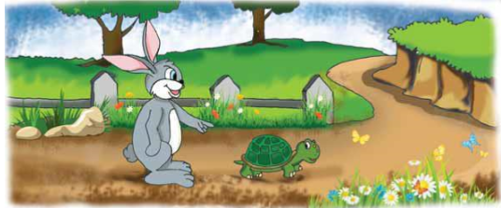
Here is a picture for you. Let’s see-
What can you see in the picture?
Where are they now?
What are they doing?

Slide 11
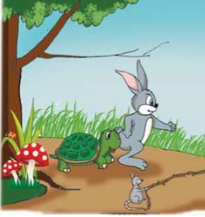
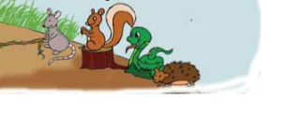
Let’s see another picture
What can you see in this picture?
What are the other animals doing?
Why are they holding the twig?

Slide 12
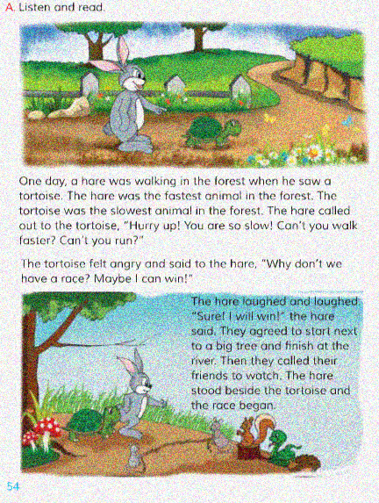
Teacher’s model reading
Listen to me

Slide 13
Students reading
The whole classwork
Open at page 54
Read the topic silently
One student read and other will listen

Slide 14
Group work
One member will read and other members will listen

Slide 15
Individual work
One student will read and other will listen

Slide 16
Evaluation
Say the meaning of the following words:
Slow
Fast
Angry
Agree
Race
Next to
Beside
Furious

Slide 17
Say the answer of the following questions:
Who was the fastest and who was the slowest animal in the forest?
Why do you think the tortoise want to have a race with hare?
Where did they start their race from?
Where did they finish?

Slide 18
Home work
Write five sentences about “Race”

Slide 19
BYE

Slide 20
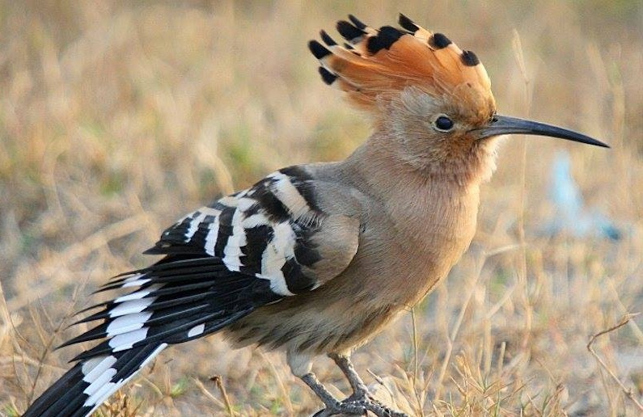
GOOD BYE

