Slide 1


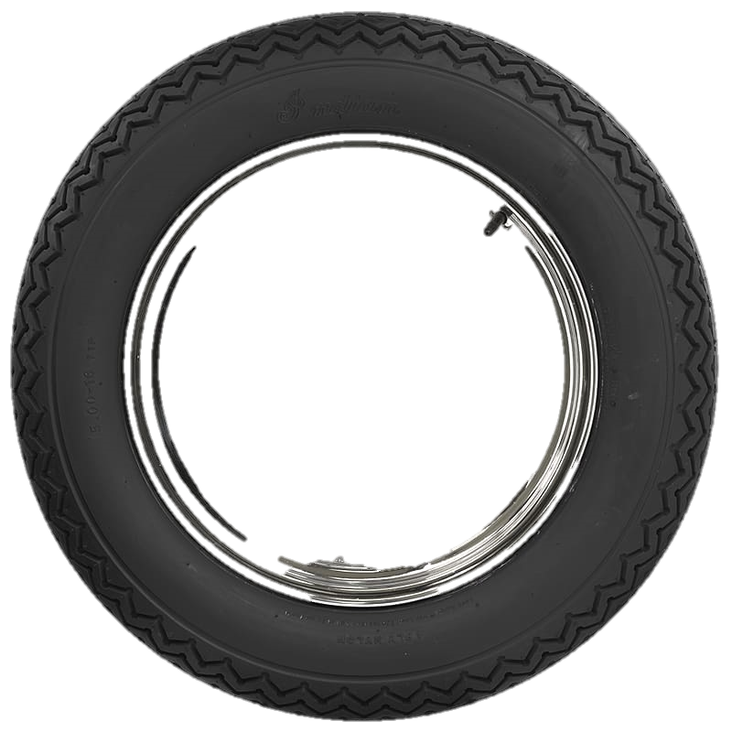
Welcome

Slide 2


Identity
The Wheel
Md. Noor -E- Alam Siddiki
Asstt. Teacher
Nageswari Keramotia M.L High School.
Mobile- 01716962418
E- Mail- nooralam.na35@gmail.com
Unit-9, Lesson -1

Slide 3
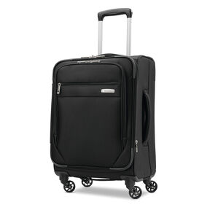
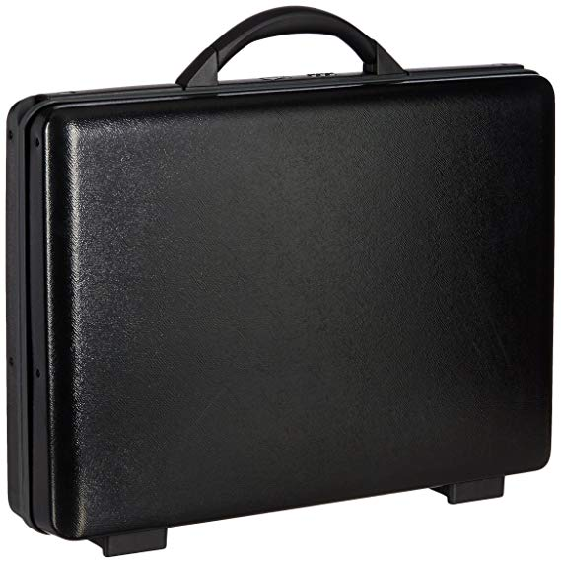
Look at the pictures and say which one is easier to move and why?
1
2
As there are wheels in second picture…

Slide 4
Todays lesson is
The wheel
Unit- 9, lesson-1

Slide 5

Learning outcome
After we have studied this lesson, we will be able to…
Infer meaning from the text.
Ask and answer question.
Make meaningful sentence.
Write a paragraph.

Slide 6

circular
disc-like
round
disc-shaped
having the form of a circle

Slide 7
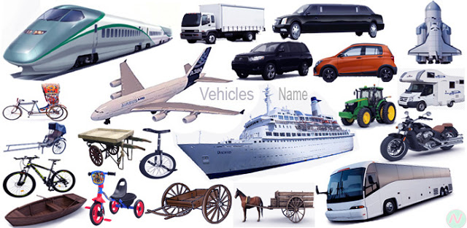
Vehicle
automobiles
conveyance
means of transport
a thing used for transporting people or goods, especially on land, such as a car, lorry, or cart.

Slide 8
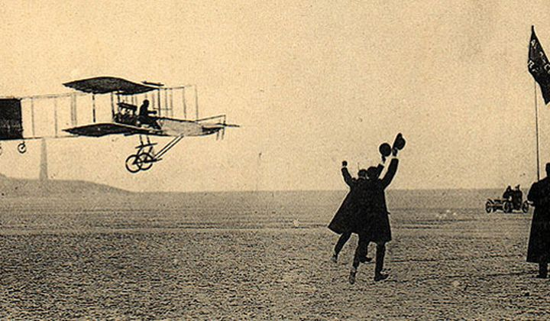
invention
discover
origination
creation
An invention is a new thing that someone has made.

Slide 9
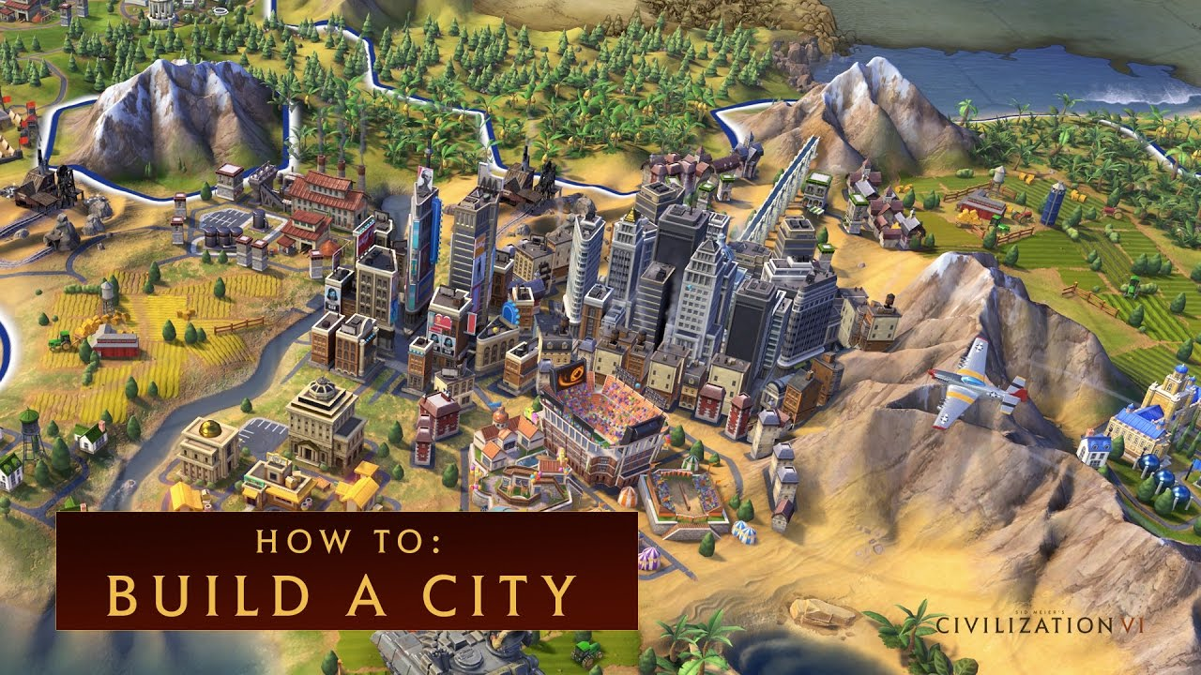
Civilization
human development
advancement
progress
the stage of human social and cultural development and organization that is considered most advanced

Slide 10
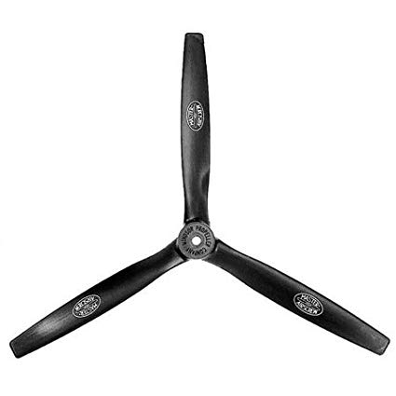
propeller
screw
rotor
vane
A propeller is a type of fan that transmits power by converting rotational motion into thrust.

Slide 11
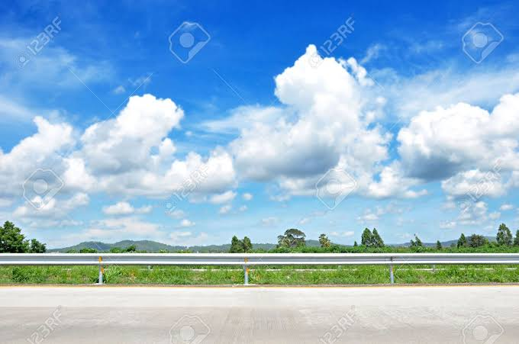
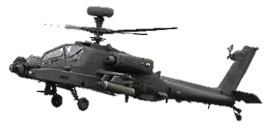
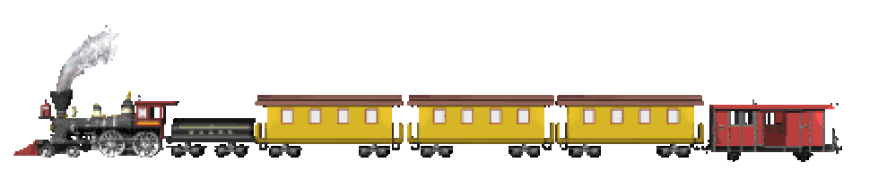
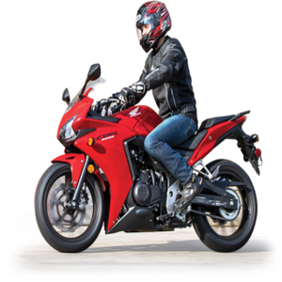



Human beings have invented many important things so far.
They have brought great civilization to the world through this invention.
Do you know which invention is the greatest?

Slide 12
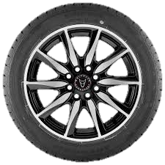
A wheel is a circular object.
It can rotate around its axis and help easy movement of things across a surface.

Slide 13
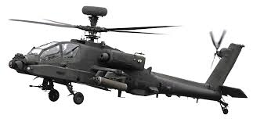
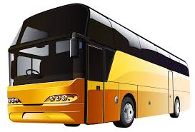
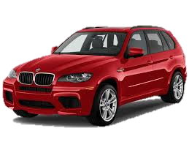
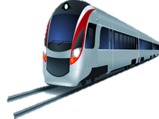
The wheels are ,in fact, everywhere . They are on our cars, trains, planes, wagons and so on.
Besides, they are on most factory and farm equipment ..

Slide 14
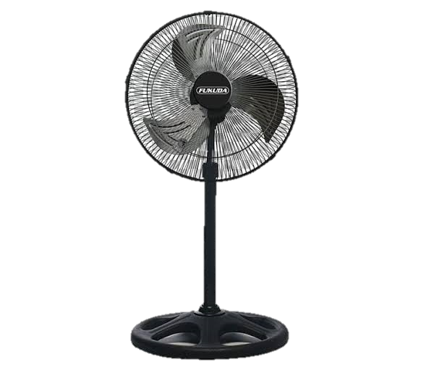
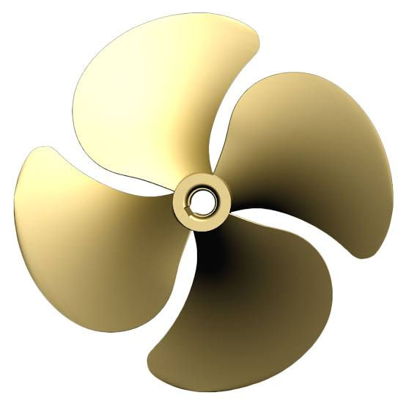
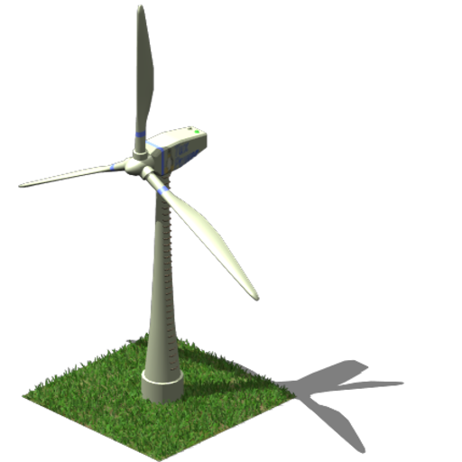
Fans, propellers, turbines are also other types of wheels.

Slide 15

Time – 10 minutes
Silent Reading
Read the Text B silently

Slide 16

Time – 10 minutes
Individual work
What is wheel?
What can a wheel do?
Where can you find wheels?

Slide 17
Match your answer
1. A wheel is a circular object.
2. It can rotate around its axis and help easy movement of things across a surface.
3. We can find wheels in cars, buses, trains, planes and in every machines.

Slide 18


Time – 10 minutes
Group work
Fill in the blanks with appropriate words from the box in C read.

Slide 19
Match your answer
a) important.
b) circular
c) difficult.
d) first.
e) much

Slide 20

Time – 10 minutes
Pair Work
Make as many as correct sentences as you can using the substation table.

Slide 21
Match your answer
1. The wheel rotates around its axis.
2. A plain wheel is one of the simplest machines.
3. It has helped in rapid progress of civilization.
4. A propeller is a type of wheel.

Slide 22

Homework
Have you ever travelled by bus or car? Do you have any experience of what happens if one wheel fall flat. If yes, give a short description of your experience. If no, imagine such a situation, and write a paragraph on it.

Slide 23
Good bye

