Slide 1




Slide 2
Introduction of the teacher
Muhammad Moshiur Rahman,
Assistant teacher,
7 No. Sandiain Government Primary School,
Gafargaon, Mymensingh.

Slide 3

Introduction of the lesson
Class: Three
Unit: 29
Lesson: 01
Lesson Title: Where is it?
Today’s Lesson: A (Read)
Total Time: 35 minutes

Slide 4
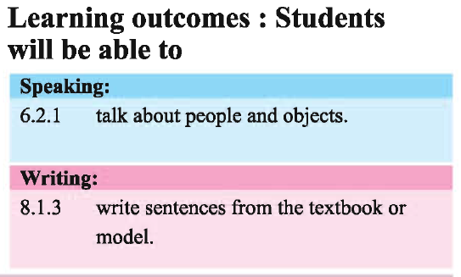


Slide 5
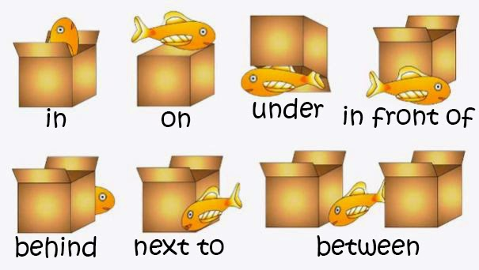
Where is the fish ?

Slide 6
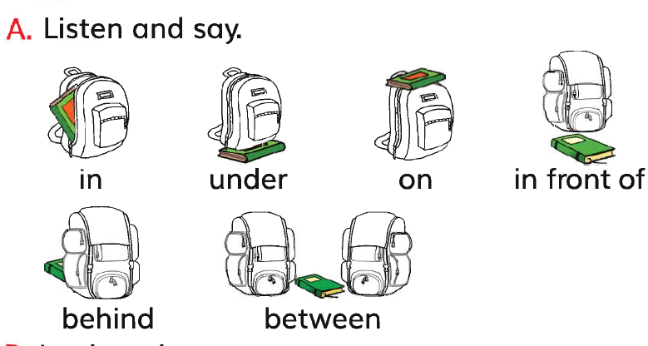
Open your book at page 58

Slide 7
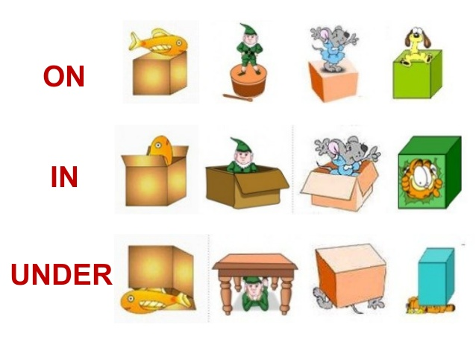
On, In, Under

Slide 8
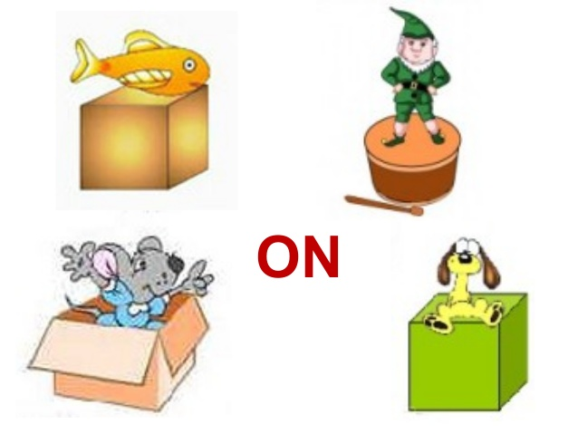
Which isn’t on?

Slide 9
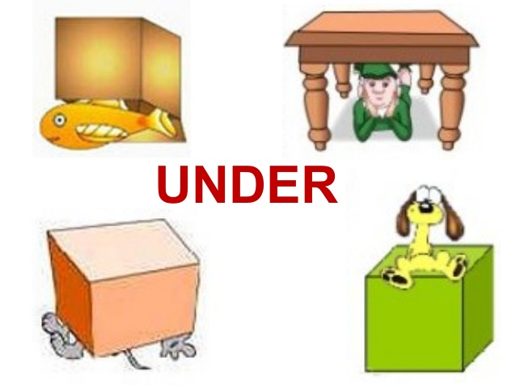
Which isn’t under?

Slide 10
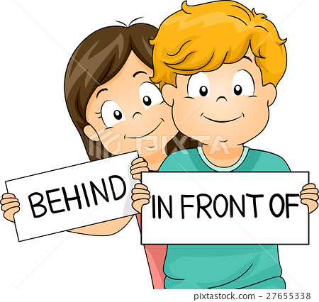

Slide 11
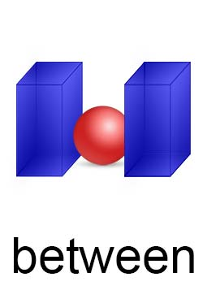
Between the box

Slide 12

Evaluation of the Class
(Questions and answers)
Where is the dog?

Slide 13
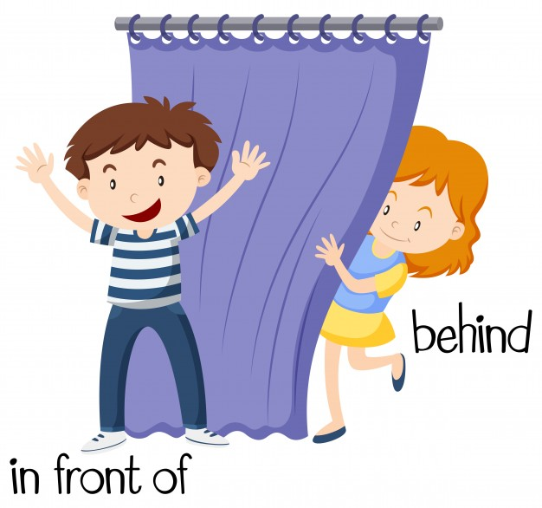
Where is the boy?
Notes:
Rule: 1. Teacher will show the word chart 2. Students will chose three words and write down 3. Teacher will say any three words randomly one after one. 4. Students will cross the name if it matches with the teacher 5. The students who cross all of the three will shout “BINGO’ and will be the winner.

Slide 14
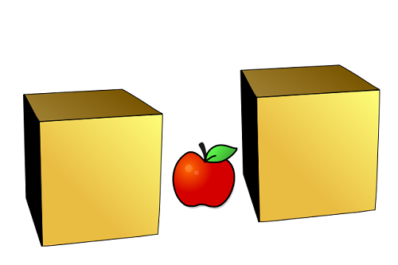
Where is the apple?

Slide 15
Home Work
Make at lest one sentence for each word
With their meanings.
Write down the sentences at your note
book to show me tomorrow in the class.

Slide 16




