Slide 1

Welcome to the world of MEA Multimedia presentation.

Slide 2
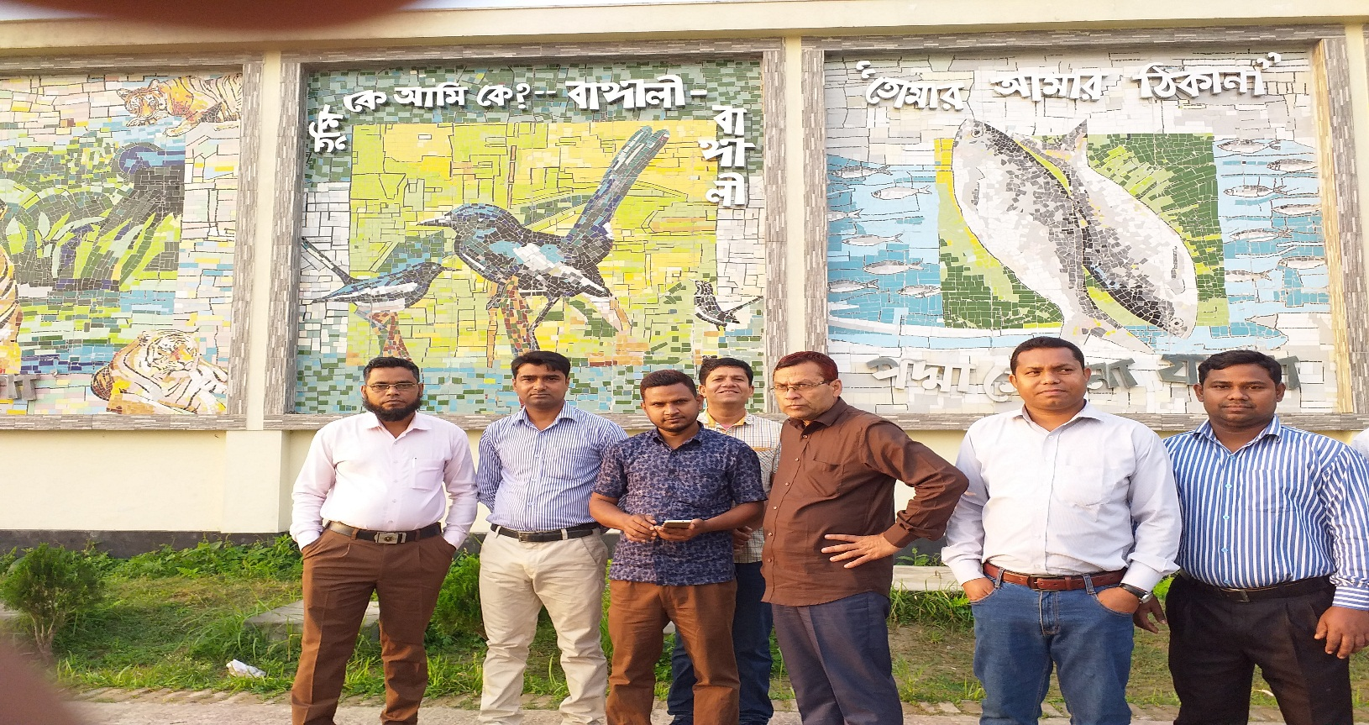
Md. Eunuse Ali
Senior Teacher
Charan High School.
Kalihati,Tangail.
Mob-01767476436
Class-Eight
English 1st Paper

Slide 3
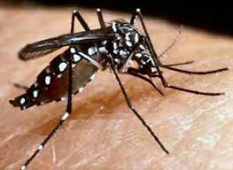
What do you see in the picture ?

Slide 4
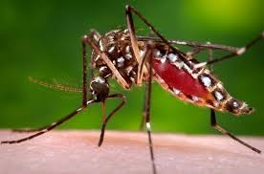
What types of mosquito is it ?

Slide 5
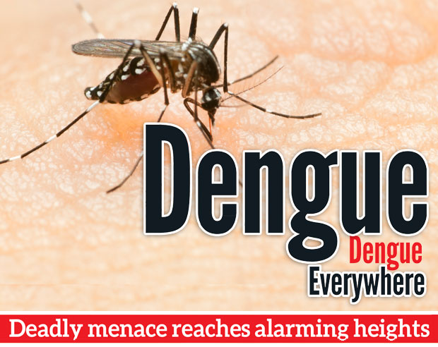
Really. It’s an Aedes mosquito bear dengue.

Slide 6
Our Today’s Lesson is-
A paragraph on
“Dengue Fever”

Slide 7
Learning outcomes
After we have studied this lesson we will be able to-
What is dengue fever
The effects of dengue fever
Take preventive measures
write a paragraph.

Slide 8
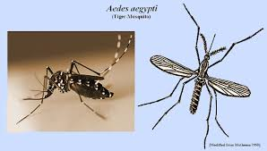
Dengue is a mosquito-borne viral infection causing a severe flu-like illness called dengue fever.

Slide 9
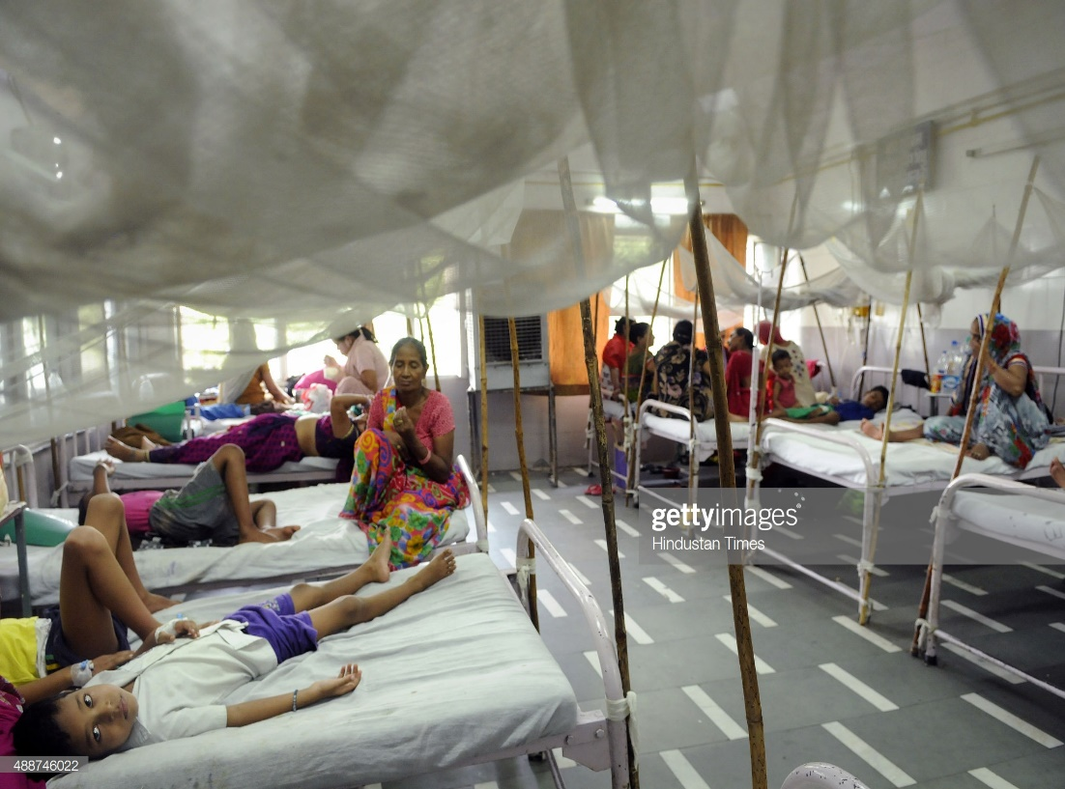
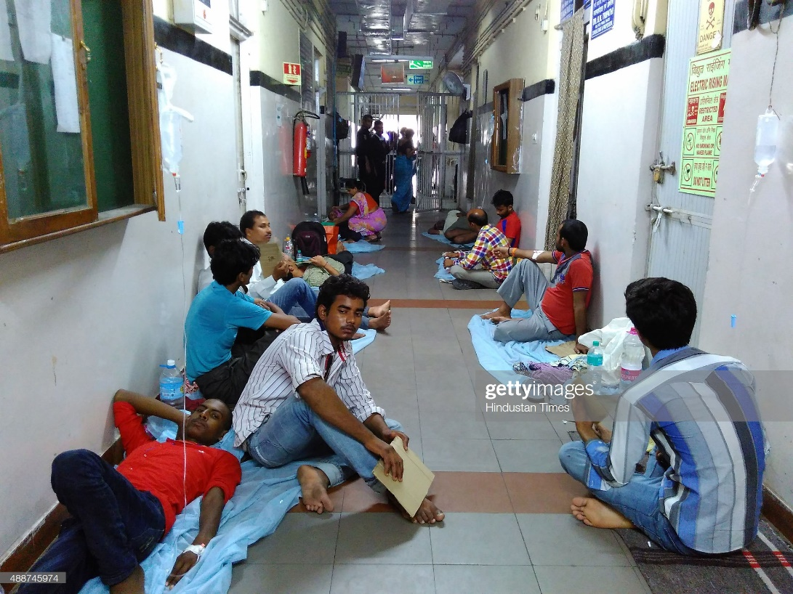
Look at the picture
Now dengue is the talk of the time. About half of the World’s population is at the risk and it affects young, children and adults.

Slide 10
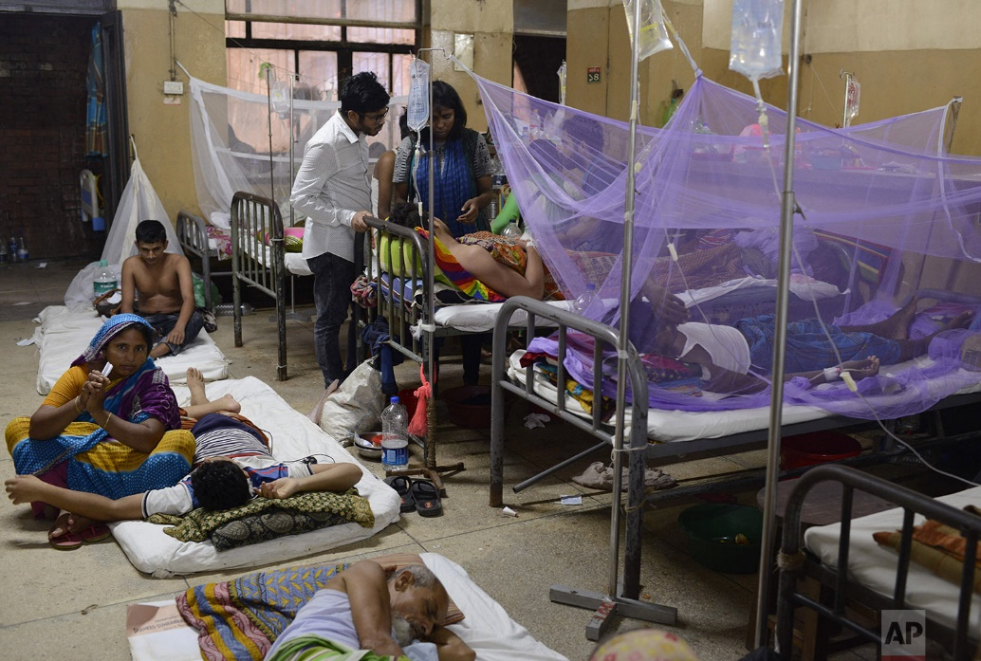
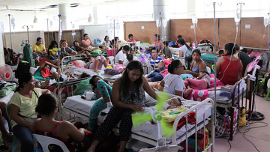
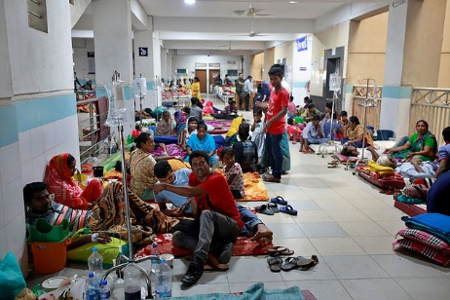
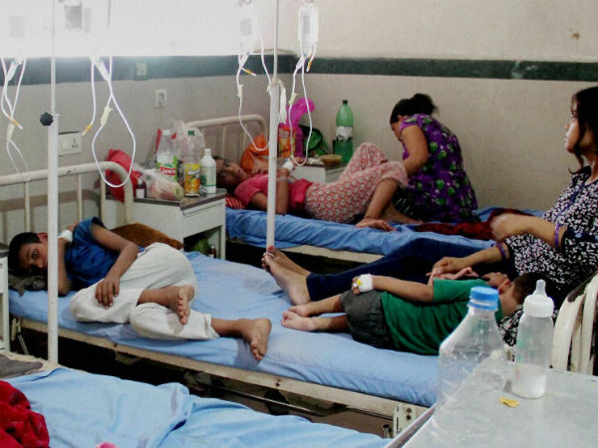
It is not only a national but also a global problem. Bangladesh is one of the countries that are affected by dengue virus.

Slide 11
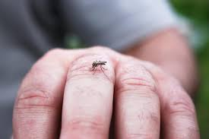
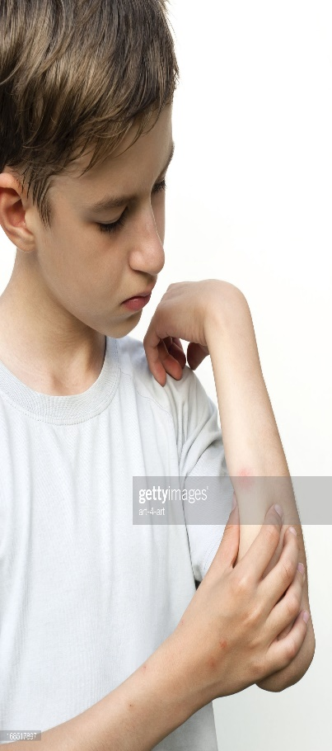

The Aedes Aegypti mosquito is the main vactor that transmits the virus that causes dengue. The virus is passed to human through the bites of an infective female aedes mosquito.

Slide 12
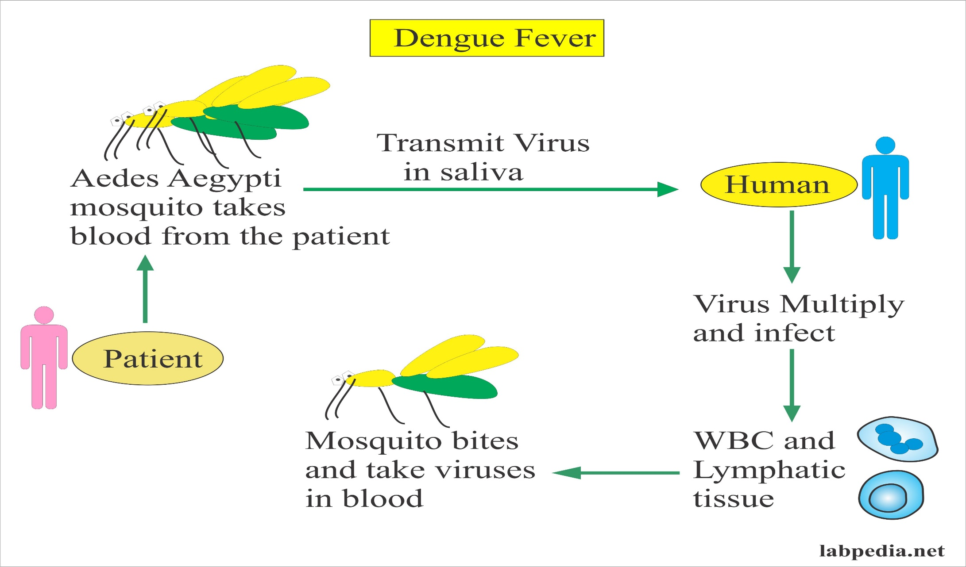
The virus circulates in the blood of an infected person for 2 to 7 days.

Slide 13
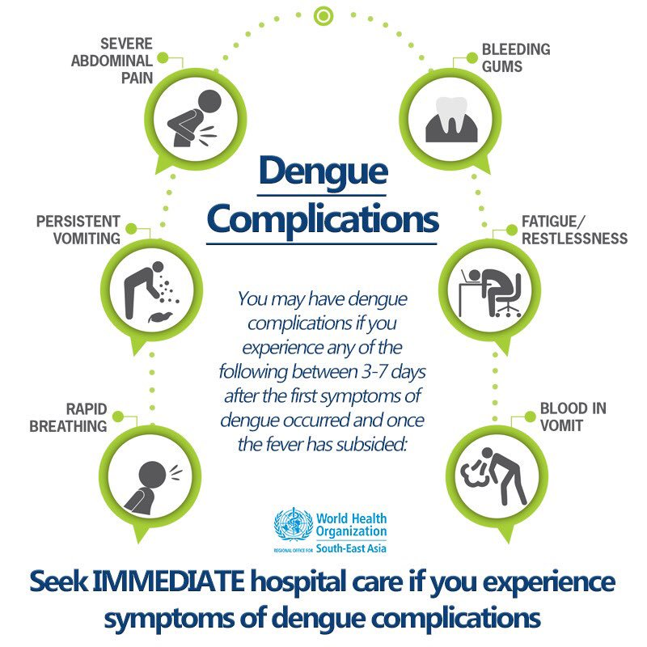
Normally the first symptom appears within 4 to 5 days maximum 12 days.

Slide 14

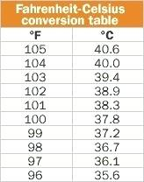
It normally causes high fever

Slide 15
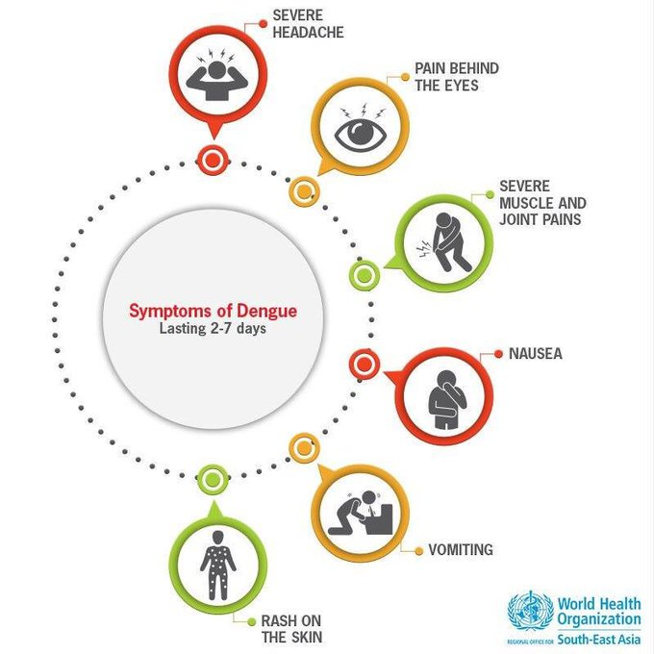

Slide 16
Pair work
o1. Is it anational problem? Why?
02. write the symptoms of dengue fever

Slide 17
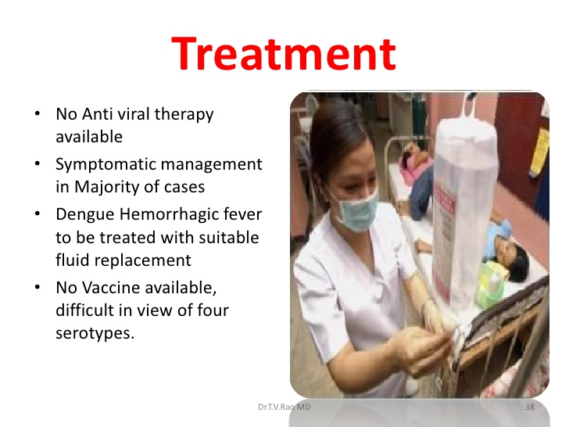
There is no specific medicines to treat dengue infection.

Slide 18


Dengue affected patient should use pain relievers,

Slide 19



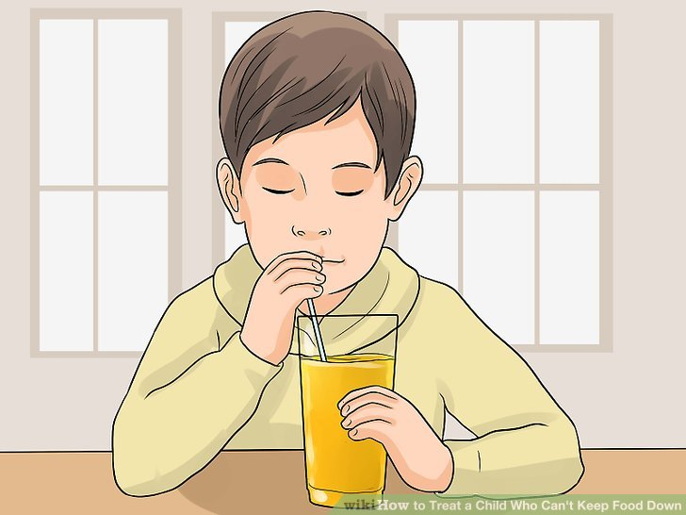
He should take proper rest, drink plenty of fluids

Slide 20


The affected patient must consult with a doctor immediately.

Slide 21
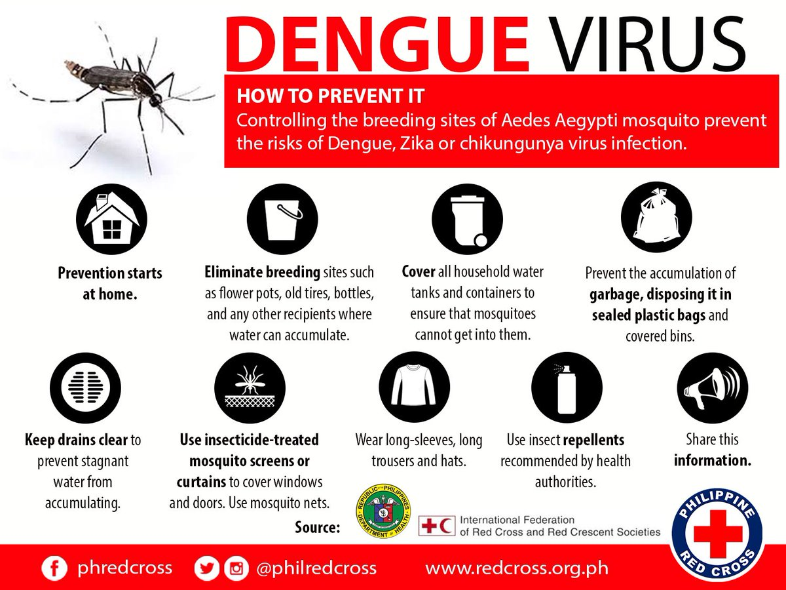
Besides this, we may take some preventive measures like this, we should use mosquito net.

Slide 22

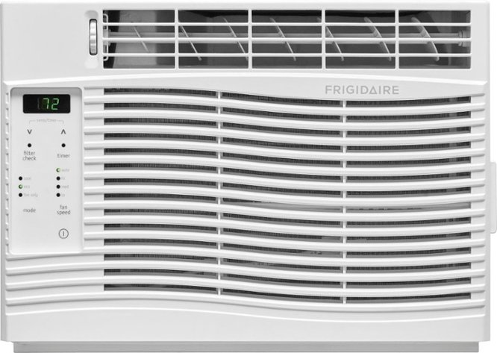

Long sleeve shirt
Air conditioner
window screen
We may wear long sleeved shirt, use air conditioner if possible, make sure the window and door screen etc.

Slide 23
Evaluation
Answer the following questions-
What is dengue fever ?
What are the symptoms of dengue fever ?
What should be done for the affected people?
How can we prevent it ?

Slide 24
Homework
Write a paragraph about
“Dengue Fever”

Slide 25
Verse Universal
“Prevention is better than cure”

Slide 26
Bye bye
Good bye

