Slide 1
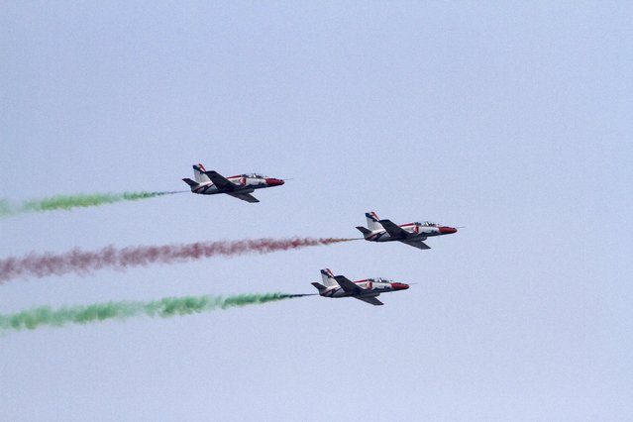
Welcome to my class

Slide 2

Teachers’ identity
Md. Imran Kabir
Assistant teacher(English)
Pabna Collectorate Public School And College, Pabna.
Mobile number-01756005577
Email-i.kabir01111@gmail.com
Subject: English For Today
Class : VIII
SS : 41
Time : 45
Date : 24/08/2019

Slide 3
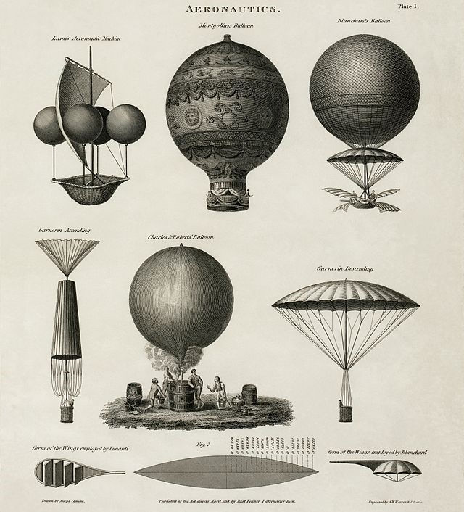
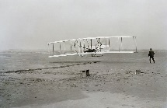
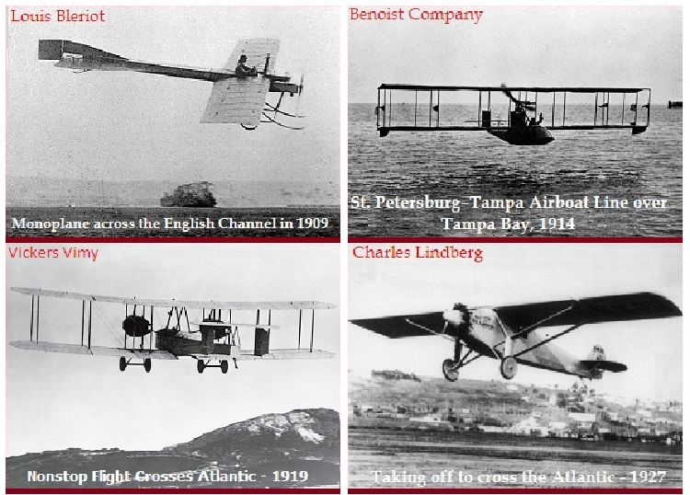
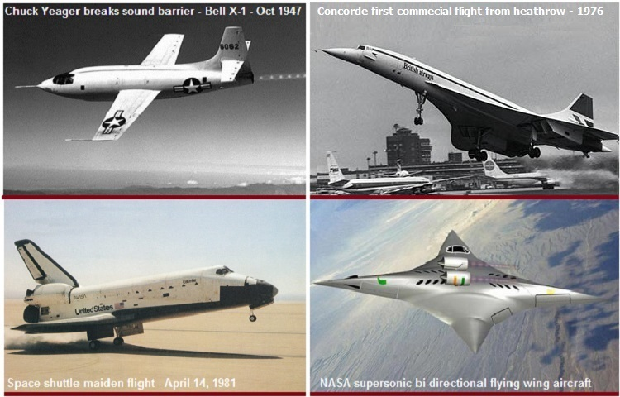
What do you see in the pictures?

Slide 4
Dear students, let’s enjoy a video

Slide 5
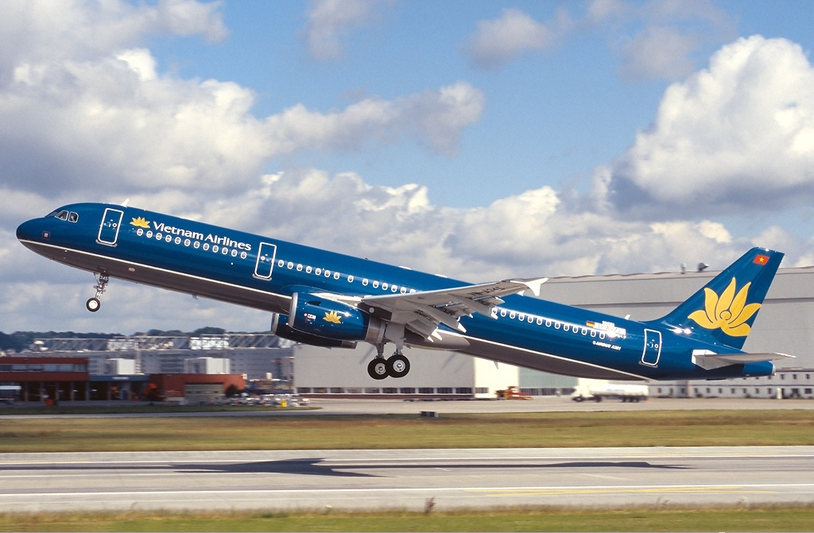
Taking off
Our today’s lesson is “Taking off”
Unit-9
Lesson-4

Slide 6
Learning outcomes
By reading this lesson students will be able to-
Ask and answer question.
New words and pronunciation.
Describe the pictures.
Read the text and understand the meaning.

Slide 7
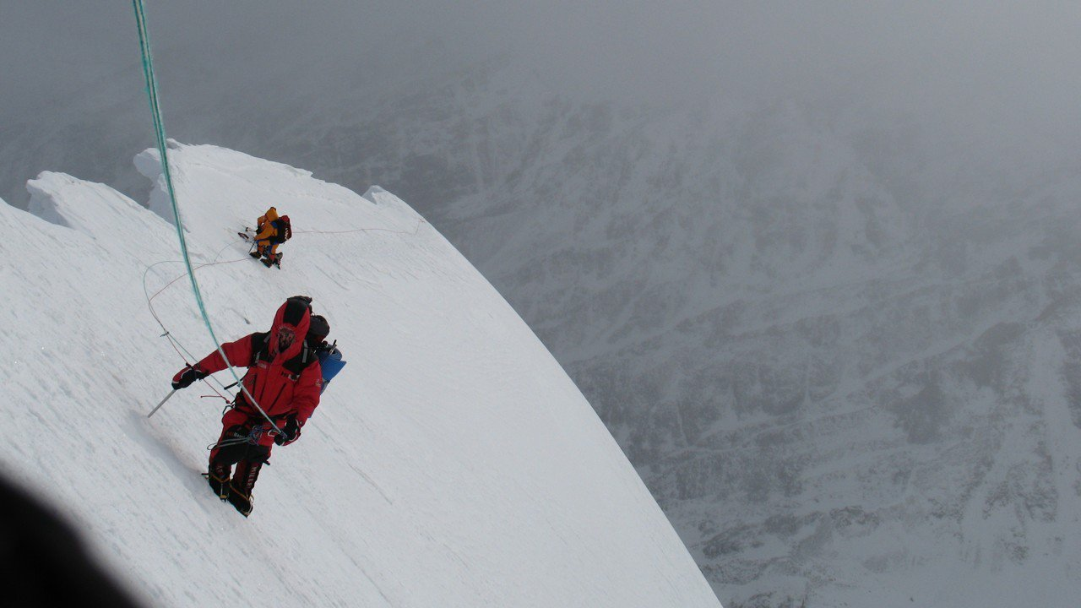
Endeavor
Meaning- try, attempt, undertake
They endeavored further

Slide 8

Conquered
Meaning-Defeat, beat, overthrow
Human beings conquered the distance.

Slide 9

Experiment
Meaning-test, investigation, enquiry
The Americans made the first experiment of flying in a plane.

Slide 10

Revolution
Meaning-mutiny, uprising, insurrection
Modern aircraft companies are making revolution.

Slide 11
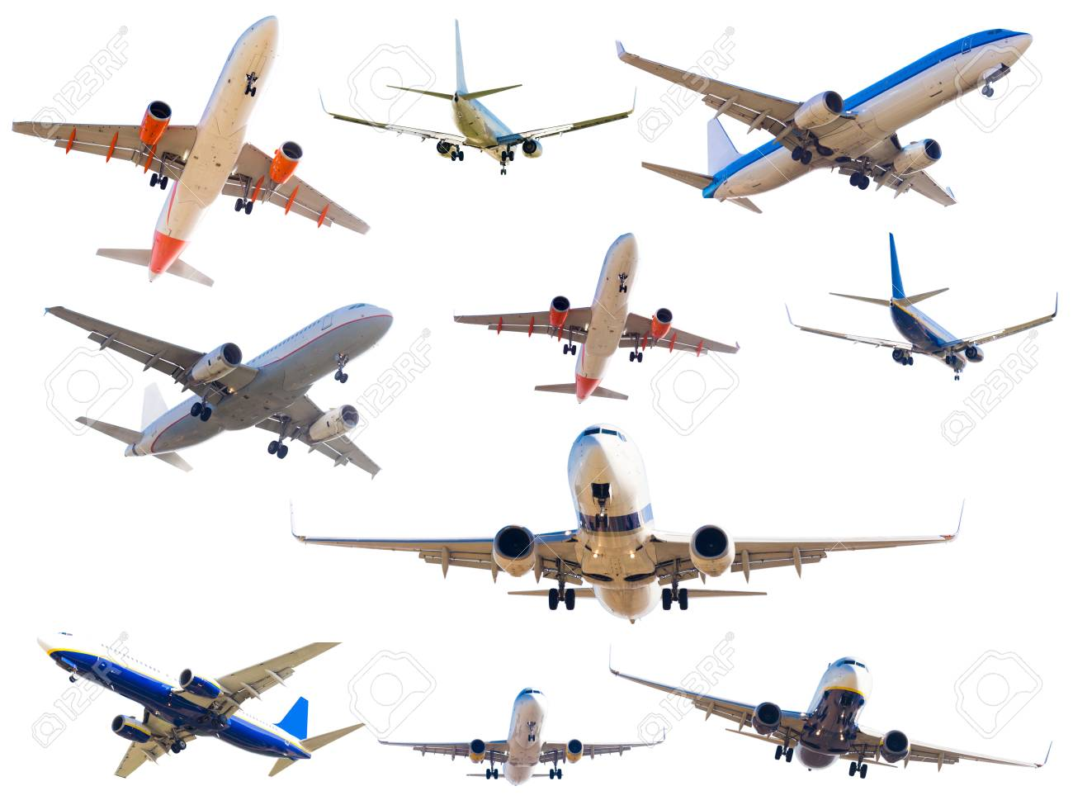
Features
Meaning-characteristics, quality, property
Both Boeing and Air bus have excellent features.

Slide 12
Read the text and answer the following questions-
Human beings conquered the distance on earth by discovering wheels. They endeavored further. The Americans wright Brothers made the first experiment of flying in a plane. The machine was called aka airplane. That was human beings real take off. Now they have got super sonic speed. In a supersonic speed, something travels faster than a plane. Modern air craft companies are making revolution. Boeing as well as Airbus is producing modern passenger airplanes. But in speed nor could defeat the Concord. It is the world’s fastest supersonic passenger air craft. It’s normal speed was 2170 km/h. It started passenger flight in 1976. Unfortunately , the Concord fleet was grounded forever in 2003 after a major accident.

Slide 13
Answer the following questions-
When did the first experiment make of flying in a plane?
Who made the first experiment of real take off?
What is called supersonic speed?
What was world’s fastest passenger airplane?
When was Concord fleet finally grounded?
Answer-a) The first experiment made of flying in a plane in 1906.
b) The American Wright brothers made the first experiment of real take off.
c)In supersonic speed, something travels faster than sound.
d) The world’s fastest passenger airplane was concord.
e) The Concord fleet was grounded forever in 2003 after a major accident.

Slide 14
Read the text and fill in the blanks without clue
Human beings(a)_ the distance on earth by discovering wheels. They(b) _ further. The Americans Wright brothers made the first experiment of flying in a plane. The machine was(c) _ aka airplane. That was human beings real take off. Now they have got super sonic speed. In a supersonic speed, something travels faster than a plane. Modern air craft Companies(d) _ making revolution. Boeing as well as Airbus is producing modern passenger airplanes. But in speed nor could_(e) the concord
Answer- a) conquered b)endeavored c)called d)are e)defeat/beat

Slide 15
Homework
Read the above text and make a summary of the passage in your own words.

Slide 16

Thank you everybody

