Slide 1
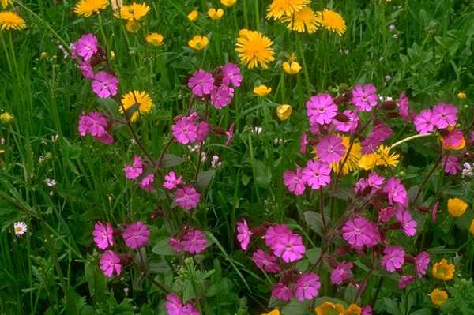
welcome

Slide 2
Teacher’s Introduce
Shikha Biswas
Asst: Teacher
Ramdi GOVT Pri: School
Kuliarchar,Kishoregonj

Slide 3
Introduction of the Lesson
Class-3 Unit-38
Lesson-01,A Look and say
Time-1 hour date-29|04|19

Slide 4
Good morning student.
How are you?
I am fine.

Slide 5
Learning outcomes: Student will be able to
Speaking:
1.1.1. repeat words , phrases and sentences after the teacher with proper sounds and stress.
1.1.2. say words ,phrases and sentences with proper sound and stress.
Reading:
2.1.1. recognize and read cardinal numbers up to 100.
Writing:
2.1.1. write cardinal numbers up to 100 in figures .
4.1.1. copy cardinal numbers up to 30 in figures and words.
4.1.2. write cardinal numbers up to 30 both in figures in words.

Slide 6
Here is video

Slide 7

Today we will learn about:
Numbers

Slide 8
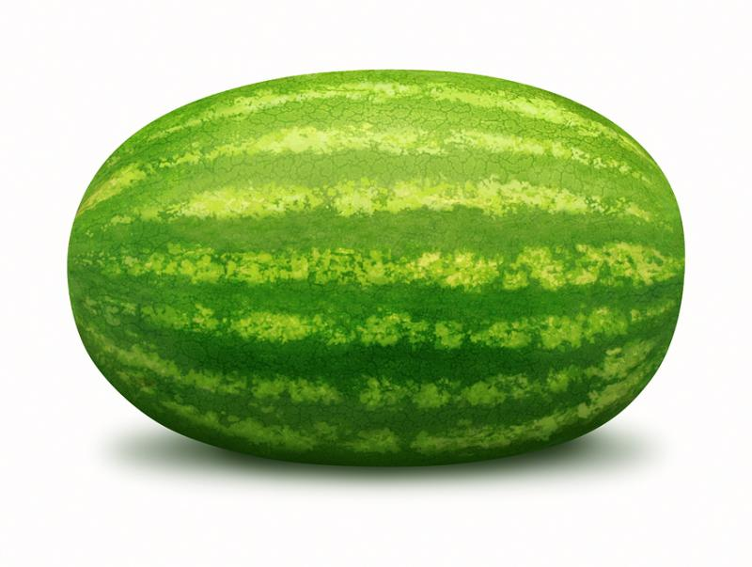
How many watermelon is there in the picture?
1

Slide 9
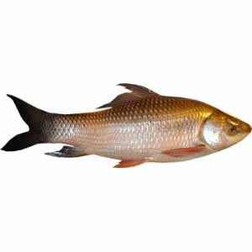
How many fishes are there in the picture?
2

Slide 10
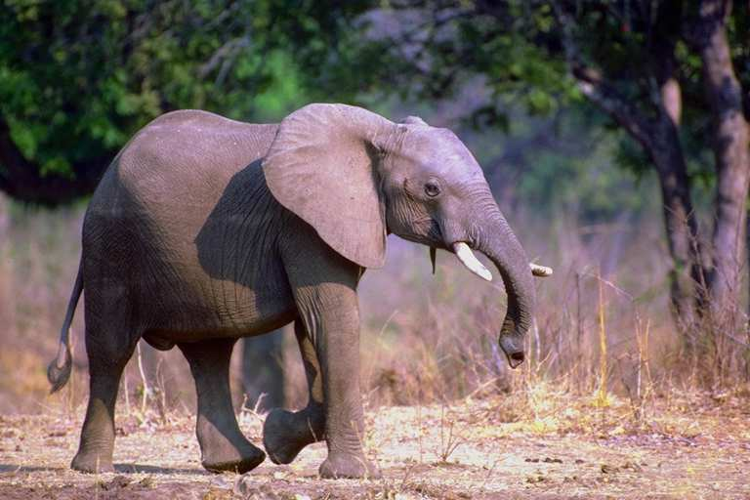
How many elephants are there in there picture?
3

Slide 11
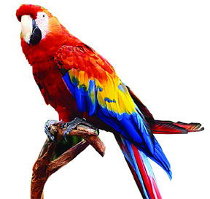
How many birds in this picture?
4

Slide 12

How many flowers are there in the picture?
5

Slide 13
8
9
10
11
13
12
14
Numbers

Slide 14
Open your book at page 8.

Slide 15
Student ,Look at page 8 and count and say.

Slide 16
Student say with me.
1,2,………….50.

Slide 17
Kim’s game
1
2
3
4
5
6

Slide 18
Students make 5 groups and count your group books.

Slide 19
Student write down the numbers.
1-20

Slide 20
Write down (20-50) in the house.

Slide 21

No more today.

Slide 22
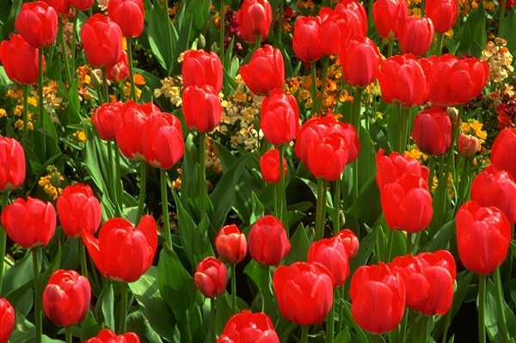
Thank you all

