Slide 1

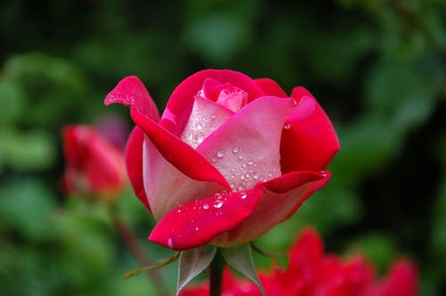
Welcome to all.

Slide 2
Presented by
Sarup Das
Head Teacher
Azompur Govt. Primay school,
Damurhuda,Chuadanga.

Slide 3
Introduction of Lesson
Class: 2
Subject: English
Lesson Headline: Life everyday, Unit: 25, Lesson: 1-3
Time: 40 minutes.
Notes:
Good morning student. How are you all? Are you all happy? Ok. Lets see a poem today.

Slide 4
Learning outcomes
Students will be able to:-
Listening:- 1.1.1* become familiar with English sounds by listening to common English words.
Speaking-1.1.2-Say simple words and phrases with proper sound and stress.
8.1.1-Ask and answer simple question about everyday life.
Reading---1.4.1-Read word and phrases with the help of visual clues.

Slide 5

Let’s listen to audio.

Slide 6
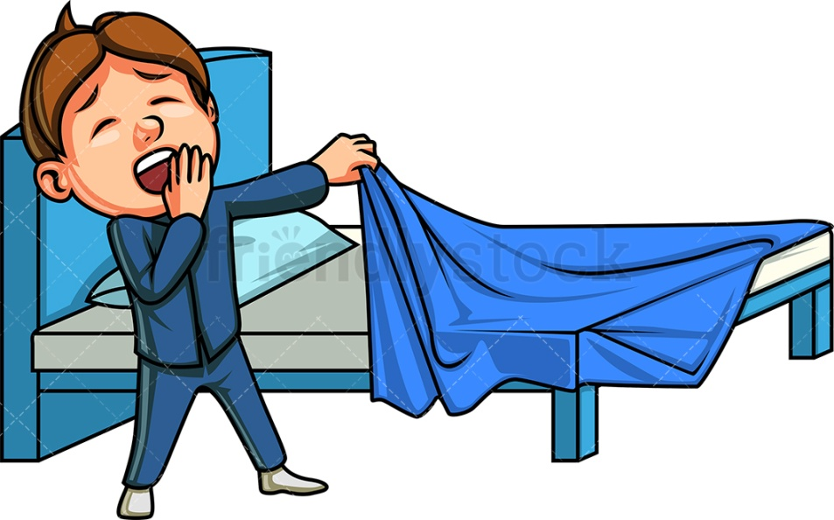
Look at the picture below attentively
What can you see in the picture?

Slide 7
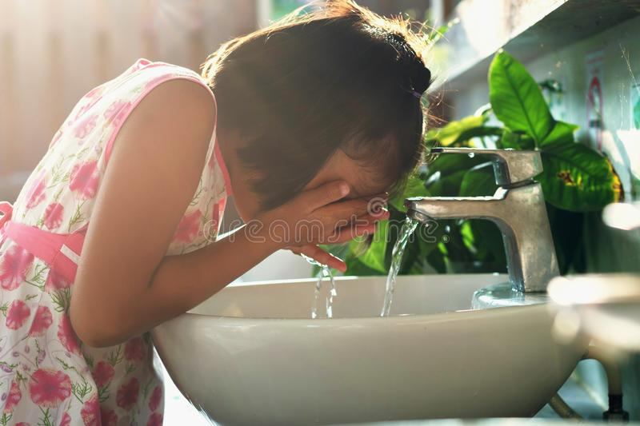
What can you see?
Wash face

Slide 8
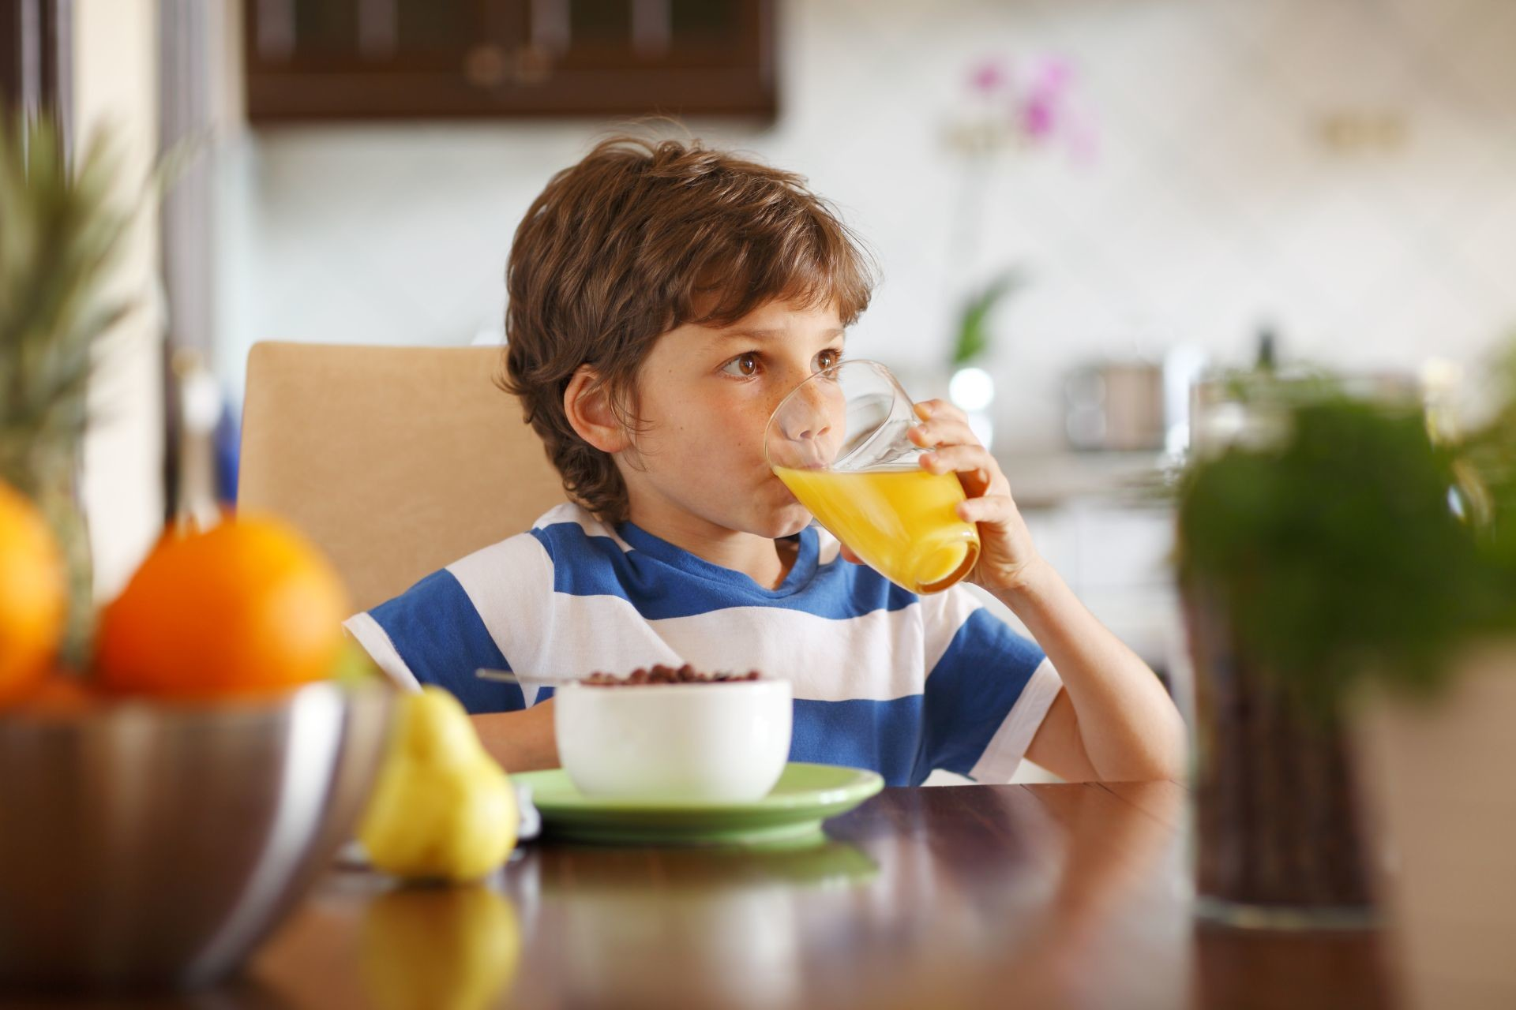
What can you see?
Have breakfast

Slide 9
Today’s lesson:-
Life everyday.

Slide 10
Let’s listen to audio.

Slide 11
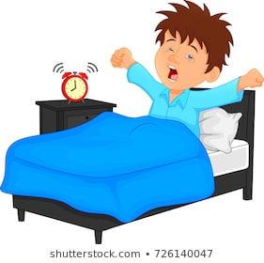
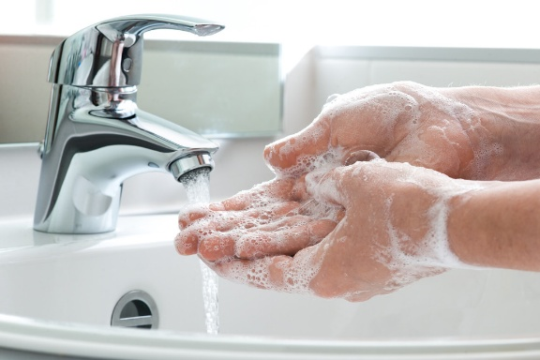
Word meaning
Word | Meaning | Make sentence
Get up |  | I get up early in the morning.
Wash |  | I wash my hand.

Slide 12

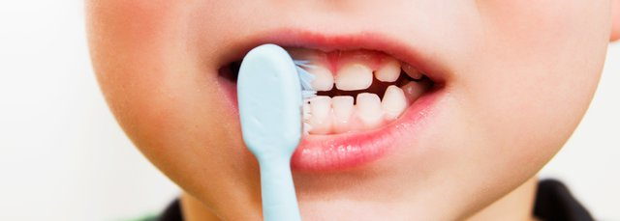
Word meaning
Word | Meaning | Make sentence
Breakfast |  | I have breakfast.
Teeth |  | I brush my teeth.

Slide 13
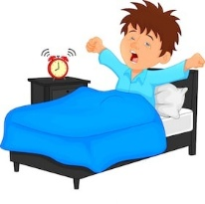
Teacher’s loud reading.
I get up in the morning.
I wash my face.

Slide 14
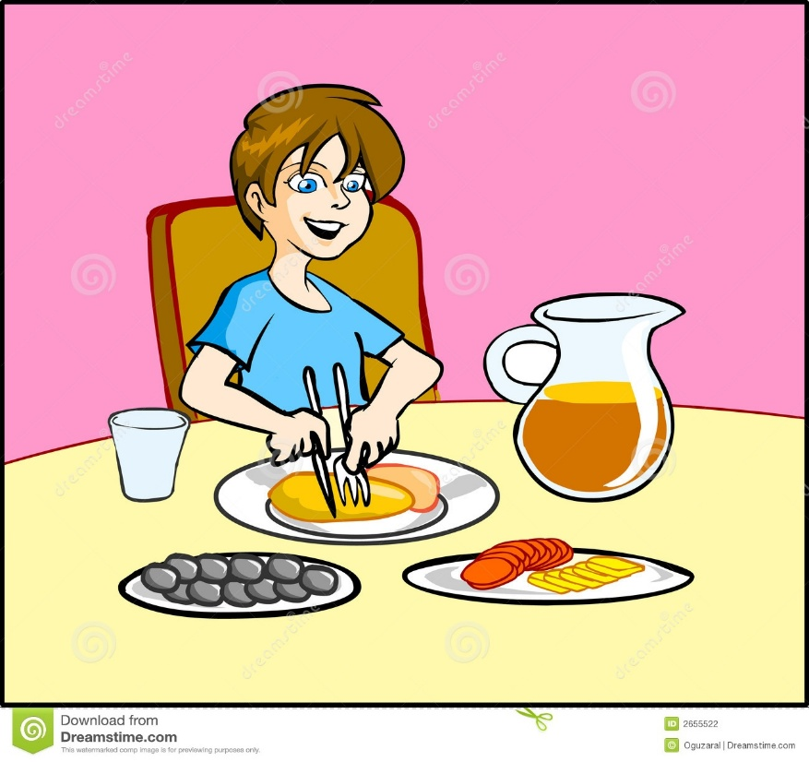
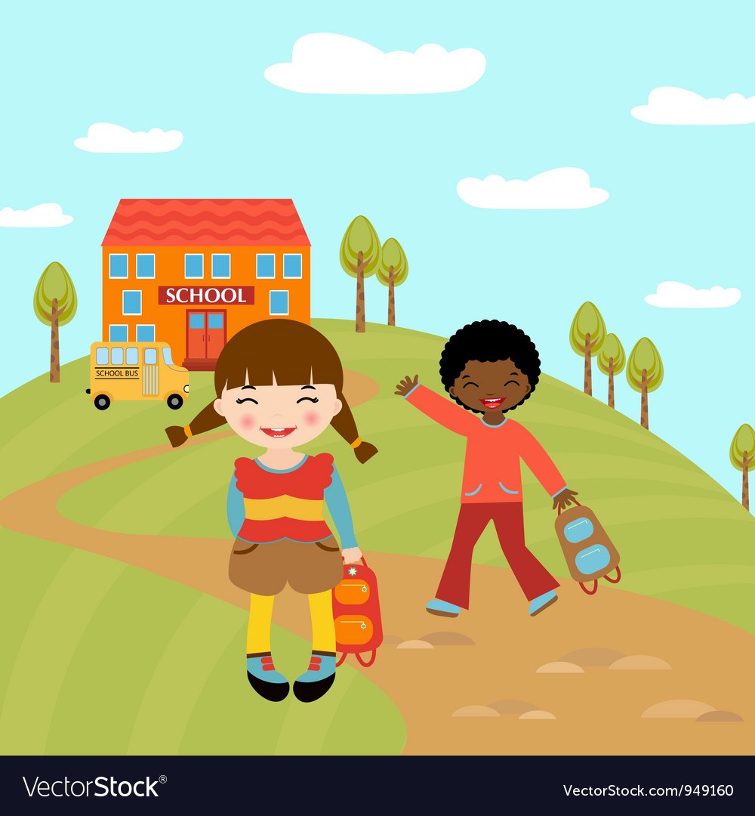
Then,I have breakfast.
Then, I go to school.
After breakfast, I brush my teeth.

Slide 15

Open your book at page - 50
Notes:
Loud reading by the teacher and students.

Slide 16

P W
Match the words and phrases with picture.
Get up
Wash my face
Brush my teeth
Have breakfast

Slide 17
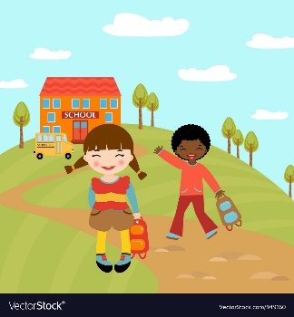
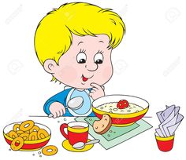
I W
Look at the picture and fill in the gaps.
Go to school
Get up
Have breakfast
Brush teeth

Slide 18
Evaluation
Answer the following questions:-
1.
When do you get up?
Ans. I get up in the morning .
2.
When do you brush your teeth ?
Ans. After breakfast, I brush my teeth.

Slide 19
Home Work
What do you do in the morning?

Slide 20

Thanks to all for today and goodbye.

