Slide 1


WELCOME TO EVERYBODY TO THIS CLASS.

Slide 2



Teacher Identification
Muhammad Mahbubul Alam
Assistant Teacher
Sharaipara Hazi Abdul Ali Government Primary School
Pahartali, Chittagong.

Slide 3

Lesson Identification
Class: Two
Subject: English For Today
Unit: 23
Lesson: 4-6
Part of Lesson: A,B

Slide 4

Learning Outcomes
After completing the lesson the students will be able to:
3.1.1. Understand simple questions and statements about familiar objects.
8.1.1. Ask and answer questions about familiar objects.
1.4.1.To read words and phrases with the help of visual clues and simple sentences.
12.To fill in the simple form.

Slide 5
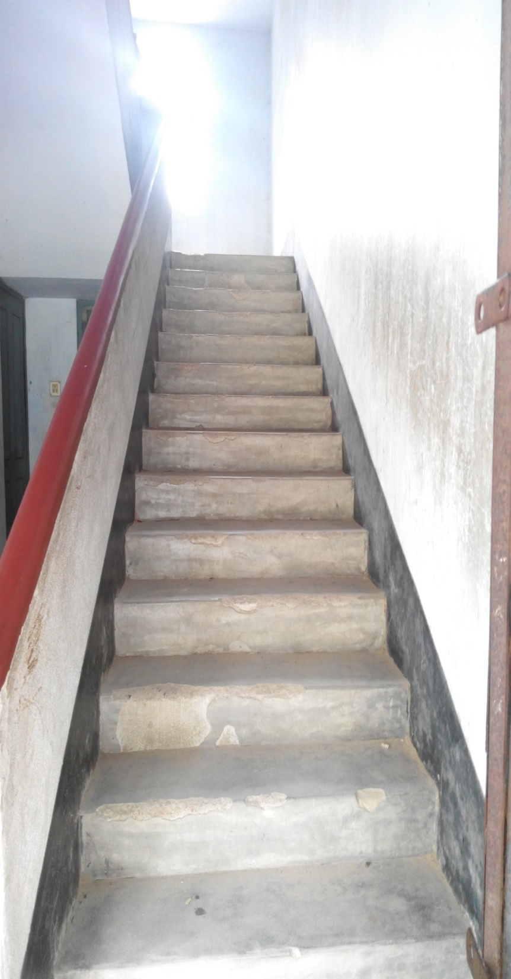

Slide 6
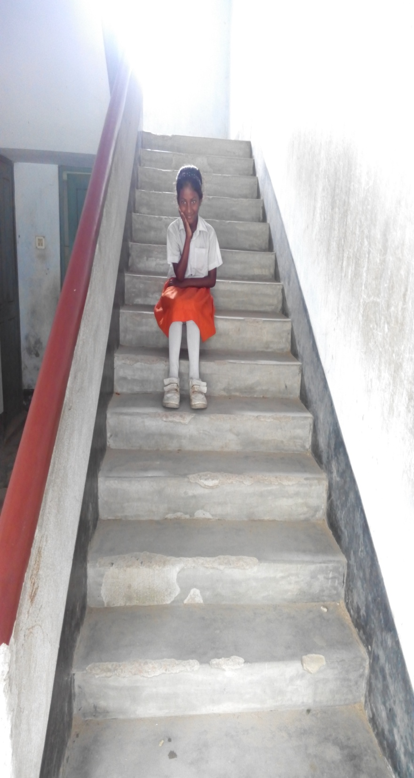
I am not up.
(on)
Where is she?
She is in middle.
(in)
I am not down.
(Under)

Slide 7
Where is it?
By using in, on and under

Slide 8
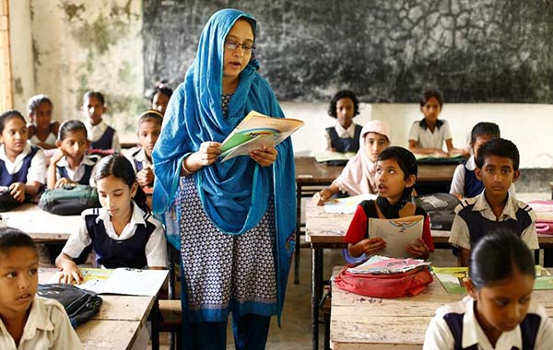
Open at page 47.

Slide 9
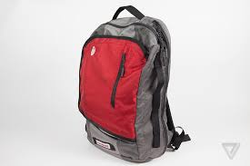

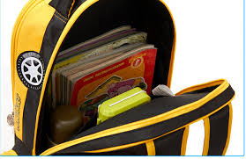
At first only listen
bag
book
on
in
under

Slide 10
Now say after teacher
bag
book
on
in
under

Slide 11
Read these with teacher and than alone
A book
A bag
A book is in a bag
A book is on a bag.
A book is under a bag.

Slide 12

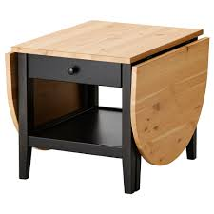
The students will practice again and again with teacher.
Where is the ball?
The ball is on the table.
Where is the ball?
The ball is in the table.
The ball is under the table.
Where is the ball?

Slide 13
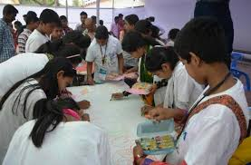
S.1. will ask question and S.2. will answer. S.2. will ask question and S.3 will answer. Like this the process will continue according the next slide

Slide 14

S.1. Where is the doll?
S.2.The doll is on the table.
S.2.Where is the doll?
S.3.The doll is in the table.
S.5.The doll is under the table.
S.4.Where is the doll?

Slide 15
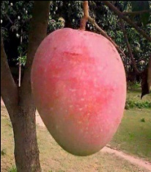

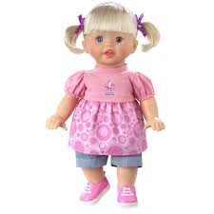
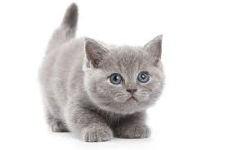
Look at the above pictures and fill in the gaps.
A ball is …………..the table.
A book is ……………the table.
A cat is ……………..the table.
A bag is …………….the table.
A doll is …………….the table.

Slide 16
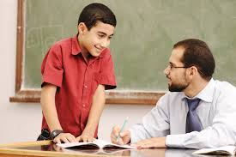

Slide 17

Thanks and good wishes to all.

