Slide 1
Well come all student Today lesson
Good morning

Slide 2
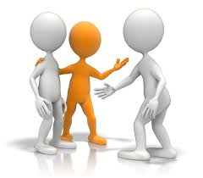
How are you?
Fine, Thank you.
How are you?
Fine, Thank you.

Slide 3
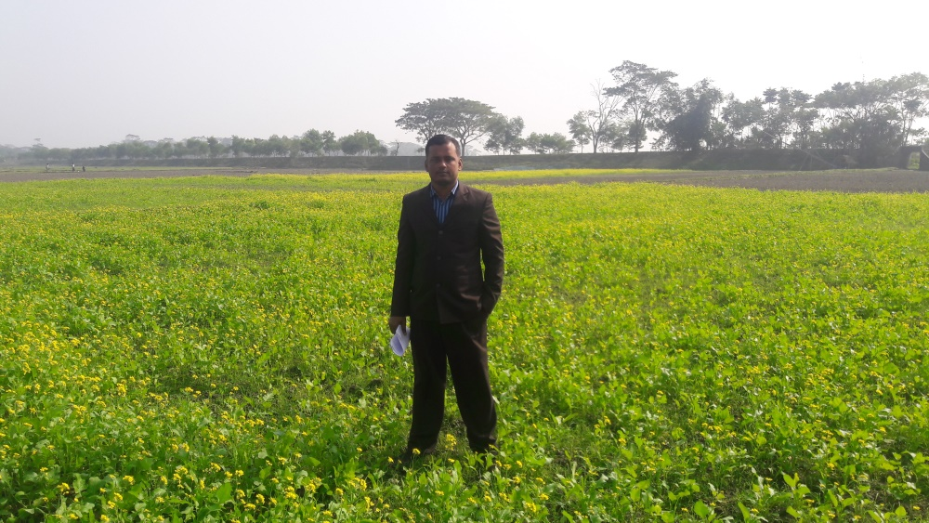
Introduce
Md. Sorfuddin Mridha
Assistant Teacher
41 No Luxmipur GPS
Matlab South, Chandpur
Mobile- 01818-490889
Class-1
Subject: English
Unit: 2
Lesson: 2
Text: B

Slide 4
Learning outcomes
Listening:
1.1.1 :- Become familiar with English sounds by listening to common English words.
3.1.1 :- Understand simple questions about students.
3.2.1 :-Understand simple statements.
Speaking:
1.1.1 :- Repeat after the teacher simple words and phrases.
1.1.2 :- Say simple words and phrases.
2.1.2 :- Bid farewell to each other.
3.1.1 :- Answer questions asked by the teacher about students.

Slide 5
Creating a favorable environment for reading
Let see the video

Slide 6
One day One Word learning activities
Yesterday we learned a word, what is the word? Who can tell me?
Ans: Point
Who can tell the meaning of the word?
অর্থঃ বিন্দু

Slide 7
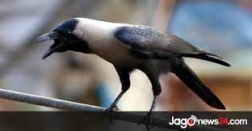
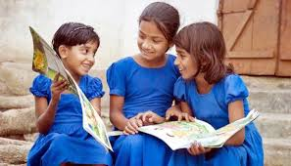
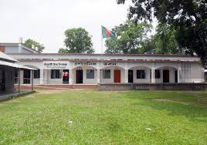
One day One Word learning activities
Today we will learn a new word. Write it down in your note book.
Picture
Who can tell the meaning of the Picture?
Picture অর্থ
ছবি

Slide 8
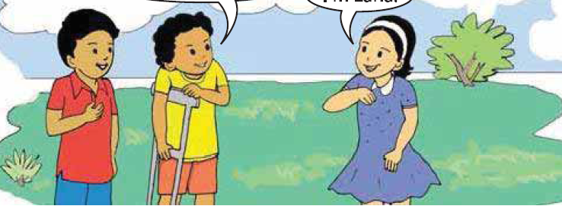
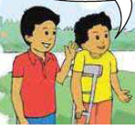
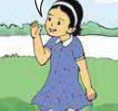
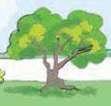
INPUT
Look at the picture. ACTIVITY .B
What can you see in the picture?
Two Boys
A Girl
A Tree

Slide 9
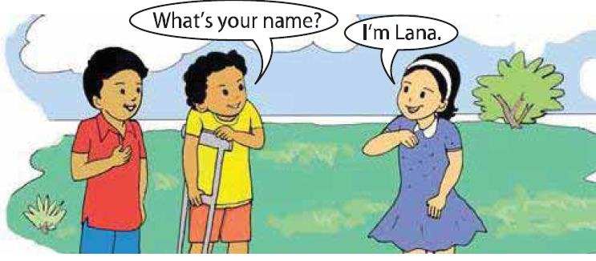
Dear student open your book, Page-4
And listen and Say with me.
At first listen a Audio player.
ACTIVITY .B
Dear student’s “What is” কে সংক্ষেপে বলে
“What’s” এবং “I am” কে সংক্ষেপে বলে “I’m”।

Slide 10
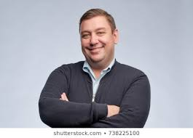
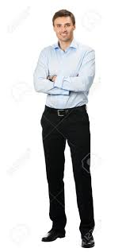
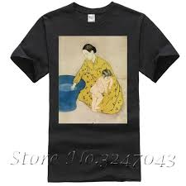
What is
কে সংক্ষেপে বলে
What’s
I am
কে সংক্ষেপে বলে
I’m

Slide 11
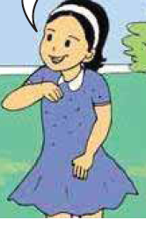
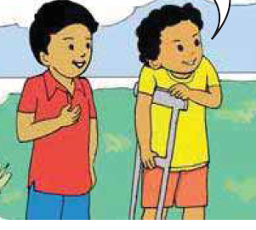
Practice
Now you Speak loudly
I’m Lana.
What’s your name?

Slide 12
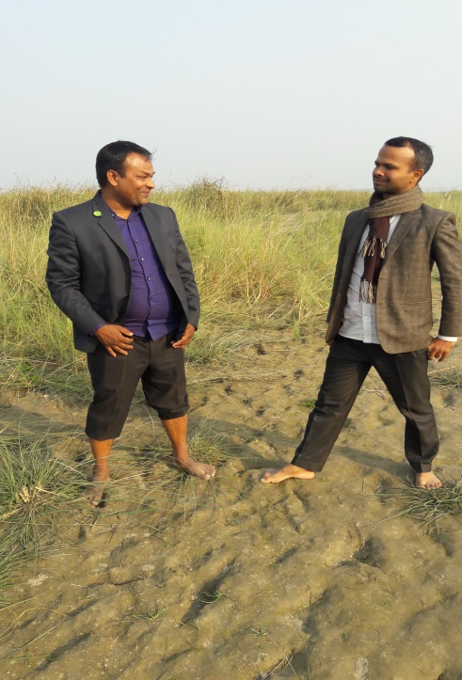
Pair Work:
As you see in the picture below, ask each other questions and answer in pairs.
Now again listen a Audio player.
What’s your name?
I’m Mizan.
I’m Jasim.
What’s your name?

Slide 13
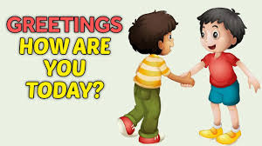
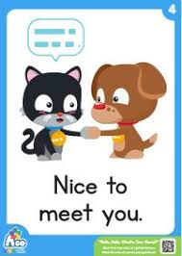
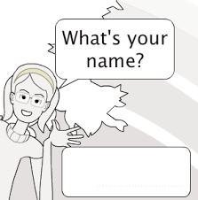
Task/Checking Learning/Assessment
What have we learned today?
Ans: We learn introductions.

Slide 14
What do we say when you meet someone new?
What’s your name?
I’m Fahad.
What’s your name?
I’m Karim.

Slide 15
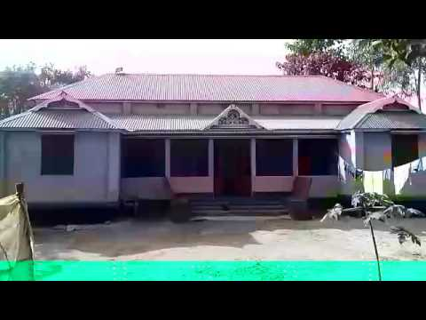
Home work
You will write English A to C Small (a,b & c) and capital (A, B & C) letters handwriting five times from home.

Slide 16
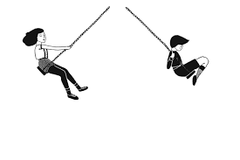
Thanks all students

