Slide 1
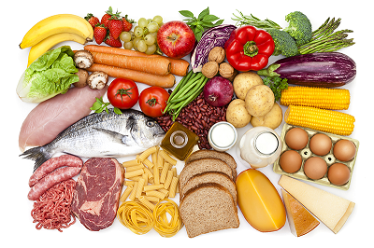
W
E
L
C
O
M
E

Slide 2
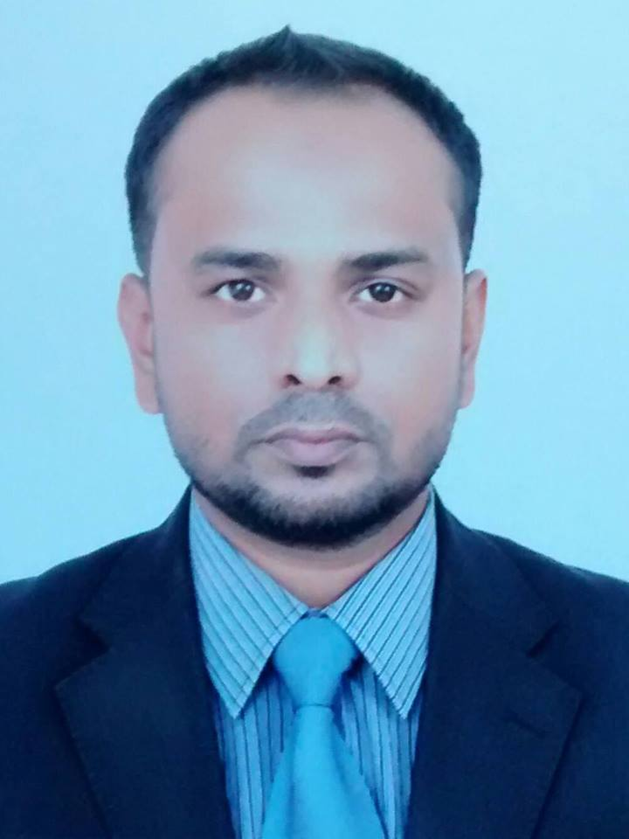
Presented by
Murshed Ahmed Munna
Assistant teacher
Raka Govt. Primary School
Moulvibazar Sadar.

Slide 3
Lesson Introducing
Class: Three
Subject: English
Unit: 27 / Lesson 1
Time: 40 minutes

Slide 4
Learning outcomes
Speaking:
1.1.1 repeat words, phrases and sentences after the teacher with proper sounds and stress.
1.1.2 say words, phrases and sentences with proper sound and stress.

Slide 5

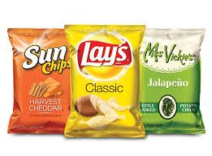
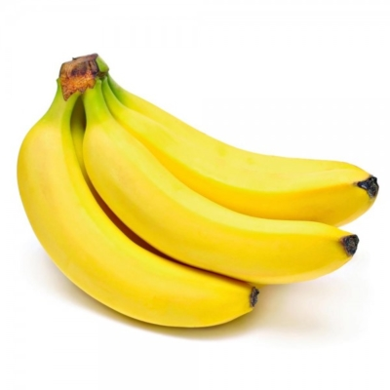


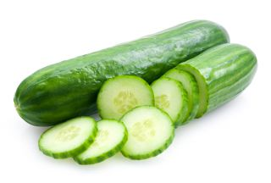

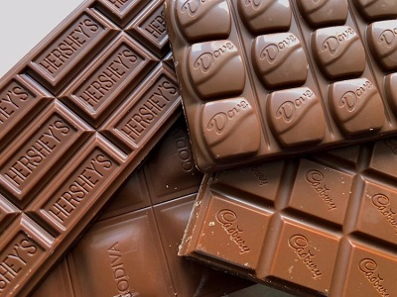
Which food do you like best?
Input

Slide 6
Title declaration
Open your book
Page no: 74
Unit:37
What food should we eat?
Lesson: 1

Slide 7
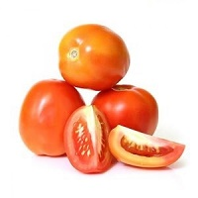
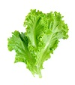
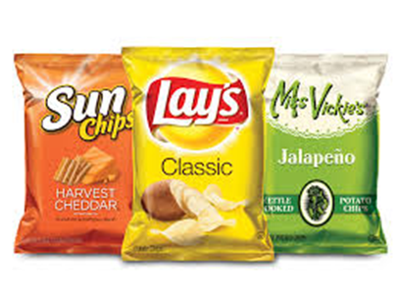
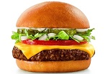
Listen & say
Tomato
Cucumber
Lettuce
Pineapple
Chips
Chocolate
Ice-cream
Burger
Notes:
s

Slide 8
Say with me again
P
R
A
C
T
I
C
E
Tomato
Cucumber
Lettuce
Pineapple
Chips
Chocolate
Ice-cream
Burger

Slide 9
Say with me
Healthy Foods
Unhealthy foods
Tomato
Lettuce
Cucumber
Pineapple
Chips
Chocolate
Ice-cream
Burger

Slide 10
T
A
S
K
To write 3 healthy food items name.

Slide 11
Group Work
Mango group
Write 5 healthy foods name.
Chips group
Write 5 unhealthy foods name.
Banana group
Write 5 healthy foods name.
Burger group
Write 5 unhealthy foods name.

Slide 12
Todays lesson
‘What food should we eat’
We’ve learn
We should eat healthy foods regularly.

Slide 13
Home work
To write 5 healthy food items name what you eat regularly?

Slide 14

Thanks

