Slide 1

Well-come

Slide 2

INTRODUCTION
Name of the topic : Simple,Complex &
Compound.
Class : Nine & Ten
Unit : 07
Lesson : 01
Time : 45 minutes
Md. Norul Haque
Headmaster
Hazi Rahmatullah Forquania High School
South Tengra, Sarulia, Demra, Dhaka. Subject : English

Slide 3
At the end of the lesson :-
The learners will know simple, complex
& compound sentences.
They will form the sentences easily.
They will be able to apply the sentences
in writing.
They will be able to create many
examples.

Slide 4
Sentences are of three kinds according to forms .
They are :
Simple
Compound
Complex

Slide 5
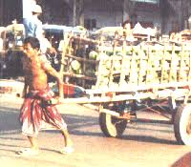
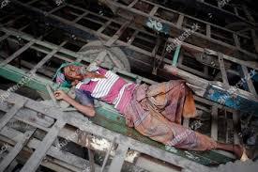
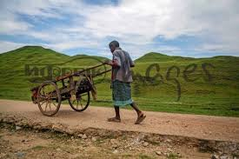
What can you see in the pictures ?
A pushcart works hard.
After working he is sleeping deeply.
He starts for his works to maintain his family.

Slide 6
What can you see in the above sentences ?
Answer : There is a subject and a verb in them .
Such as :
A pushcart works hard.
After working he is sleeping deeply.
He starts for his works to maintain his family.
So, they are called simple sentences.

Slide 7
Group Work
Now, make five simple sentences in which there will be a subject and a finite verb.

Slide 8
What can you see in the pictures?
Though a pushcart works hard, he gets a poor salary.
As he worked hard, he took rest.
He starts for his works so that he can maintain his family.

Slide 9
What can you see in the above sentences ?
Answer : There is a main clause between two or more clauses.
Such as :
1.Though a pushcart works hard, he gets a poor salary.
2. As he worked hard, he took rest.
3. He starts for his works so that he can maintain his family.
So, they are called complex sentences.

Slide 10
Group Work
Now, make five complex sentences in which there will be a main clause between two or more clauses

Slide 11
What can you see in the pictures ?
A pushcart works hard but gets a poor salary.
He worked hard and took rest.
He starts for his works and can maintain his family.

Slide 12
What can you see in the above sentences ?
Answer : There two main clauses using co-ordanating conjunctios like and, but,or etc.
Such as :
1. A pushcart works hard, but he gets a poor salary.
2. He worked hard and took rest.
3. He starts for his works and can maintain his family.
So, they are called compound sentences.

Slide 13
Group Work
Now, make five compound sentences in which there will be two main clauses using conjunctions.

Slide 14
Evaluation
What is a simple sentence ?
What is a complex sentence ?
What is a compound sentence ?

Slide 15

HOME WORK
Make five simple , complex & compound sentences in a paragraph.

Slide 16

Thank You

