Slide 1

WElCOME

Slide 2
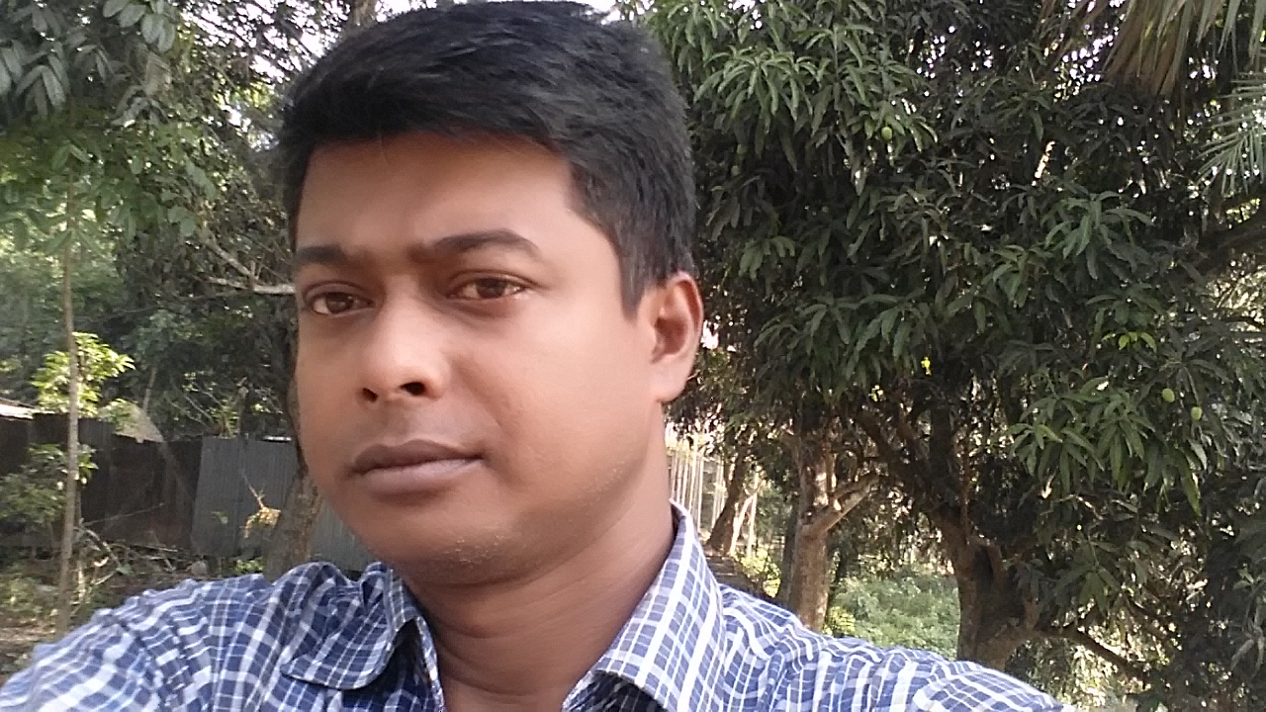
Identity of teacher
MD.TAIBUR RAHMAN
Assistant Teacher
Chowdhury M.H.Girls’ High School,Rajbari

Slide 3
Class Eight
English 2nd Paper
Grammar

Slide 4

Objectives
By the end of the lesson students will---
All the rules of voice.
            Change active into passive voice.

Slide 5

voice

Slide 6

Active voice কে passive voice করার নিয়মঃ
Active voice এর object কে passive voice এ subject করতে হয়।
Subject ও tense অনুসারে সাহায্যকারী verb বসে ।
মুল verb এর past participle form হয় ।
preposition by বসে ।
Active voice এর subject কে passive voice এ object করতে হয়।

Slide 7

Active voice
Passive voice
1. They may help the boy.-------The boy may be helped by them.
2. We can plant trees.--------Trees can be planted by us.
3. I am going to buy a pen.-----A pen is going to be bought by me.
5.You must finish the book.
6. He is going to take many things.

Slide 8

Active voice Passive Voice
5. I saw him crying.------He was seen crying by me.
6. They heard the boy singing.-----The boy was heard singing by them.
7.We saw the boys playing.
8.She heard me reading.
“Present participle”

Slide 9
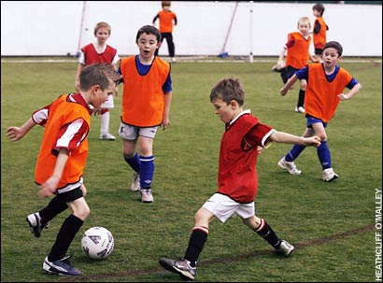
We saw the boys playing.

Slide 10

Active voice -Passive voice
8. A car ran over the old man.-------The old
man was run over by a car .
9. She looks after the baby.------The baby is looked after by her.
He penned through the line.
She looks down upon me.

Slide 11
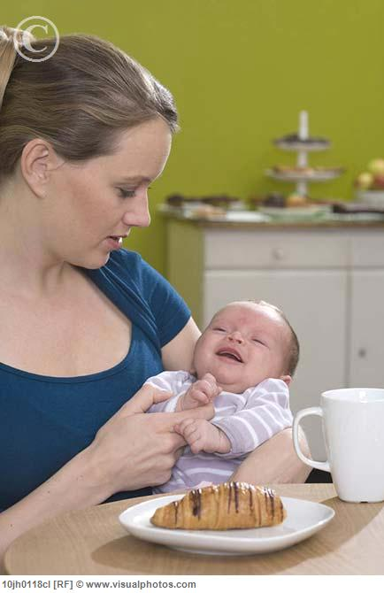
She looks after the baby.

Slide 12
Active voice
Passive voice
I have to do the work. The work has to be done by me.
11. She has to wear cheap dress
Cheap dress has to be worn by her.
12. He has to read many books.
Many books has to be read by him.
13. I have to help my family.
My family has to be helped by me.

Slide 13

Active voice
Passive voice
12. We named her Mithila---She was named Mithila by us.
13. They made me captain.---I was made captain by them.
1 .I called her Mayna.
2. They selected him chairman.
“Factitive Object”

Slide 14
Active voice
Passive voice
14.The food tastes sour.-----The food is tasted sour.
15. The bed felt soft----The bed was felt soft.
16. The book reads well.----The book is well when it is read
1.Rice sells cheap.
2.Sugar tastes sweet.
“Quasi passive”

Slide 15
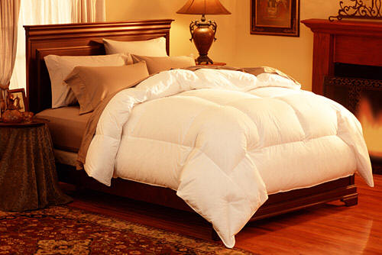
The bed felt soft.

Slide 16

Active voice
Passive voice
17.He fanned himself---He was fanned by himself.
18.We amuse ourselves.----We are amused by ourselves.
1.She deprived herself.
2 Rina cheated herself.
“Reflexive object”

Slide 17
Hometask
1 We may suggest many ideas.
2 The teacher saw her gossiping.
3 I look after the baby.
4 They have to wash dishes.
5 Olive tastes sour.
6 They are going to visit many places.
7 She consoled herself.

Slide 18
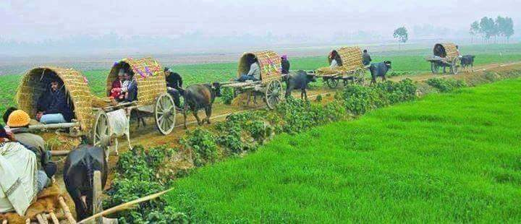
THANKS EVERYBODY

