Slide 1

WELCOME
TO
ENGLISH CLASS

Slide 2

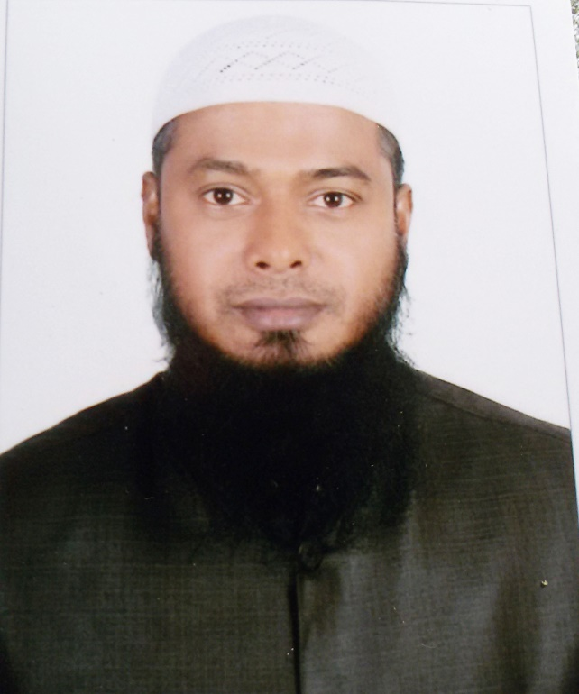
Teacher Identity
MD.TAIBUR RAHMAN
ASSISTANT TEACHER
CHOWDHURY MAHBUB HOSSAIN GIRLS HIGHS CHOOL
GOALANDA,RAJBARI.

Slide 3


Class-Six
English 1st Paper
Time-50 minutes
Lesson Identity

Slide 4

LEARNING OUTCOMES
By the end of this lesson, students will be able to-
1. Ask and answer questions
2. Read and understand text.
3. Participate in dialogues and conversations on familiar topics

Slide 5
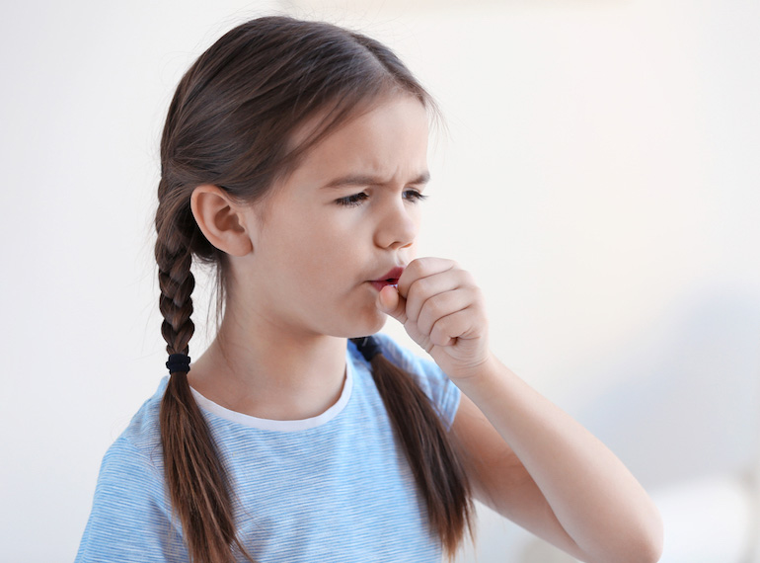
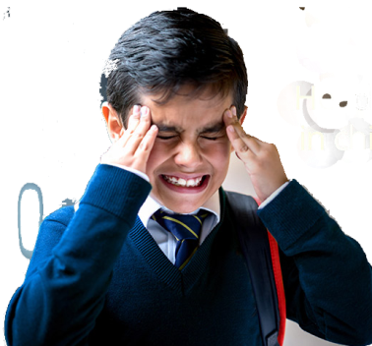
Look at the pictures
Cough
Headache

Slide 6
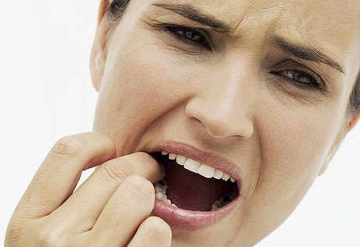
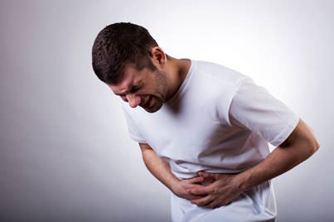
Look at the pictures
Stomachache
Toothache

Slide 7

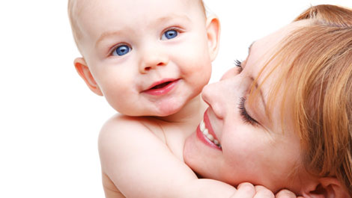
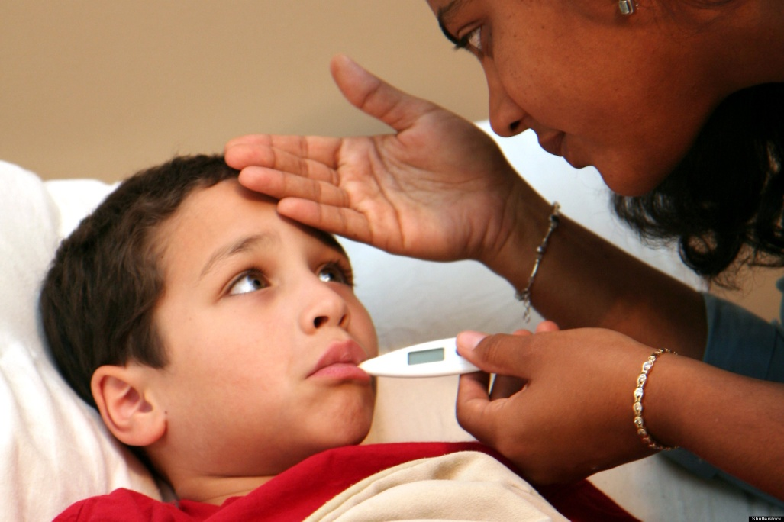
Look at the pictures
Sick baby
Healthy baby

Slide 8
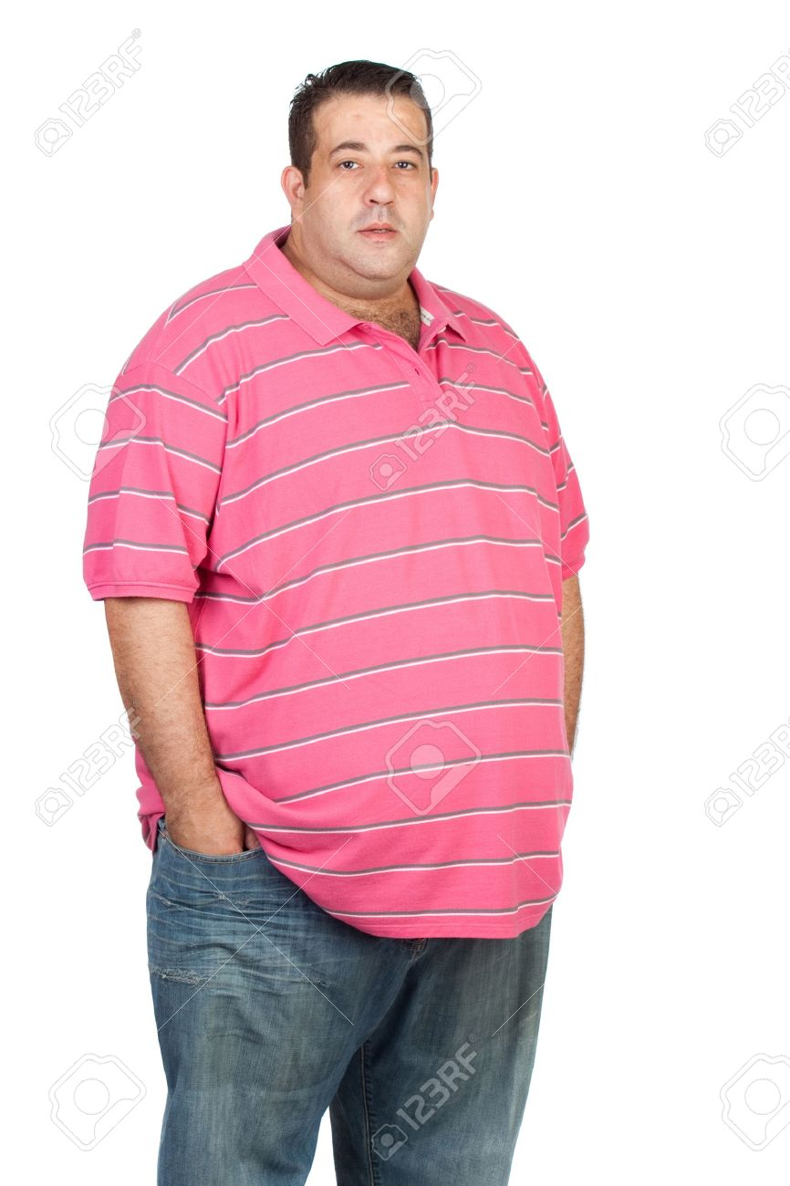
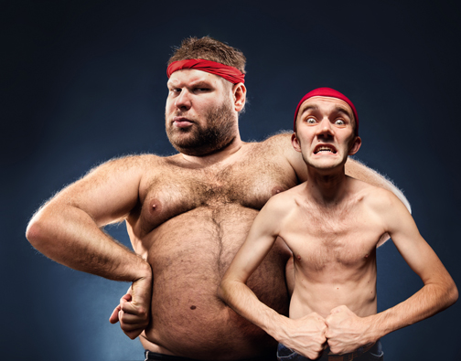
Is he healthy?
Are they healthy?
No, he is not healthy . He is fat

Slide 9


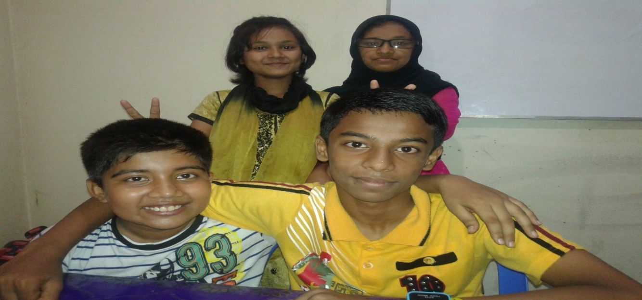
Today's Topic
HEALTH IS WEALTH

Slide 10

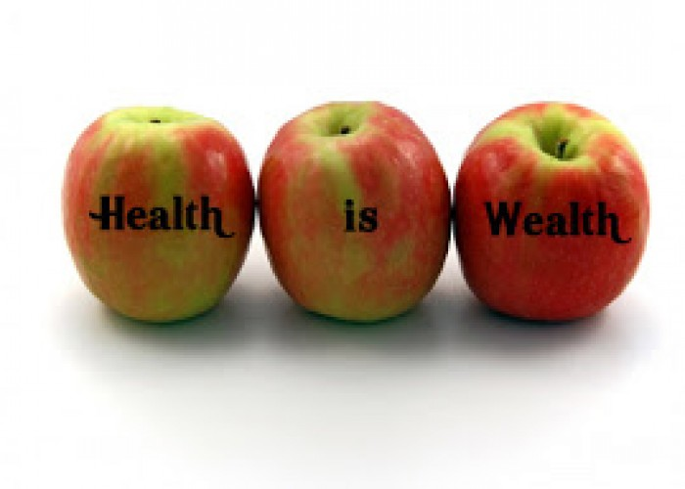
Health
A proverb goes that “Health is Wealth”

Slide 11
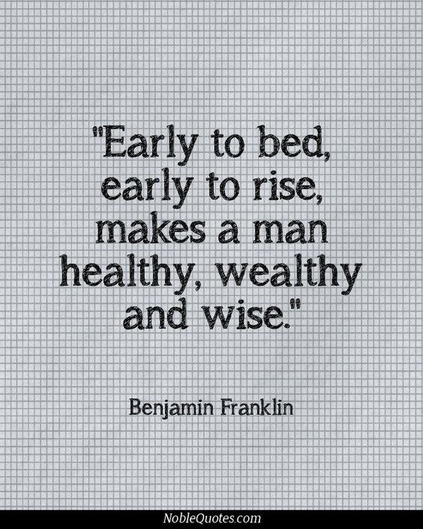
Do you know the old saying about health?

Slide 12
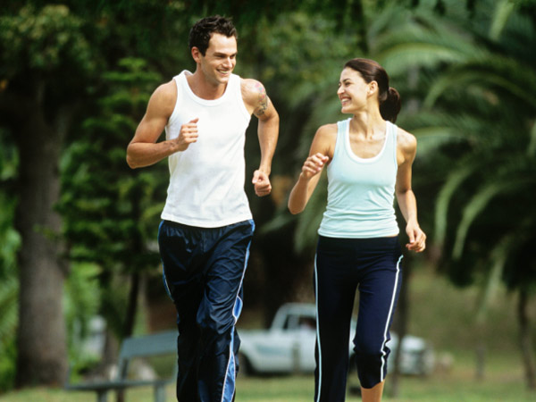

A healthy body is free from diseases

Slide 13
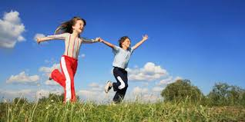
INDIVIDUAL WORK
5 minutes
1. What is health?

Slide 14
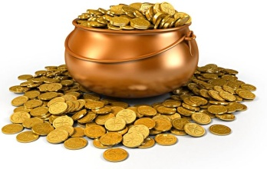
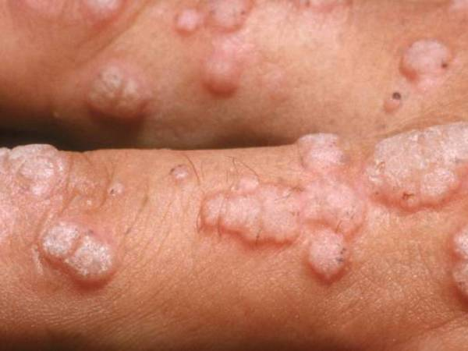
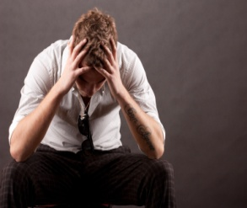
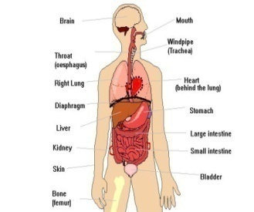
Key Words
Wealth-
Disease-
Anxiety
Organs-
an abundance of valuable possessions or money.
সম্পদ
a particular abnormal condition
রোগ
an emotion characterized
দুচিন্তা
body parts
In biology, an organ is a collection of tissues joined in a structural unit to serve a common function
অঙ্গ

Slide 15
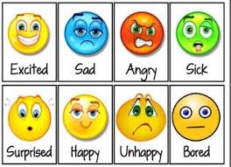
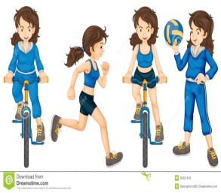

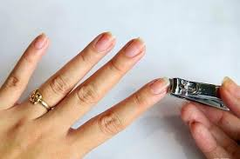
Key Words
Feeling-
Active-
Cheerful-
Hygiene-
an emotional state or reaction.
অনুভুতি
doing things that require physical movement and energy
সক্রিয়
noticeably happy and optimistic.
প্রফুল্ল
Hygiene refers to conditions and practices that help to maintain health and prevent the spread of diseases.
স্বাস্থ্যবিধি

Slide 16

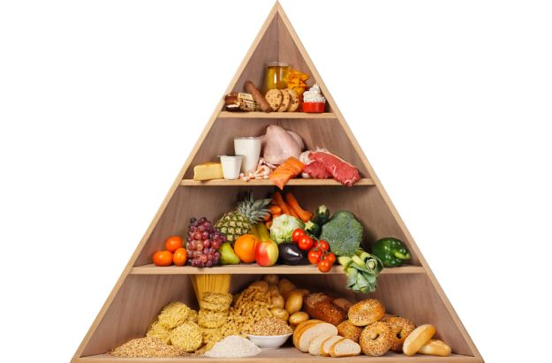
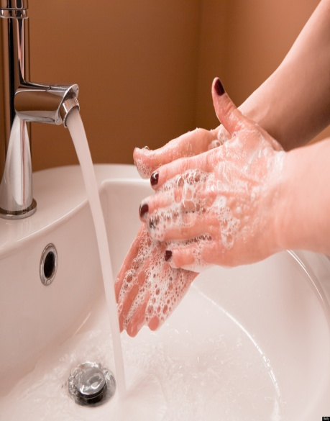
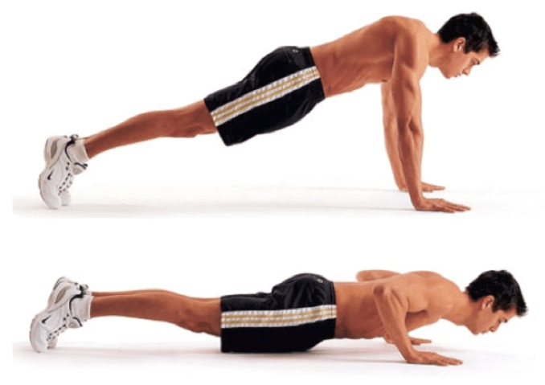
How you can be maintain your good health?
Ans: -
Take a balanced diet
Wash your hands
Cut your nails
Regular exercise

Slide 17
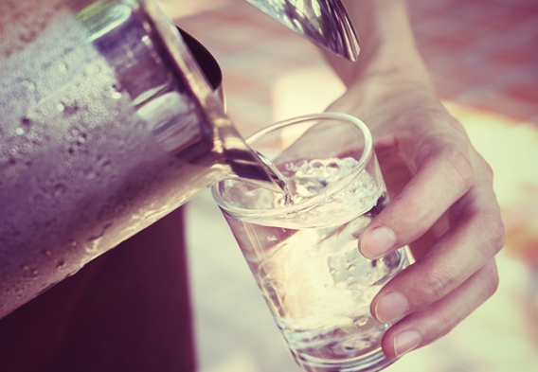
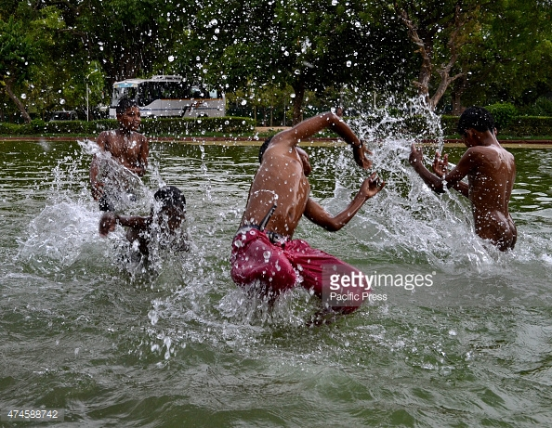
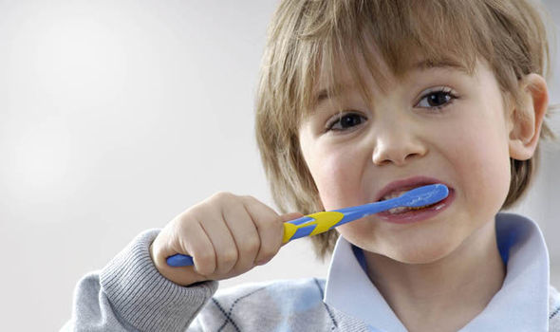

How you can be maintain your good health?
Ans: -
Brush your teeth regularly
Drink clean water
Take regular bath
Proper rest
Get up early in the morning
Should not go to bed lately.

Slide 18

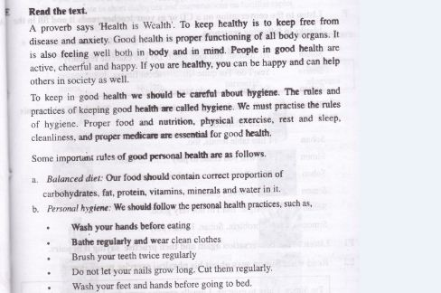
Silent Reading

Slide 19

PAIR WORK
5 minutes
Write down 3 points about maintaining good health.

Slide 20

Group Work
5 minutes
Why is good health is necessary for us?

Slide 21


Evaluation
What is health?
What do you mean by hygiene?
What do you mean by balanced diet?

Slide 22


Home Work
Write five sentences about good health

Slide 23


THANKS
TO
ALL

