Slide 1
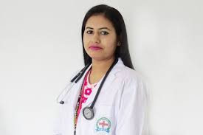
WELCOME

Slide 2


Presented by
MD. AL AMIN
ASSISTANT TEACHER
KAITKUNA GPS
alamin4bd@gmail.com

Slide 3

Introduction of the lesson
Class: Three
Unit: 19
Lesson: 1-2
Time: 35 m

Slide 4
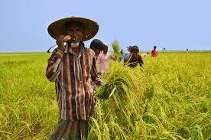
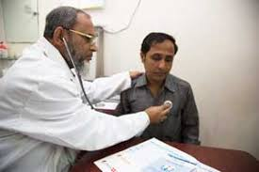
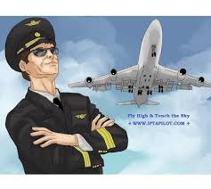
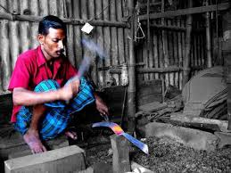
Let’s see some pictures

Slide 5
Do you know about these pictures?
Doctor
Farmer
Pailot
Blacksmith

Slide 6

What do you think today’s lesson might be?
Doctor
Farmer
Occupations
Pailot
Blacksmith

Slide 7
Learning outcomes
By the end of the lesson Students will be able to…
3.1.1 ask and answer Wh-questions.
8.1.1 write words from the textbook or model.
6.1.2 talk about people.
8.1.3 write sentences from the textbook or model .

Slide 8
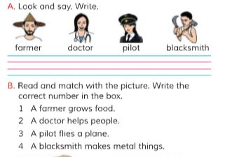
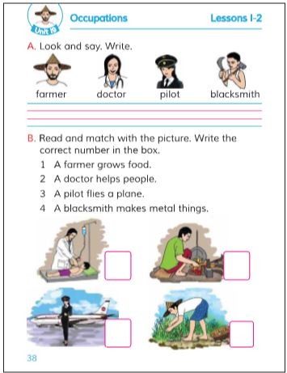
Listen Carefully &
Open Your Book at Page 38
Finger through the line
Notes:
Teachers Reading

Slide 9
What is Occupation?
Occupation is a job or Profession such as Teacher, Doctor, Farmer, Pilot, Driver etc.
Notes:
Stand-up 2 students, say them do the activity.

Slide 10
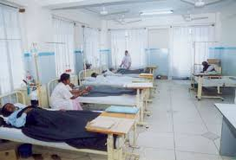
Let’s know them
Doctor
A person who practice medicine.

Slide 11
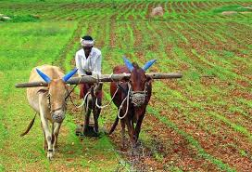
Let’s know them
Farmer
A person who grows crops.

Slide 12
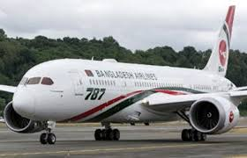
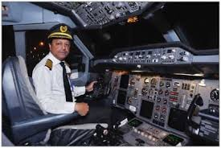
Let’s know them
Pilot
A person who flies a plane.

Slide 13
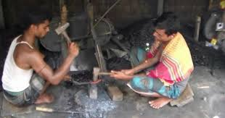
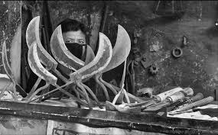
Let’s know them
Blacksmith
A person who makes metal things.

Slide 14
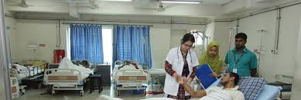
New Words by using picture
New Words | Word meaning
Farmer | Who grows food
Doctor | Who helps people
Pilot | Who flies a plane
Blacksmith | Who makes metal things.

Slide 15
Match the word with the picture
Farmer
Blacksmith
Pilot
Doctor

Slide 16
Let’s Play a Bingo Game
Teacher
Painter
Blacksmith
Driver
Pilot
Doctor

Slide 17
Let’s Spell them
Farmer
F A R M E R
P I L O T
Pilot
Doctor
D O C T O R
Blacksmith
B L A C K S M I T H

Slide 18
Make the sentence with the words
Farmer
A farmer grows food.
Pilot
A pilot flies a plane.
Doctor
A doctor helps people.
Blacksmith
A blacksmith makes metal things.

Slide 19
Ask & Answer
Evaluation
What does farmer do?
Ans:
A farmer grows food.
What does pilot do?
Ans:
A pilot flies a plane.

Slide 20
Ask & Answer
Evaluation
Wat does a doctor do?
A doctor helps people.
What does blacksmith do?
Ans:
A blacksmith makes metal things.

Slide 21


Home Task
Write five sentences about an Occupation you like most.

Slide 22
Time up

Slide 23
Let’s sing goodbye song.

Slide 24




