Slide 1

Good
Morning
Welcome
everybody
to
Multimedia
class

Slide 2


Identity
Nurul Aziz
Assistant Teacher (English)
Krishnakumari City Corporation Girls’ High School,
Nandankanan,Chittagong
E-mail : naziz13.na@gmail.com
Skype: naziz3924
English For Today
Class : 9
Time : 45 Minutes
Date : 19.09.2019

Slide 3

What do you see in the picture?
River erosion due to climate change

Slide 4
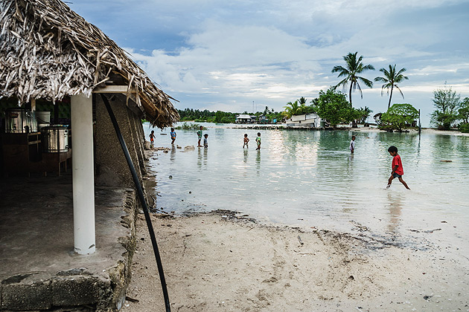
Express your feeling about the picture.
Man is the main victim of climate change.

Slide 5
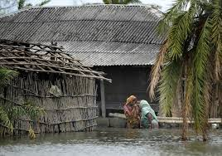
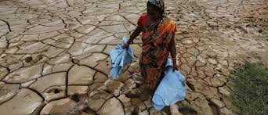
Our today's lesson is
Man and climate
Unit : 5, Lesson: 3
English For Today

Slide 6
Learning outcomes
After the end of the lesson students will be able to
discuss about impacts of climate change on men
Match information in a chart ,
Use synonyms in right place
Write about the importance of trees

Slide 7
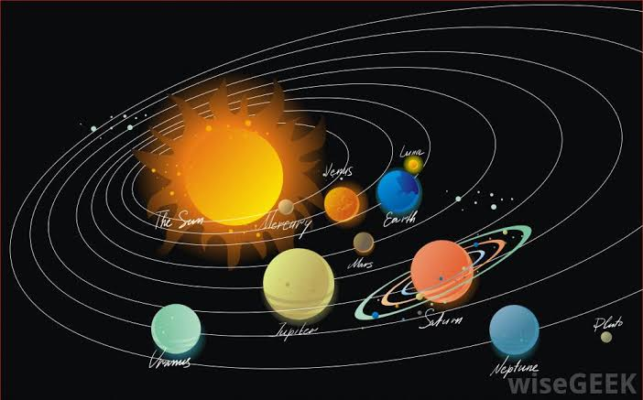
Vocabulary Presentation
Orbit (noun)
a circular path
Syn. Compass
The earth makes an orbit around the sun.

Slide 8
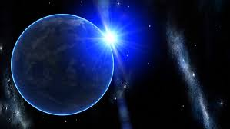
Vocabulary Presentation
Atmosphere
(Noun) The mixture of gases surrounding the earth
Syn. troposphere, airspace
The atmosphere is made up of oxygen.

Slide 9
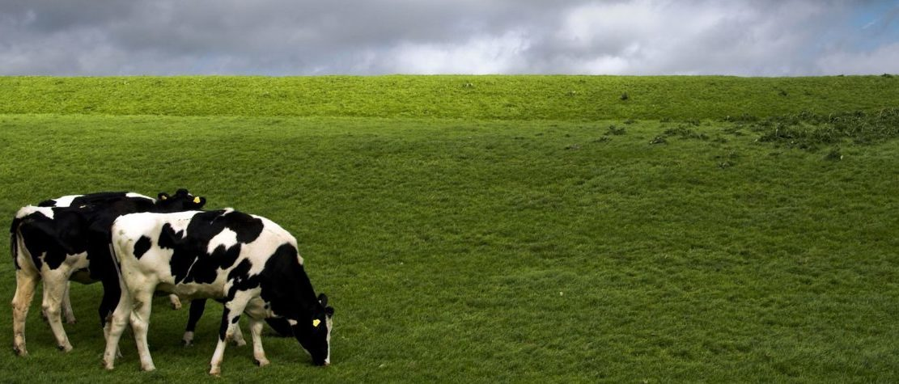
Vocabulary Presentation
Pasture
(Noun) a field covered with grass.
Syn.- grassland, grazing land
The black and white cows are in the pasture.

Slide 10
Pair Work
Match the meanings in column B and the words in column A
A
B
Sun’s radiation
The process used by plants to convert light energy captured from the sun to chemical energy.
Fossil fuels
Energy that transmitted from the sun in the form of rays or waves
Photosynthesis
A basic material or substance used in the production or manufacturing of goods.
Raw materials
Intentional destructions or removal of trees and other vegetations for agricultural, commercial, housing or firewood use.
Deforestation
Non-renewable sources of energy, that come from the remains of plants and animals.
Crude oil
a naturally occurring, unrefined petroleum product that can be refined to produce usable products such as diesel, gasoline, heating oil, jet fuel, kerosene etc.

Slide 11
Pair Work
Match the meanings (answers)
A
B
Sun’s radiation
Energy that transmitted from the sun in the form of rays or waves
Fossil fuels
Non-renewable sources of energy, that come from the remains of plants and animals.
Photosynthesis
The process used by plants to convert light energy captured from the sun to chemical energy.
Raw materials
A basic material or substance used in the production or manufacturing of goods.
Deforestation
Intentional destructions or removal of trees and other vegetations for agricultural, commercial, housing or firewood use.
Crude oil
a naturally occurring, unrefined petroleum product that can be refined to produce usable products such as diesel, gasoline, heating oil, jet fuel, kerosene etc.

Slide 12
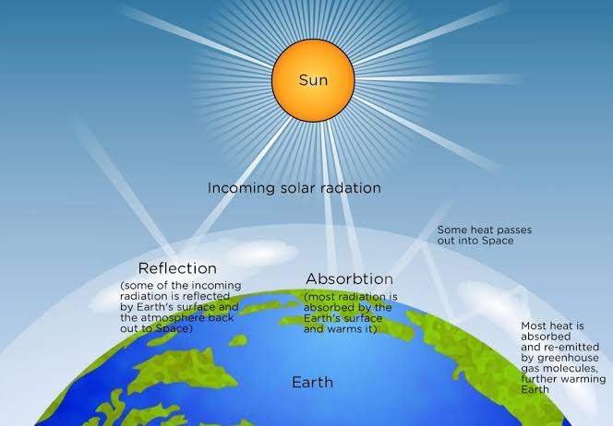
Humans can not change the sun’s radiation.
Notes:
This image refers to line #1 of the seen passage.

Slide 13
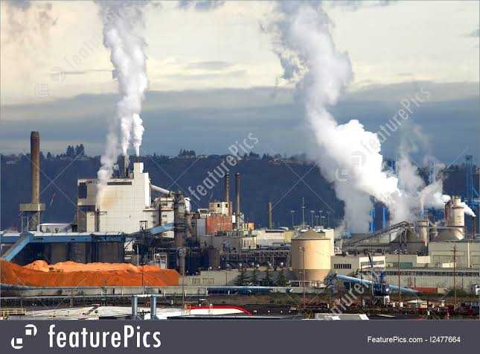
Industries burning fossil fuels.
Notes:
This image refers to the rapid growth of greenhouse gases in the atmosphere and it is related to line # 5 of the seen passage.

Slide 14
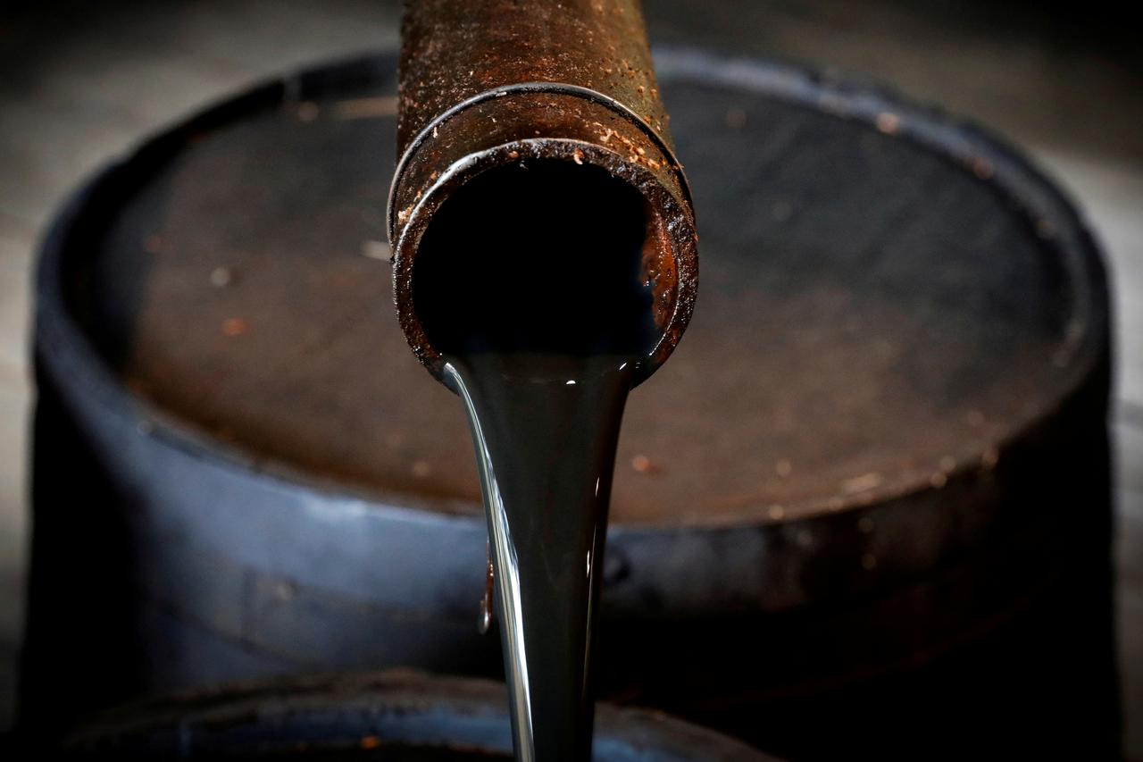
Crude oil
Notes:
This image is taken from the line # 10 of the seen passage.

Slide 15
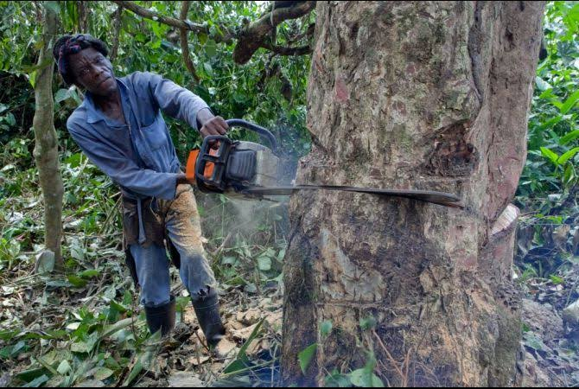
Deforestation
Notes:
This image is related to line # 13 of the seen passage.

Slide 16

Forests are the important storehouse of oxygen
Notes:
The image refers to the concluding sentence of the passage.

Slide 17

Group work
Look at the posters below. They are made to make people aware of the dangers of deforestation. In groups, design a poster to show the dangers caused by deforestation. Then write a slogan for the poster.
Possible answer: “Who want to live? Then let trees live.”

Slide 18
Evaluation
Say if the following sentences are true/false. If false, give the correct information.
1. Fossil fuels are burned at an alarming rate due to industrialization.
2. Coal is the only fuel used for generating energy.
3. At present, nearly 85 million barrels of crude oil are used weekly.
4. Deforestation is caused by nature.
5. Forests help consume carbon dioxide gases from the air.

Slide 19
Answers of evaluation
1. Fossil fuels are burned at an alarming rate due to industrialization. True.
2. Coal is the only fuel used for generating energy. False
Correct answer: Besides coal, other sources of energy such as mineral oil and natural gas are used for generating energy.
3. At present, nearly 85 million barrels of crude oil are used weekly. False.
Correct answer: At present, nearly 85 million barrels of crude oil are used daily.
4. Deforestation is caused by nature. False.
Correct answer: Deforestation is caused by people to obtain wood and clear regions for mining and create pasture.
5. Forests help consume carbon dioxide gases from the air. True.

Slide 20

Home Work
Write a letter to the Editor of a newspaper expressing your concern about growing deforestation in your area.

Slide 21

Thank you all.
See you tomorrow.

