Slide 2
Teacher’s Information
Md. Hasan-ul-Bari
Senior Teacher, Mathematics
Millennium Scholastic School & College
Jahangirabad Cantonment, Bogura.

Slide 3
Lesson’s Information
Class : VIII
Section : Orbit
Chapter : One
Subject : Mathematics
Period : 4th
Date: 11/10/2019

Slide 4
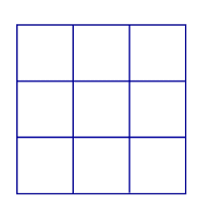
Observe the following figures/Pictures :
Can you tell what type of figures/ pictures are shown above?

Slide 5
Topic = ?
Magic Square

Slide 6
Learning Outcomes / Objectives
At the end of the lesson, the students
will be able to ………..
Define Magic square
Define order of magic square
Find out the magic sum or magic number
Construct the magic square of order 3 & 4

Slide 7
Magic Square: Magic square is an arrangement of integer numbers in the form of a square, where the sum of numbers in each row, each column and each diagonal is the same.
Magic squares were first invented by ancient Chinese founder known as Fuh-Hi in 2800 BC.

Slide 10
Individual Work
Construct a magic square of order-3 starting with any odd number

Slide 11
Magic Number
Formula:

Slide 12
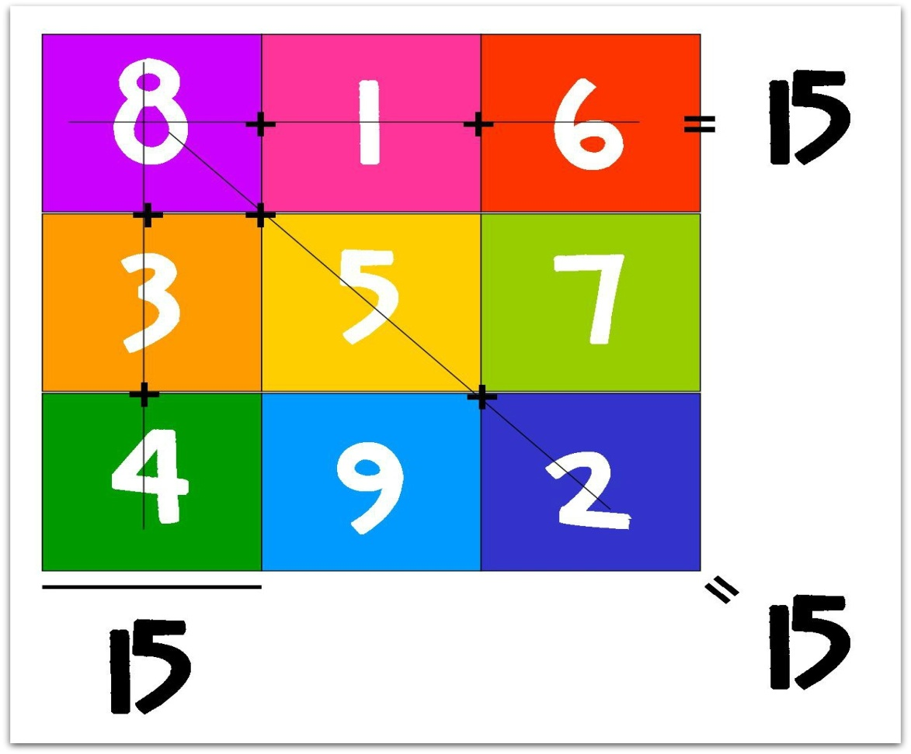
Example of 3 by 3 order magic square:

Slide 13
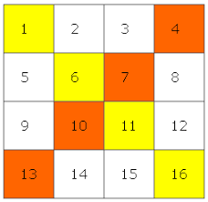
Magic square of order-4:

Slide 14
Group Work

Slide 15
Evaluation
1. What is magic square?
What is the magic sum of order-5?
Construct a magic square of order-4.

Slide 16
Home Work
Construct a magic square of order-3, starting with 5 and also find the magic sum.

