Slide 1

Welcome

Slide 2
Teacher Identity
Md. Mamunur Rashid
Assistant Teacher.
Boro pir Mohiuddin Govt. primary School,Mithapukur,Rangpur

Slide 3
Subject Identity
Subject:English
Class :Five
Unit:15,Lesson: 1
Happy birthday
Time:40 Minute.
Date:15/09/2019.

Slide 4
Learning Outcomes
By the end of the lesson Students Will be able-
How to celebrate Birthday party.
Correct pronunciation.
Know new Words.

Slide 5
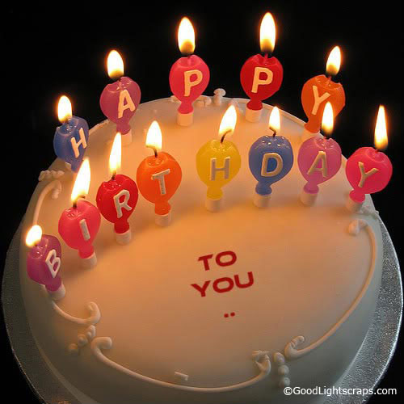
Let us see some picture

Slide 6
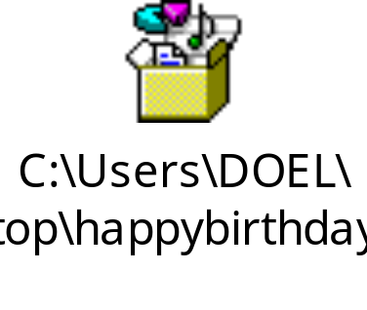
Let us see a video

Slide 7


Slide 8
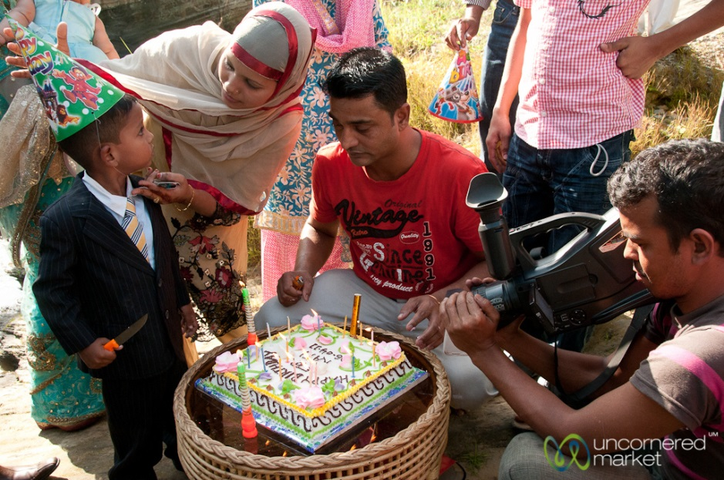

Slide 9
New Word
Memorable-স্মরণীয়,
Life-জীবন, Born-জন্ম
Around- চারিদিকে
Enjoy-উপভোগ করা
Candle-মোমবাতি

Slide 10
Teacher reading
A birthday is a ………..
………….different ways

Slide 11
Open the book
Page no 58..

Slide 12
Student indevisual reading.
A birthday is a ………..
………….different ways

Slide 13
Group work
1.Sing birthday song.
2.Play a game.
3.How to lit on candle ?

Slide 14
Evaluation
1. What is birthday ?
2. How can we celebrate this day ?

Slide 15

Thank you

