Slide 1


Slide 2
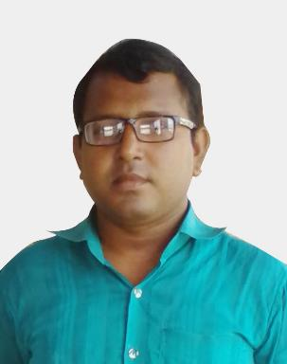
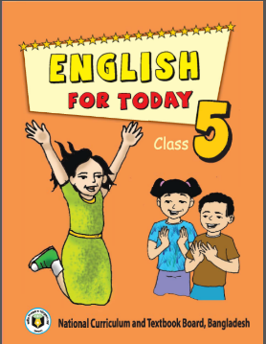
Md. Rejaul Hasan Assistant Teacher
Adampur Govt. Primary School
Austagram, Kishoreganj
Email: rejaul.hasan78@gmail.com
Class: Five
Sub: English for Today
Unit: 3
Time: 40 Minutes

Slide 3
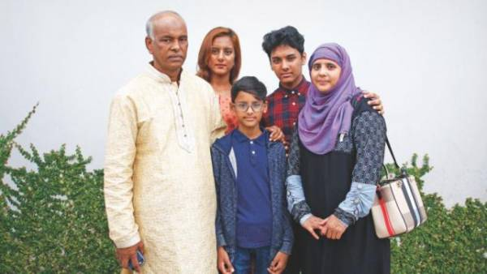
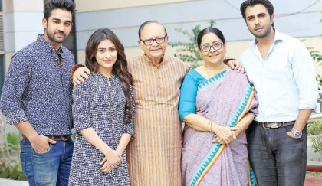
What are you seeing in the picture?
Family

Slide 4
Our today’s lesson is-
Saikat’s family

Slide 5
Learning outcomes: Student will able to
Listening:
1.2.1 recognize which syllable in a word is stressed.
1.3.1 recognize which word in a sentence are stressed.
1.4.2 recognize and use intonation patterns for greetings and statements.
Speaking:
1.1.1 say words, phrases and sentences with proper sound and stress.
1.1.2 say sentences with proper intonation.
Reading:
1.5.1 read words, phrases and sentences in the text with proper pronunciation, stress and intonation.
5.1.1 read silently with understanding paragraph.

Slide 6
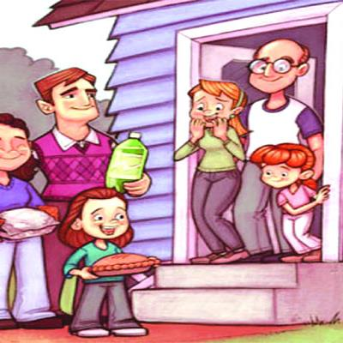
Banker Housewife Sewing Neighbors Improve Animal Especially
Key words
প্রতিবেশী (A person who lives near another.)
Helps first come from neighbor.

Slide 7
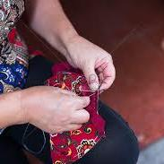
Banker Housewife Sewing Neighbors Improve Animal Especially
Key words
সেলাই করা (Needle Work)
My mother is sewing a shirt

Slide 8
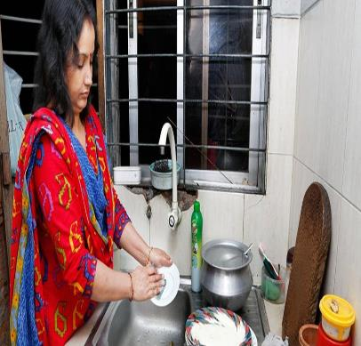
Banker Housewife Sewing Neighbors Improve Animal Especially
Key words
গৃহিনী (a woman who works in home)
My mother is a house wife.

Slide 9
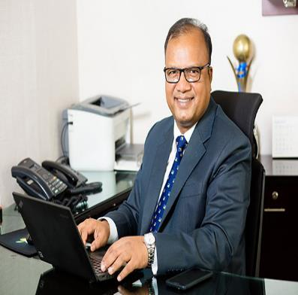
Banker Housewife Sewing Neighbors Improve Animal Especially
Key words
SonaliBank
ব্যাংককর্মী (a person who works in a bank.)
My father is a banker.

Slide 10
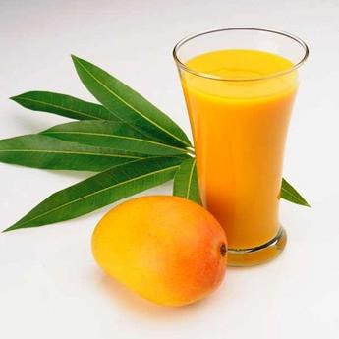
Banker Housewife Sewing Neighbors Improve Animal Especially
Key words
বিশেষত (particularly.)
I like juice especially mango juice.

Slide 11
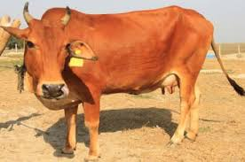
Banker Housewife Sewing Neighbors Improve Animal Especially
Key words
প্রাণী (beast)
The cow is a useful animal.

Slide 12

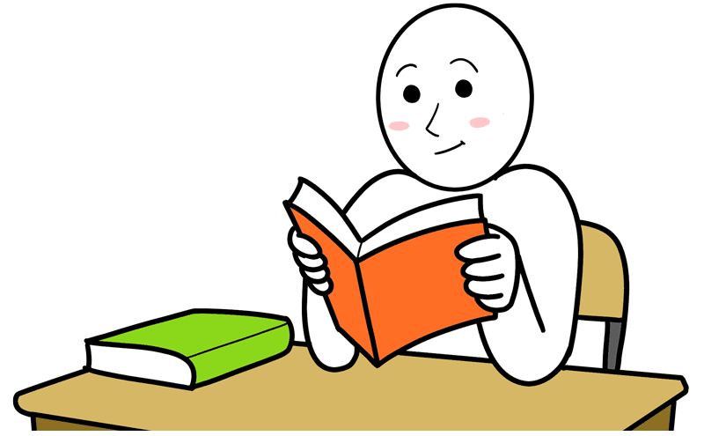
Banker Housewife Sewing Neighbors Improve Animal Especially
Key words
উন্নত করা (better)
I want to improve in English.

Slide 13

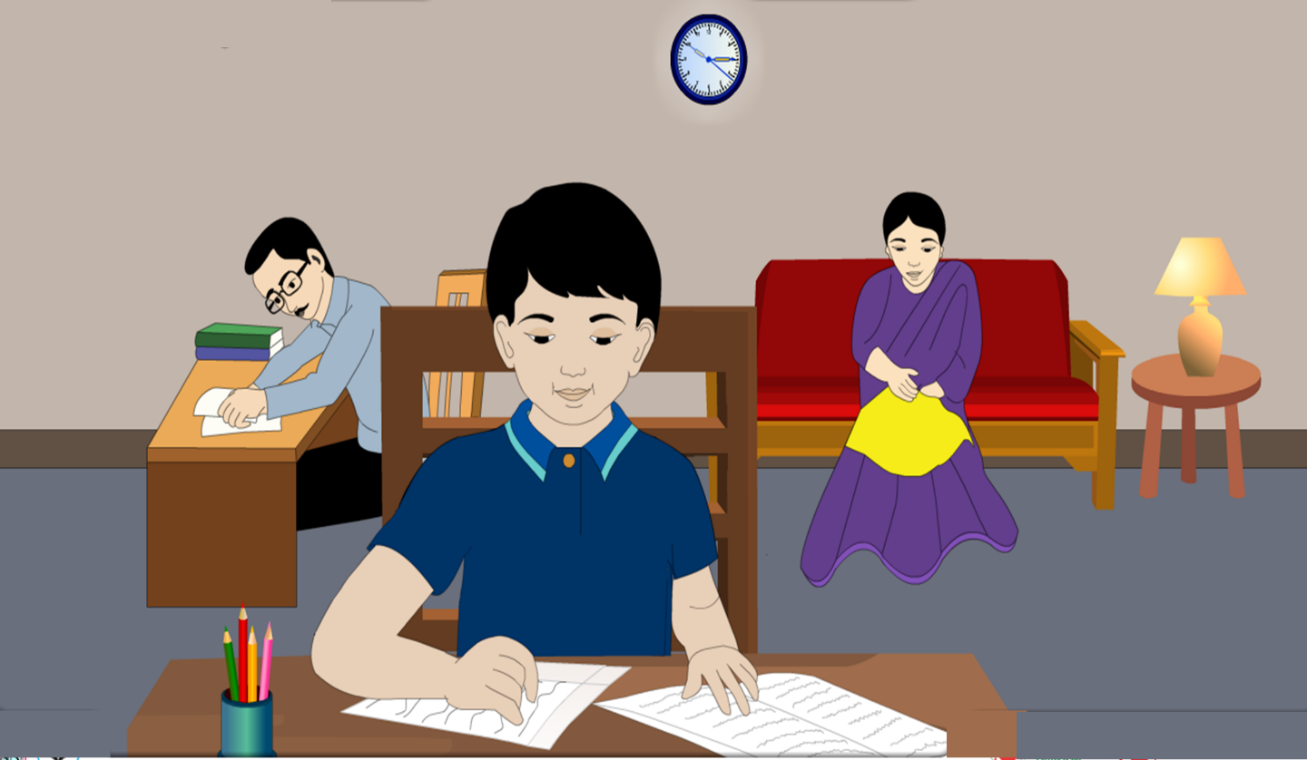


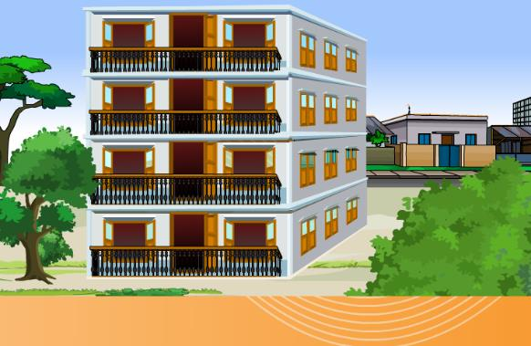
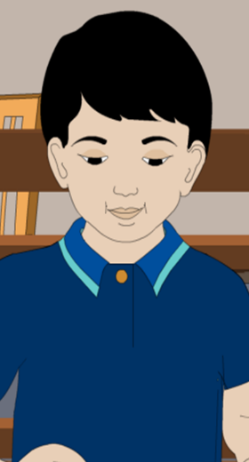
Saikat Islam lives with his parents in a flat in Bogra.
His father Mr. Rashidul Islam is a banker.

Slide 14
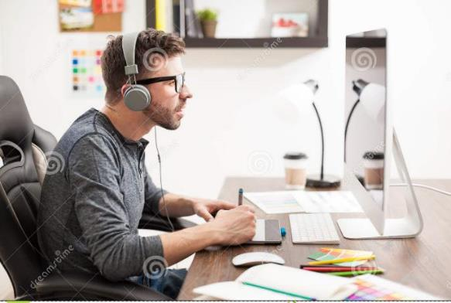
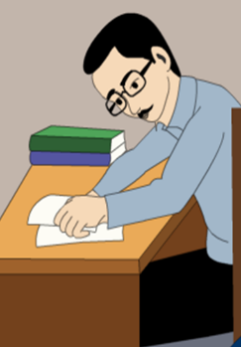
But in his free time Mr. Islam writes stories and listens to music.

Slide 15
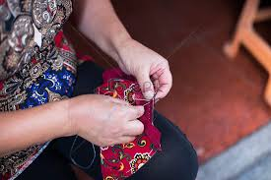

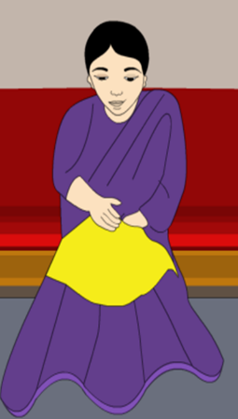
Saikat mother is Mrs. Monowara Islam.
She is a house wife.
In her free time she enjoys sewing. She makes dresses.
She often gets order from her friends and neighbours.

Slide 16
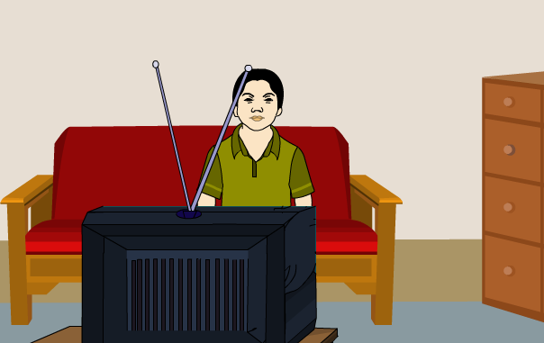
Saikat is in class 5. He is a good student.
He wants to improve his English,
so he watches cartoon on TV everyday.

Slide 17
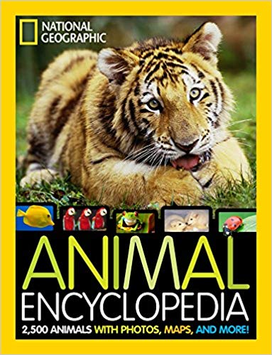
He also read English books.
He likes books about animals, especially tiger and lions.

Slide 18
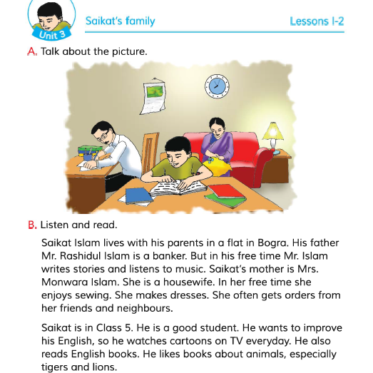
Open your book page no. 10 and read loudly

Slide 19
Individual work
Answer the following questions:
What is Saikat’s father’s name?
What is Saikat’s mother name?
Whats do his parents to in their free time?
What kind of books does Saikat like?

Slide 20
Open your book page no. 10 and read silently.

Slide 21

Group work
Evaluation
Fill in the blanks with the suitable words.

Slide 22
Home work
Write a short paragraph about your family at least five sentences.

Slide 23

Good bye

