Slide 1
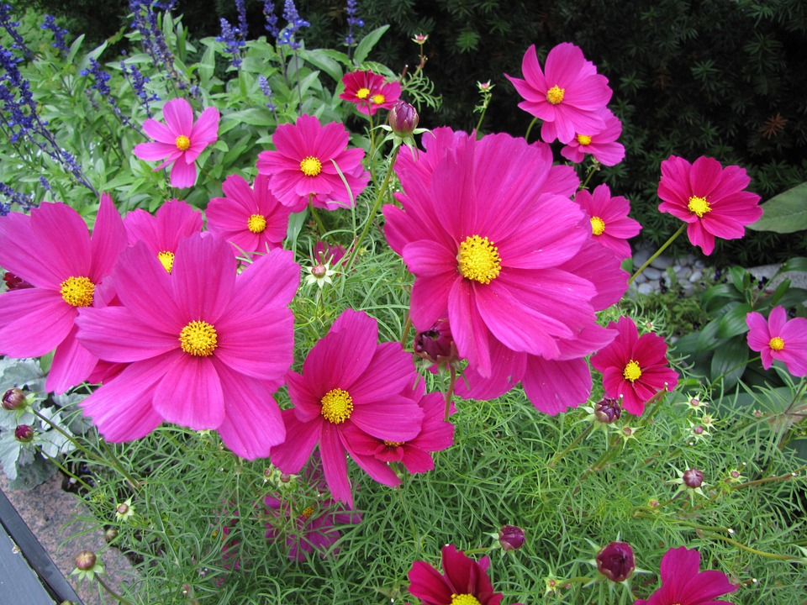
স্বাগতম

Slide 2
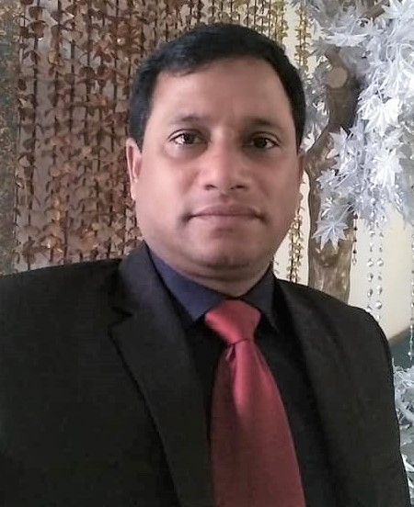
পরিচিতি
মোঃকামাল উদ্দিন
সহকারি শিক্ষক(গণিত)
শ্রীমঙ্গল সরকারি বালিকা উচ্চ বিদ্যালয়,
Mob : 01712885501

Slide 3
Please follow the following green picture.
What is it?
How many sides of it?
Area of it?
How to find area?
AB
BC
CA

Slide 4
Area of Triangles.
Todays LESSION is

Slide 5
After the end of class…
1.Can tell the law of the area of triangles.
2. Can find the areas of the triangles.
3. Can tell the differences of varioues tringles

Slide 6
Let us find out the area of triangle ABC.
A
.
AB
BC
h
CA
AD
B
C
D
Area of a triangle =

Slide 7
Let us find out the area of triangle ABC.
Unit Work
A
.
AB
BC
20 m
CA
AD
36m
Area
B
C
D
Area of a triangle = sqm
= 360 sqm

Slide 8
The area of an equilateral triangle ABC.
A
.
AB
BC
CA
Area
B
C
Area of a triangle =

Slide 9
Pair work
The area of an isoscale triangle ABC whose side 16 m.
A
AB
.
BC
16m
16m
CA
Area
B
C
16m
Area of a triangle

Slide 10
A scalene triangle of sides a , b and c .
A
AB
a
c
BC
CA
C
B
b
Area
Where S = (a + b + c )/2
Area = s(s-a)(s-b)(s-c)

Slide 11
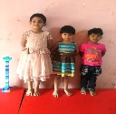
Group work
A scalene triangle of sides 10m, 12 m and 16 m .Find the area of it.
A
AB
a
c
BC
CA
B
b
C
Where
a = 10m, b = 12m , c = 16m
Area
S = (a + b + c)/2 = (10 + 12 + 16 )/2 m = 19 m
Area = 19(19-10)(19-12)(19-16)

Slide 12
A Multilateral triangle of sides 10m, 12 m and angle of them is 30 degree.
Group work
A
AB
a
c
BC
CA
θ
B
C
b
Where
a = 10m, b = 12m θ = 30 degree
Area
Area = ½ ab Sinθ

Slide 13
A Multilateral triangle of sides 10m, 12 m and angle of them is 30 degree.
Group work
A
AB
a
c
BC
CA
θ
B
C
Where
a = 10m, b = 12m θ = 30 degree
b
Area = ½ ab Sin30⁰
= ½ ×10×12× ½ m²
= 30 m²
Area

Slide 14
Recap
3. Area of a triangle =
6
1. Area of a scalene triangle =
8
10
2. Area = s(s-a)(s-b)(s-c)
Whrer ,S = (a + b + c )/2
13
4. Area = $\frac{1}{2 }$ab sinθ

Slide 15
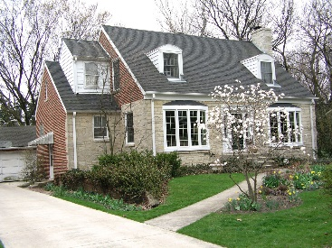
HOMEWORK
1. An equilateral triangle of 4 m. Find the area of it.
2. Two sides of a triangle are a=12m , b=20m and angle between them is 60 degree. Find the area of it.
3. Tree sides of a triangle are a=12m , b=20m and c= 12m. Find the area of it.

Slide 16
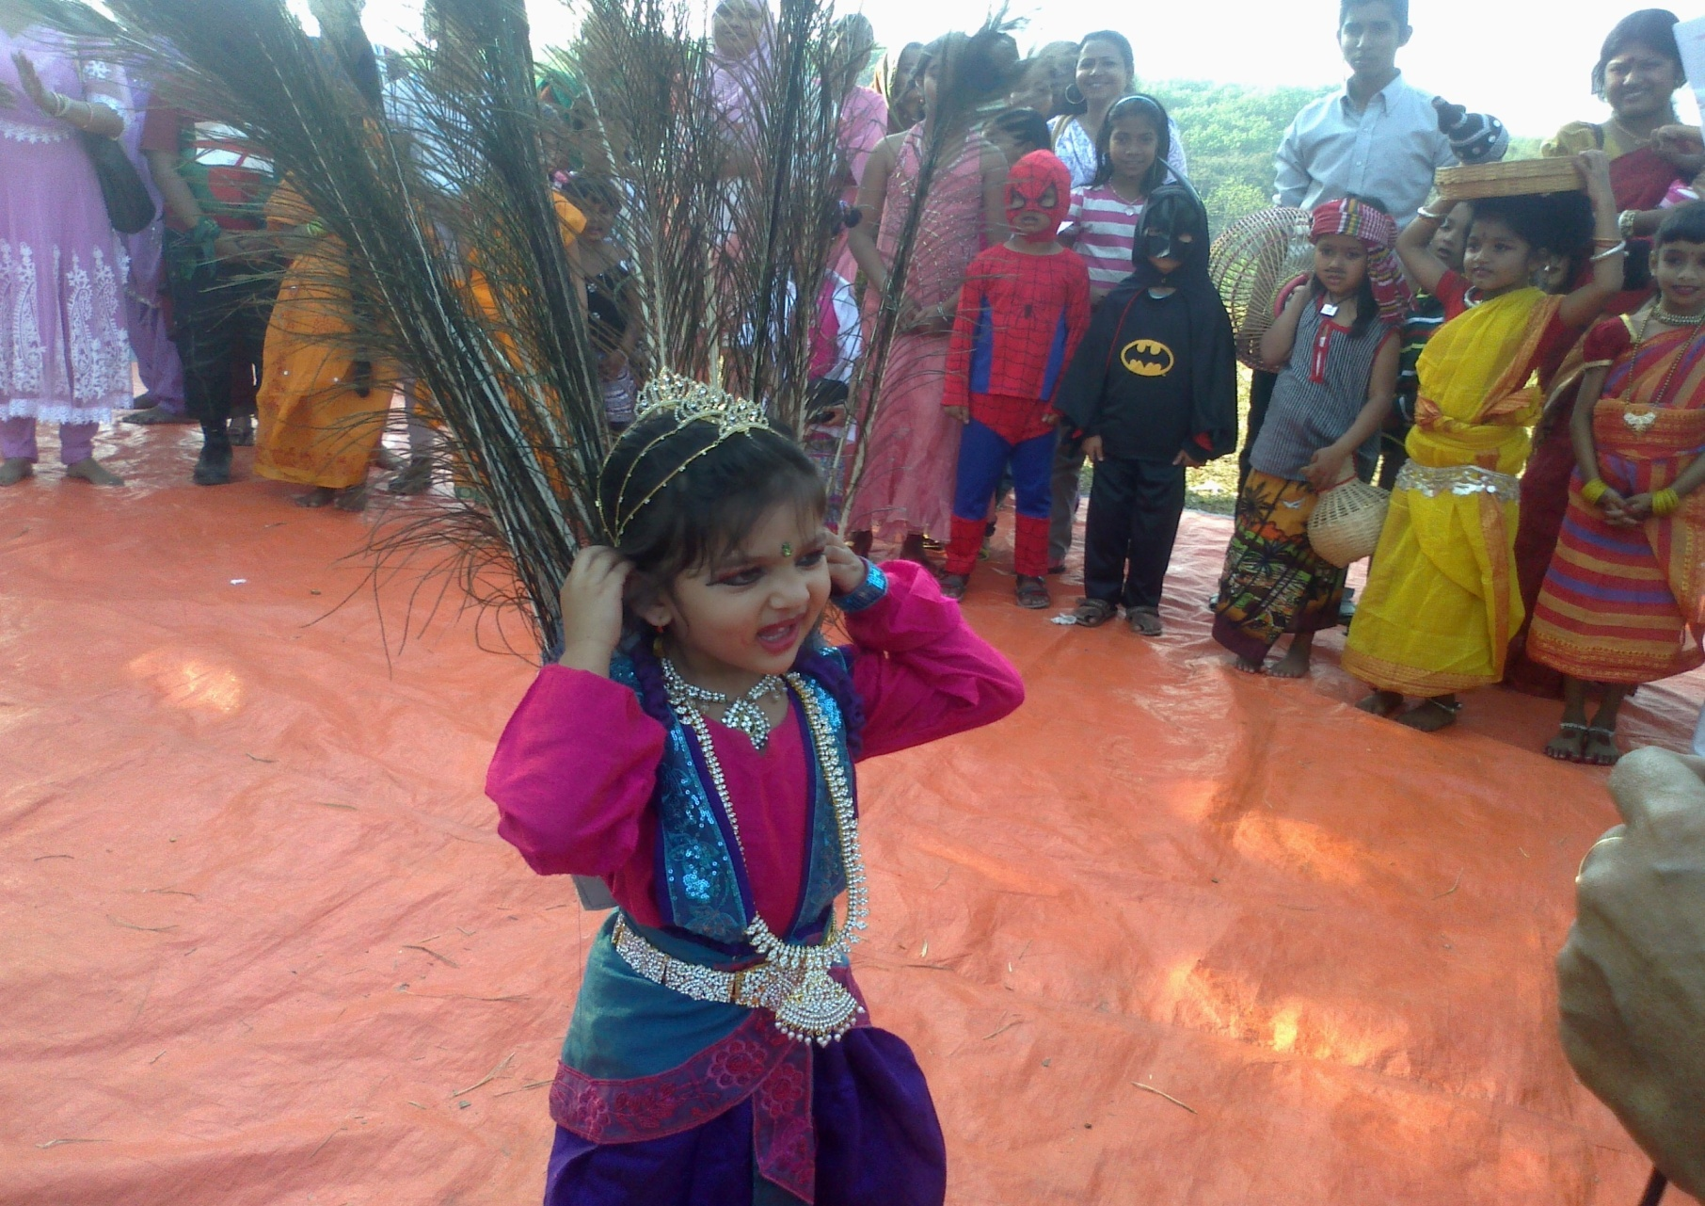
THANKS

Slide 17
