Slide 1

Welcome

Slide 2

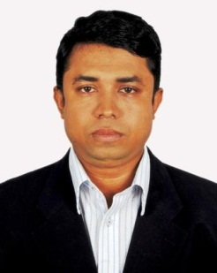

Teacher Identification
Muhammad Mahbubul Alam
Assistant Teacher
Sharaipara Hazi Abdul Ali Government Primary School
Pahartali, Chittagong.

Slide 3
Introduction of the lesson
Class:Two
Unit:22
Lesson:1-3
Time:40 minutes

Slide 4
Song
Good morning, good morning .
How are you today ? I am fine ,I am fine . I wish you a good day.

Slide 5
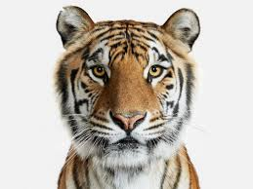
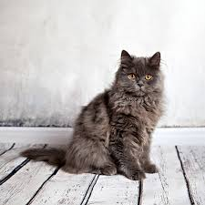
Title of the lesson
Sizes

Slide 6
Learning Outcomes
By the end of the lesson the students will be to able -
1.Become familiar with English sounds by listening to common English words.
2.Repeat after the teacher simple words and phrases with proper sounds and stress.
3.Say simple words and phrases with proper sounds and stress.

Slide 7


Big
Small

Slide 8
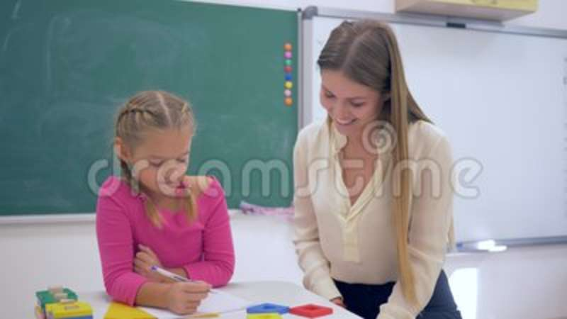
Short
Tall

Slide 9
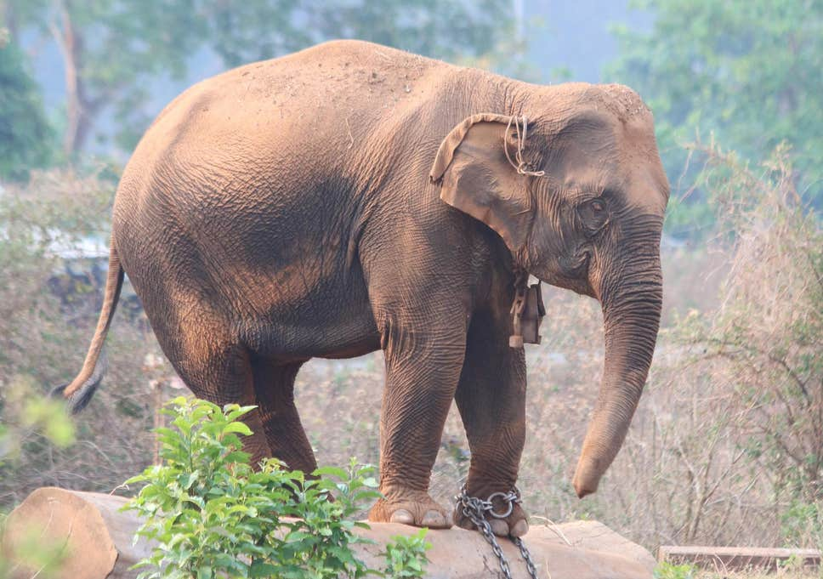
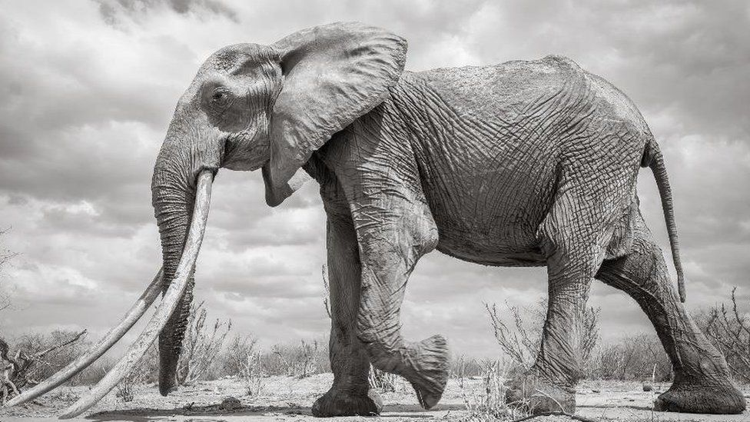
Fat
Thin

Slide 10
Big
Tall
Fat
Small
Short
Thin

Slide 11
Big
Small
-ছোট
-বড়
Tall
-লম্বা
Short
-খাটো
Fat
Thin
-মোটা
-পাতলা

Slide 12
Pair Work
1st one read and the other one will hear
Tall
Big
Fat
Small
Short
Thin

Slide 13
Read Individually
Big
Tall
Fat
Small
Thin
Short

Slide 14

Goodbye
Thank you

