Slide 1

WELCOME

Slide 2
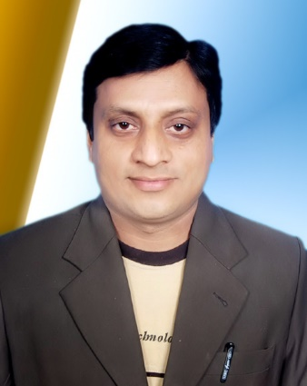
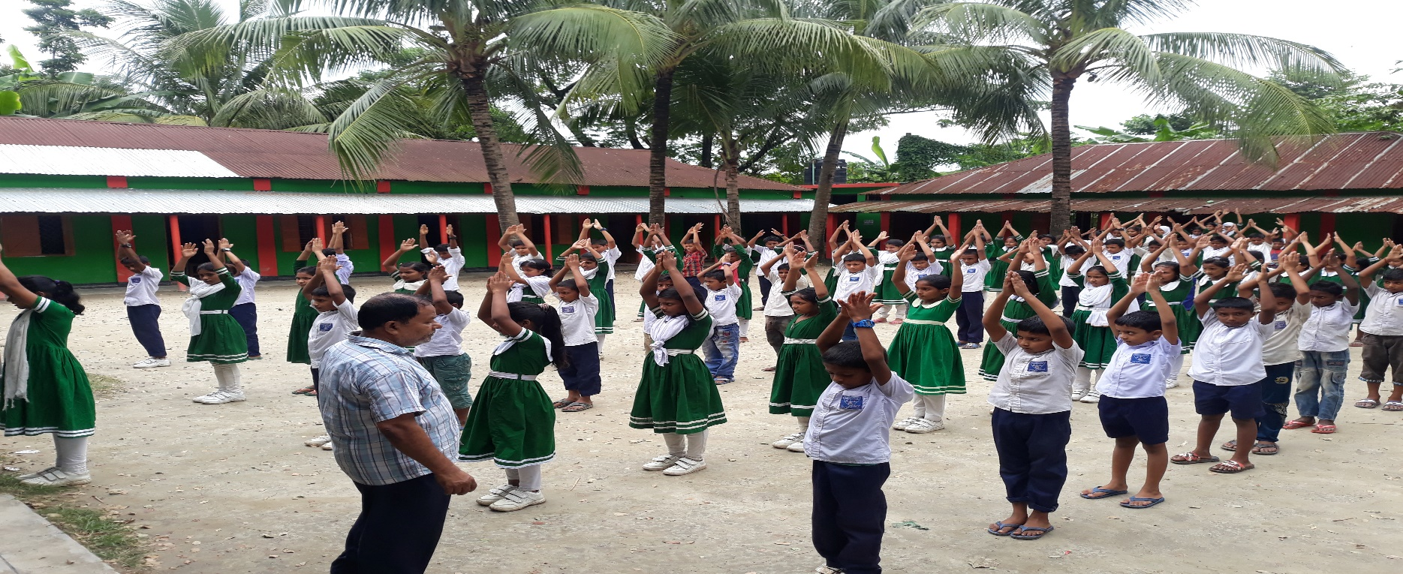
TEACHERS IDENTITY
Md. Ali Hossain Pathan
Asistant Teacher
Chowra Nayabari Gps
Kaligonj, Gazipur

Slide 3
Learning outcomes
Listening
3.1.2 Understand simple questions and statements about familiar object.
Speaking
3.1.2Ask and answer questions about familiar object.
Reading
1.3.1 recognize and read the names of objects having the same inistial and final sound.
Writing
4.1.2 write numbers up to 10 in figures and words.

Slide 4
LET’S SEE A COLOURS SONG

Slide 5
LOOK AT THE PICTURE

Slide 6
Look at the picture.
What can you see in the picture?

Slide 7
TODAY’S LESSON
Class :Two
Unit:16
Colours
Lesson: 4-6

Slide 8

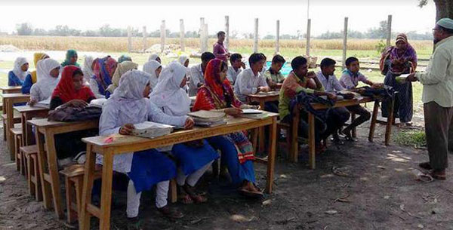
TEACHER’S LOUD READING

Slide 9
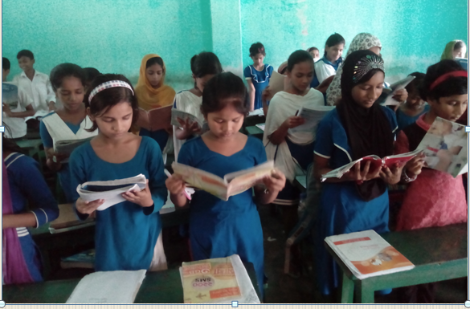
STUDENT’S READING

Slide 10
Look ,listen and say.
Red
Yeallow
Green
Blue

Slide 11
Look ,listen and say.
Orange
Indigo
Violet

Slide 12
Match the colour with words.
IW
Blue
Indigo
Orange
Red
Green
Violet
Yellow

Slide 13
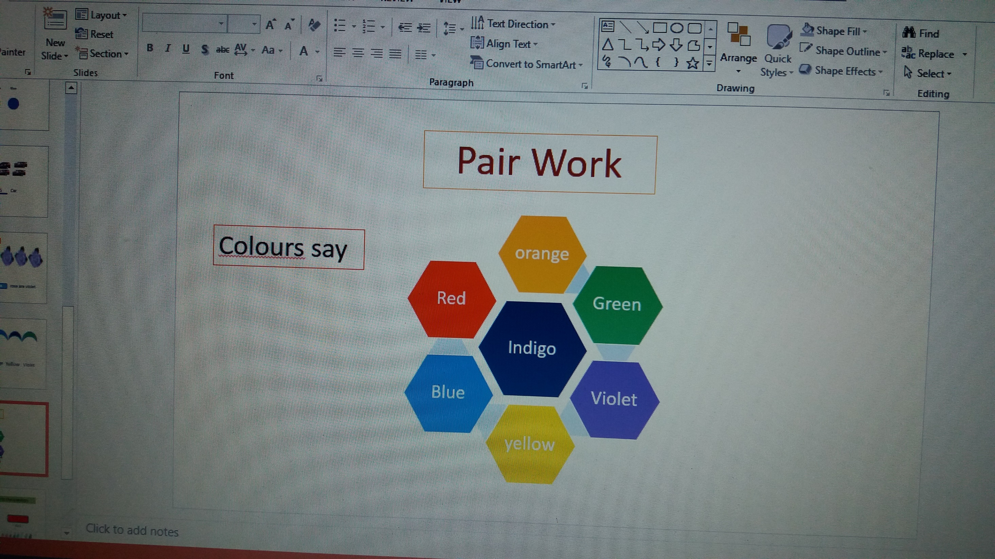
Pair work
Say the colours

Slide 14
Group Work
NO | NAME | WORK
01 | Mango | Write two colours name (R, O)
02 | Banana | Write two colours name (G, Y)
03 | Apple | Write two colours name (B, O)
04 | Orange | Write two colours name (R, V)
05 | Guava | Write two colours name (I, Y)

Slide 15
Answer the following questions.
EVALUTION
IW
What colour is it ?
2.What colour is it?
3.What colour is it?
4.What colour is it?

Slide 16
EVALUTION
How many colours in the picture?
7 colours

Slide 17
HOME WORK
Write the 1 to 10 in numbers.

Slide 18
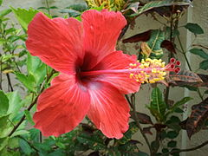
Good Bye
See you Tomorrow

