Slide 1
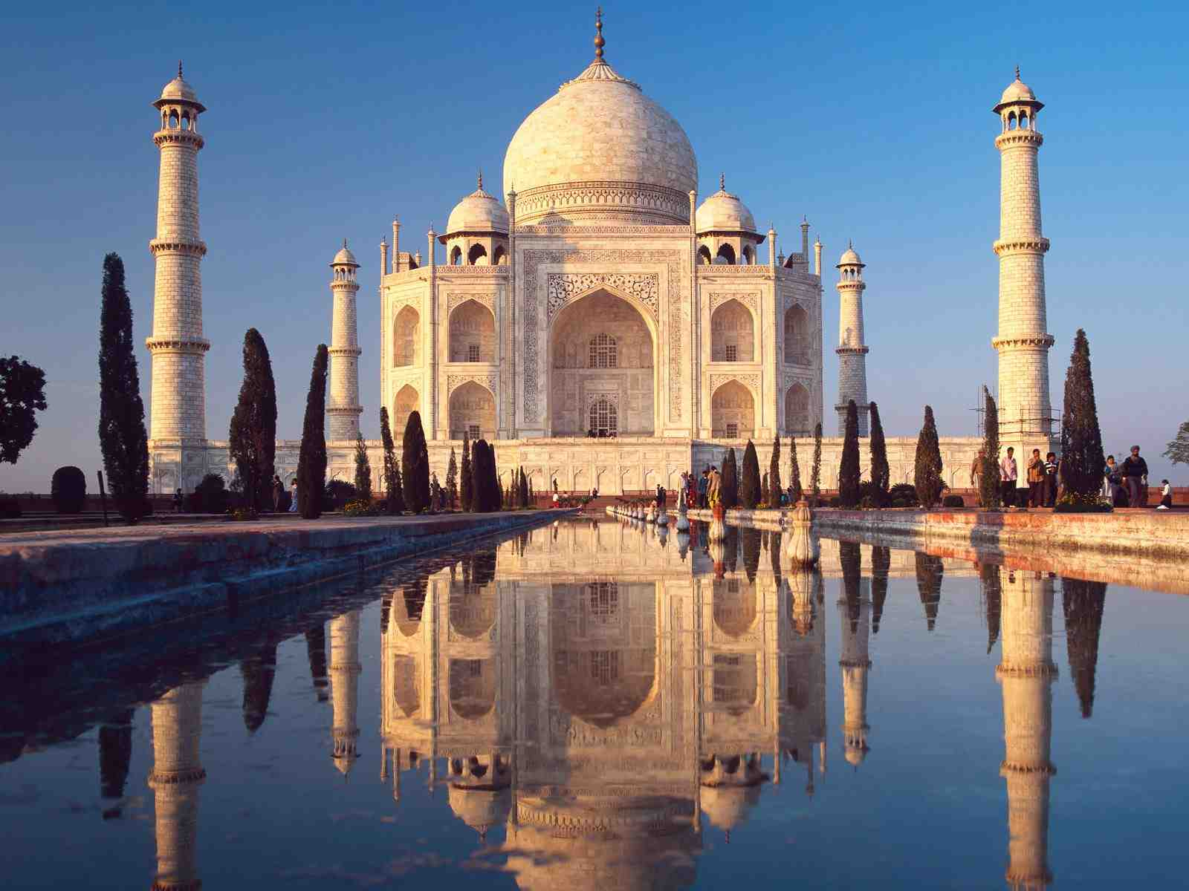
Welcome

Slide 2
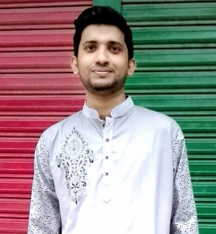

Introduction
Md. Fakhrul Islam
Assistant Teacher (ICT)
Azmiri Begum Girls High School
Fulgazi, Feni.
Mobile : 01675515237

Slide 3
Topic
Transformation
Of
Sentence
Affirmative to Negative
Subject:
English 2nd Paper
Class : 7

Slide 4
Learning outcome of the Topic
At the end you will be able to-
1) have the conception of transformation
2)Enjoy some related pictures
3) have some rulAt the end you will be able to-
1) have the conception of transformation
2)Enjoy some related pictures
3) have some rules and interchanges
4)transform different types of sentence
5) do some exercises of transformation
es and interchanges
4)transform different types of sentence
5) do some exercises of transformation
At the end you will be able to-
1) have the conception of transformation
2)Enjoy some related pictures
3) have some rules and interchanges
4)transform different types of sentence
5) do some exercises of transformation
At the end you will be able to-
1) have the conception of transformation
2)Enjoy some related pictures
3) have some rules and interchanges
4) do some exercises of transformation

Slide 5

Affirmative ↔ Negative
Man/person/Body
Only-none but
Affirmative-Only Allah Can help us.
Negative- None but Allah Can help us .

Slide 6

Objects
Only-nothing but
Affirmative -It is only a flower.
  Negative -It is nothing but a flower.

Slide 7
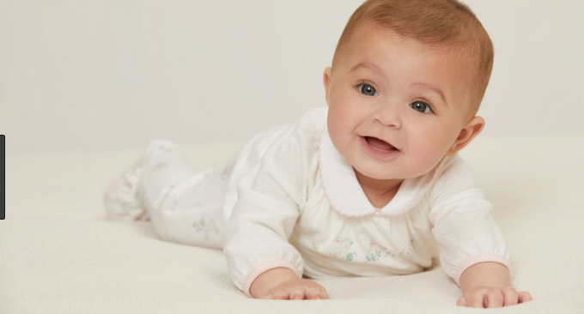
Age
Only-not more/less than
Affirmative-I am only ten.
Negative-I am not more /less than ten.

Slide 8
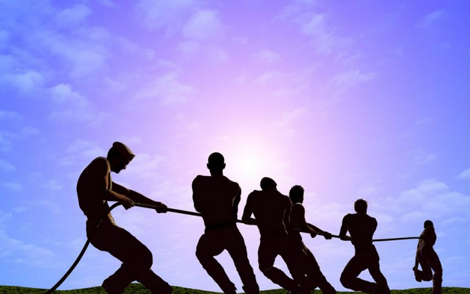
Must- can not but
Affirmative- We must do the work.
Negative- We can not but do the work.

Slide 9
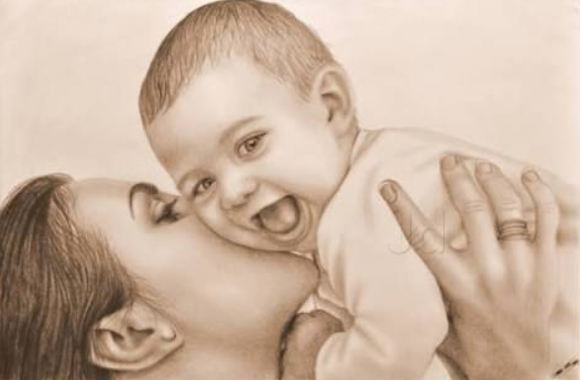
Every------ there is no…….. but
Affirmative- Every mother loves her child.
Negative- There is no mother but loves her child.

Slide 10
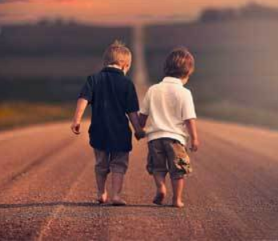
Both………..and/and----------- not only……but olso
Affirmative : Both Hasan and Arif were goods friends
Negative : Not only Hasan but also Arif were goods friends

Slide 11
Some other changes
Good-bad happy- unhappy
Never-ever/always friend- foe
Forget-remember honest- dishonest
Moral-immoral absent- present
Kind-unkind obey- disobey
Like-dislike
Love-hate

Slide 12
Single work
Affirmative -Raj is a good boy.
Negative -Raj is not a bad boy.
b)Affirmative-He always speaks the truth.
Negative-He never tells a lie.
c)Affirmative-He is a kind man.
Negative-He is not a unkind man.
d)Affirmative-Man is mortal.
Negative-Man is not immortal.

Slide 13
Home Work
Write the all rules of Affirmative to Negative

Slide 14
All the best.

