Slide 1


Slide 2
GOOD MORNING

Slide 3

Teacher’s Identity
Asim Kumar Talukder
Lecturer in English
Fenchuganj Govt. College
Fenchuganj, Sylhet.
Email Id: aktalukder@gmail.com
01716348110

Slide 4
Class: Eleven
Subject: English 1st Paper
Unit 4, Lesson 1
Time: 50 Minutes
Date: 19/08/2019
Introduction of the lesson

Slide 5
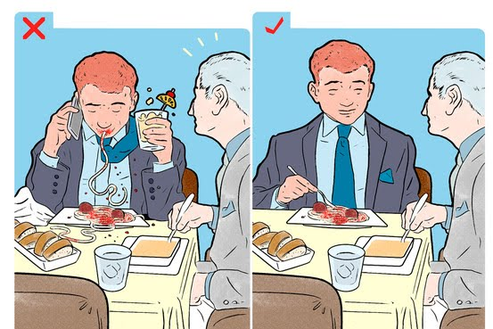
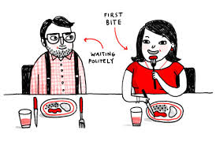
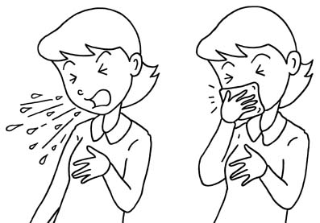
Look at the Pictures

Slide 6
Let’s enjoy the conversation
Good Morning, Santa
Great, how is you parents?
Welcome
How are you?
Good Morning, Teacher
Fine, you?
They are also fine. Thank you

Slide 7
Now dear students, in the conversation we have seen to use the words – good morning, how are you, thank you, welcome.
Why these words are used?
Expected answer will be: ways/style of speaking, behavior, manner, custom, good conduct etc.

Slide 8
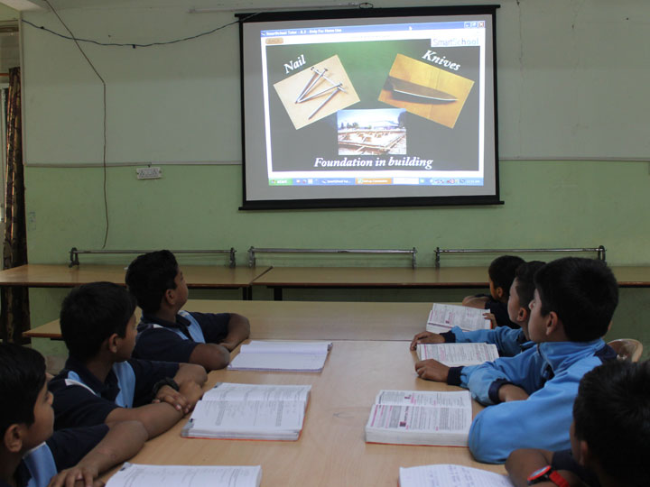
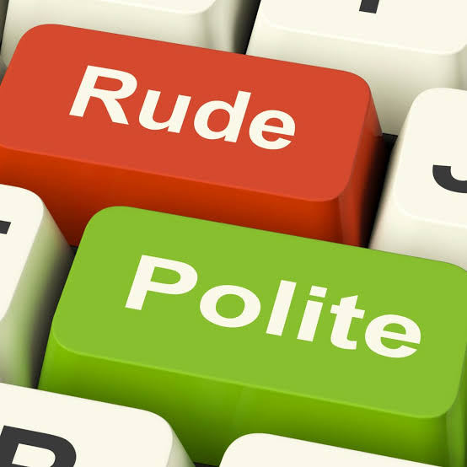
Announcement of the Lesson
Etiquette and Manners

Slide 9
Learning outcomes
Students will be able to…….
# Differentiate between Etiquette and Manner.
# Read and understand the text through silent reading.
# Participate in discussion and gather information about family, social and professional etiquette.
# Narrate a paragraph.

Slide 10
Etiquette: ‘Etiquette’ is a French word and it means the rules of correct behaviour in society. In a word, etiquette is the set of rules.
Manners: The word ‘manners’ means the behaviour that is considered to be polite in a particular society or culture. Manners can be good or bad. In a word, manners are the action.

Slide 11
Read the following words/phrase and find out which one is Etiquette & which one is Manner
How one should talk, How one should eat, Respecting the elders, Not speaking in a rude manner, How one should address people of different stature, Respecting other people’s property, How one should walk, How one should dance, Asking for permission before taking someone’s property, Not staring, How one should stand, Not talking about someone behind someone’s back, Being polite, How one should act in front of company
Pair Work

Slide 12
Individual Work
Silent Reading
Read the passage to answer the questions
“Etiquette and manners vary from culture to culture and society to society.” Do you agree or not? Explain your answer in two sentences.
How can one learn etiquette and manners?
Why should you need to be careful about etiquette and manners?

Slide 13
Remember that etiquette and manners vary from culture to culture and from society to society. We learn etiquette and manners from our parents, families and various institutions, such as schools, colleges or professional bodies. There are rules of behaviour for all kinds of social occasions and it is important to learn them and practise them in everyday life. The manners that are correct in a wedding reception will not do in a debating club. Therefore, we have to be careful about etiquette and manners.

Slide 14

Some important words that are used in our everyday life.

Slide 15
Some basic rules of etiquette:
Respect others’ personal space.
Don’t interrupt when someone else is talking.
Be a helper.
Be on time
Don’t yell in public places.
Eat politely
Chew with your mouth closed
Stand in queue

Slide 16
Different situations call for different etiquette and manners. These are divided into three groups: family etiquette, social etiquette and professional etiquette.
Now write what are the family etiquette, social etiquette and professional etiquette.
Group Work
Match the answer

Slide 17
Family etiquette:
Respect each other’s belongings.
Do not shout at children.
Treat them kindly.
Listen to your parents.

Slide 18
Basic social etiquette:
Always be on time. Showing up late is rude and shows a lack of respect for other People’s time.
Never interrupt the other person while he/she is talking.
Give and receive compliments graciously.
Refuse to gossip with and about friends.
Hold doors for people entering immediately after you.

Slide 19
Professional etiquette:
Dress properly.
Shake hands when appropriate.
Never take credit for other people’s work.
Use indoor voice while talking to people.

Slide 20

HOMEWORK
Write a paragraph on “Etiquette and Manners”

Slide 21

Thanks a lot

