Slide 1
Wel Come

Slide 2
Introduce of Teacher
Name: Abul Kashem
Assist: Teacher
Chakvarunia si Alim Madrasha
Jaypurhat sader Jaypurhat

Slide 3
Introduce of lesson
Class: Eight
Subject: English Ist part
Unit:One
Lesson:One
Time:45 minites
Date:

Slide 4
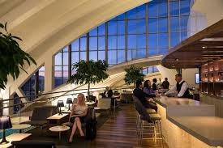
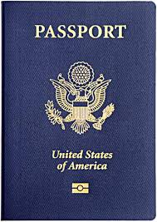
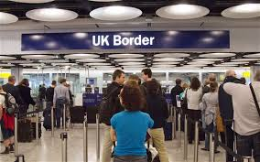
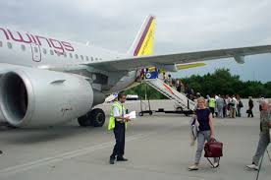
Look at picture and talk about it
Lounge
Immigration
Airport

Slide 5
Lesson Headline
Going on a Foreign trip.

Slide 6
Learing Result
1.Listen for information.
2.Listen to and follow announcement.
3.Ask and answer Question.

Slide 7
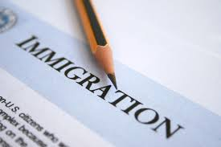
Unit Work
Look at the picture and Answer the Question

Slide 8
Question
Who cheek the passports at the airport?

Slide 9
Soluation
Immigration Officer cheek the passport.

Slide 10
Pair Work
Look at the picture and answer the question.

Slide 11
Question
What does an immigration officer do at the airport?

Slide 12
Soluation
He checks the passport of the passenger and stamp it.

Slide 13
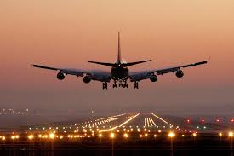
Group Work
Look at the picture and answer the question.
Immigration
Airlines
Lounge

Slide 14
Question
What do Mita and Jara do as the wait in the lounge?

Slide 15
Soluation
As Mita and Jara wait in the lounge,They start planning what they will do after reaching Thailand.

Slide 16
Evaluation
Choose the best answerfrom the alternatives.
1.Mita was born on 6 may………………………………………………
(i)1990 (ii)2000 (iii) 1998 (iv) 1994.
2. Zara lives with her parents in…………………………………………
(i) London (ii) Dhaka (iii) America (iv) India.
3. They are flying by……………………………………………………… (i)India Biman (ii) Bangladesh Biman
(iiiPakistaBiman(iv)Londan Biman
√
√
√

Slide 17
Right Answer
1.(iii) √1998
2.(i)√ London
3.(ii) √Bangladesh Biman

Slide 18
Home Work
Read the passage in again . Now Summarize in your own words.

Slide 19
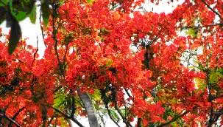
Thank You

