Slide 1

Welcome

Slide 2
Teacher’s Introduction
Md. Shahbaz Uddin
Assistant Teacher
Anujani Government Primary School
Chatak,Sunamgonj.
01747148885
uddinshahbaz87@gmail.com

Slide 3
Lesson’s Introduction
Class: Four
Lesson Unit : 26( The Lion and the Mouse )
Part of the lesson : Once there ………..let it go .
Date : 13/10/2019

Slide 4
Learning outcomes :
By end of the lesson the students will be able to …..
Listening : 4.2 : enjoy and understand simple stories.
Speaking : 6.2 : talk about people , objects , events etc.
Reading : 1.5:read words , phrases and sentences in the text with proper pronunciation, stress and intonation
Writing : 10.2 : write a short composition about oneself , friends , family and other familiar topics.

Slide 5
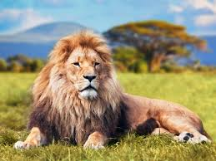
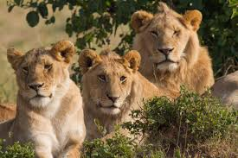
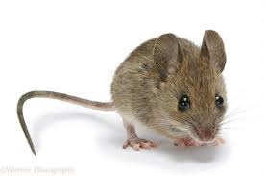

Slide 6
The Lion and the Mouse

Slide 7
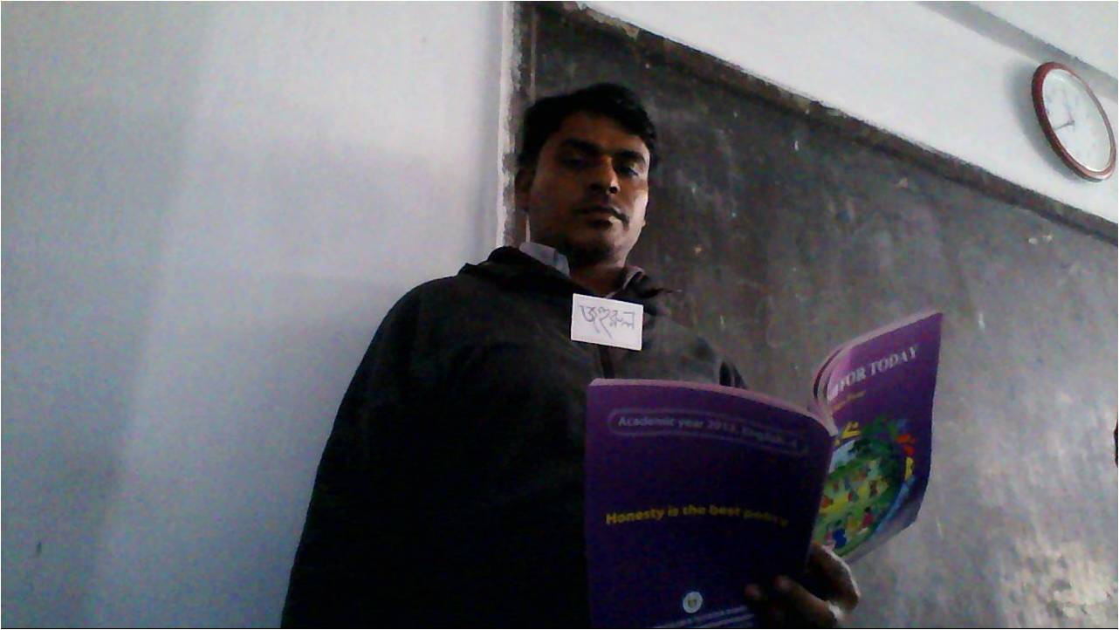
Teacher’s activities

Slide 8
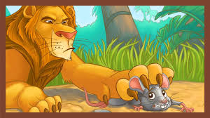
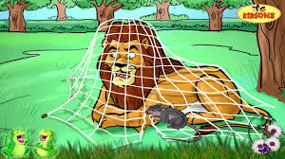
Now think yourself about the picture and discuss in groups.

Slide 9
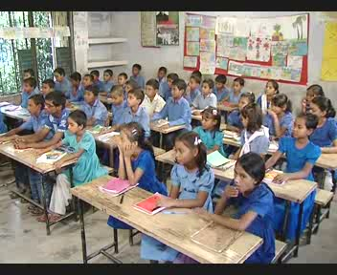
Student’s Activities

Slide 10
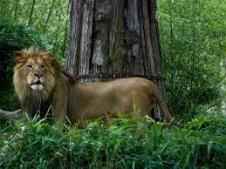
Once there was a lion in a forest. It was big and strong.

Slide 11
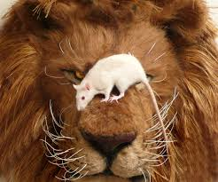
One day it was sleeping . A mouse was playing nearby . Suddenly the mouse got into the nose of the lion .

Slide 12
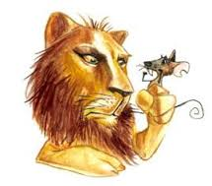
The lion woke up and caught the mouse . The lion was angry and said ,” I’ll kill you .”

Slide 13
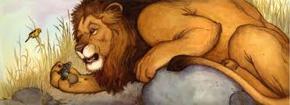
The mouse was afraid and begged for its life ,” sir , please let me go . I may be of help to you some day !” The lion laughed , ” you are so small. How can you help me ?” But he let it go .

Slide 14
New words
Lion
Mouse
Forest
Strong
Small

Slide 15
A game
Lion , strong , big , mouse , forest , small , go .

Slide 16
Bingo
Lion , mouse , forest .

Slide 17
Group work
Group A : Write some words about a lion .
Group B :Write some sentences about a mouse .
Group C :Rearrange the following letters and words in the correct order:
1)gnstor
2)lived/in/a forest/lion/the.
3)can/you/me/how/help ?

Slide 18
Evaluation
Now write a short composition in only five sentences on about “ The lion and the Mouse” .

Slide 19
Feedback
I’ll involve the advanced students to help the weaker students to understand better. If need I will help them.

Slide 20
Home work
Everybody listen to me . Everybody (one by one ) must draw a Lion’s picture for the next class.

Slide 21

Thank you everybody

