Slide 1
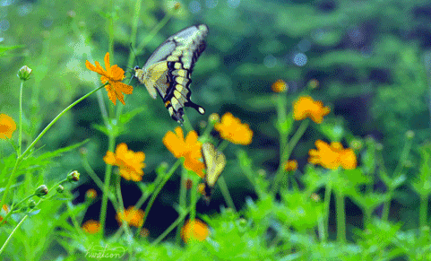
Wel come

Slide 2
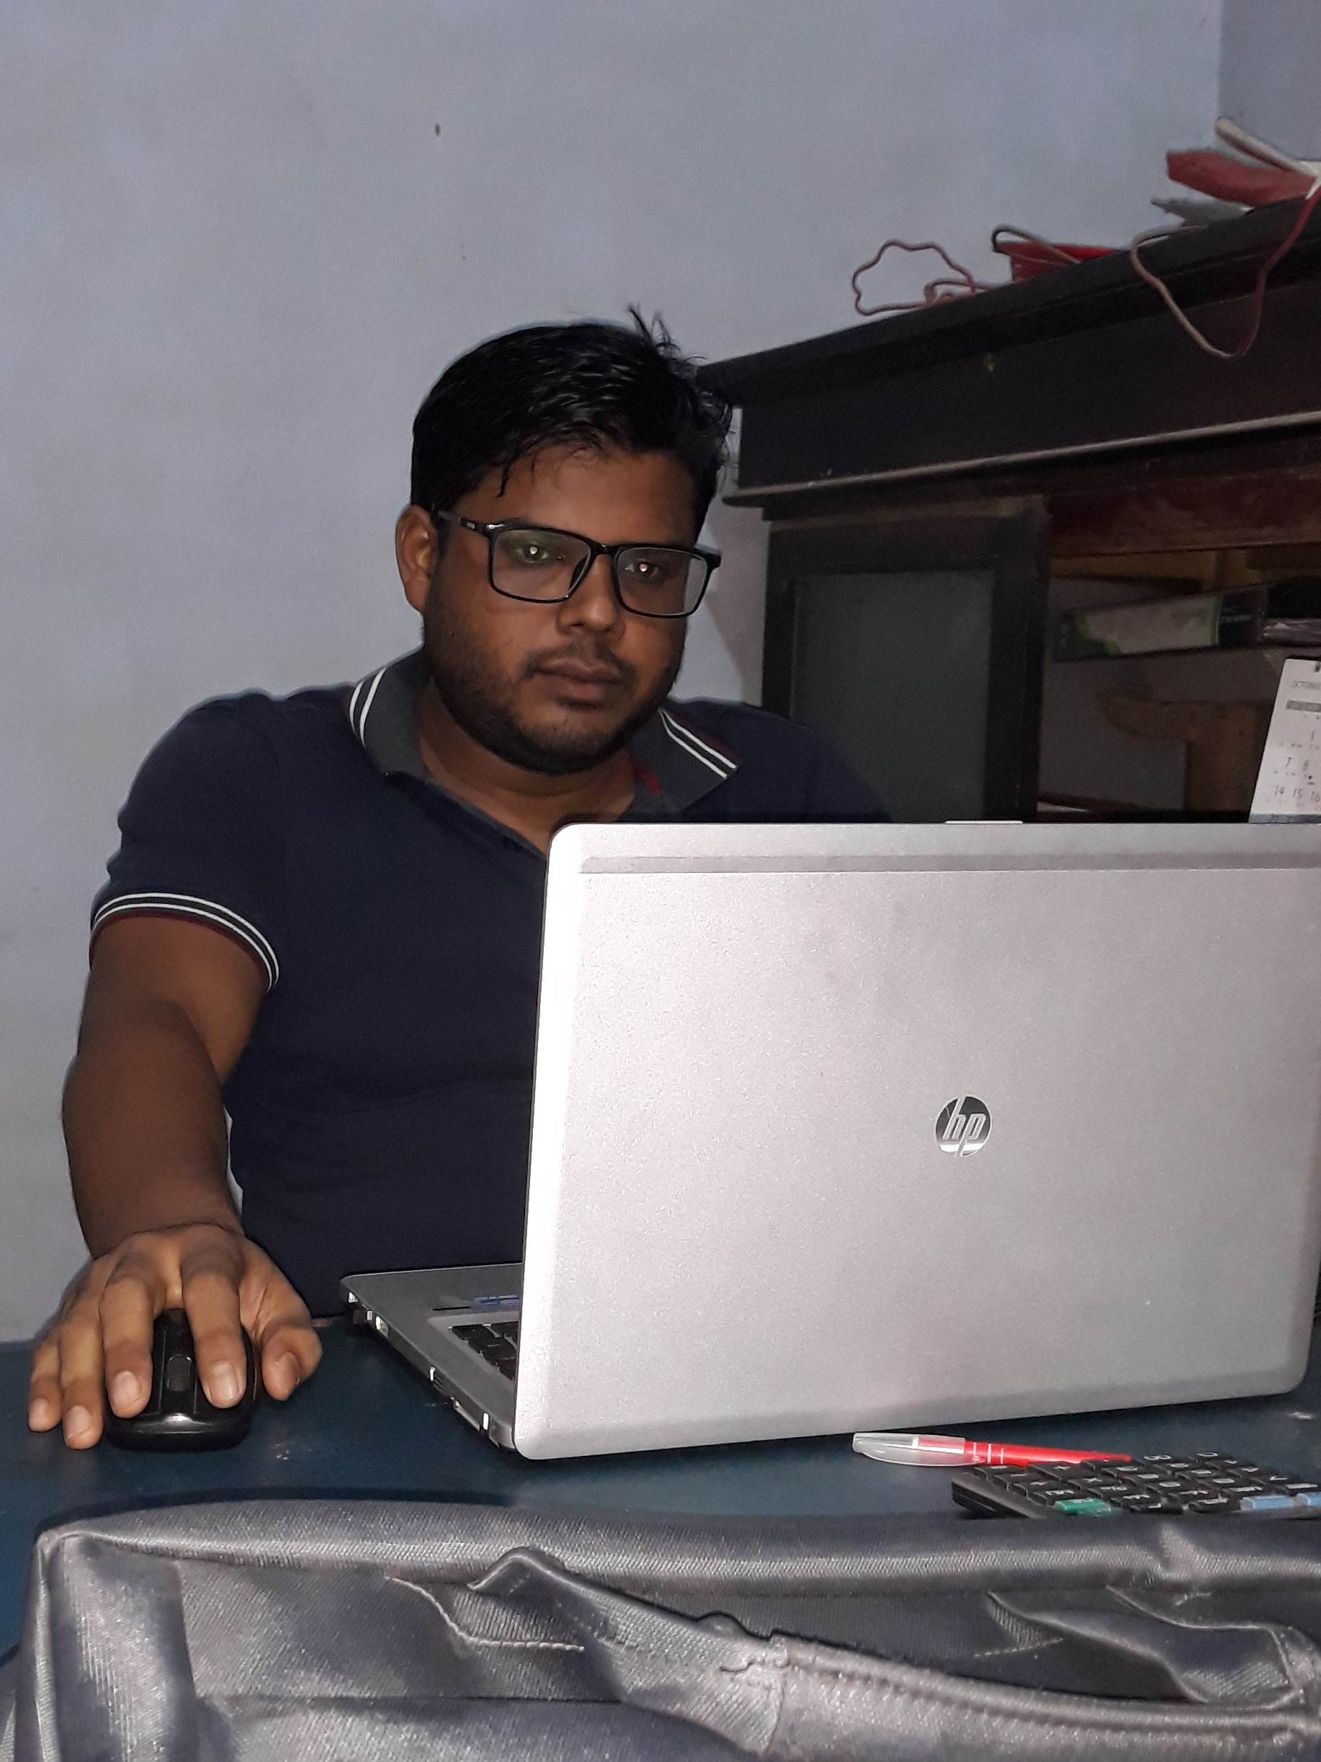
Teacher identity
Quamrul Hasan Ahmed
Assistant teacher
Shalgram Govt Primary School, Adamdighi, Bogura.
Subject-English
Class-Three
Lesson : Unit 3
Lesson: 4-6
Time-55 minutes

Slide 3
Listening-3.1.1,
Understand Simple questions about students, family and friends.
Learning out come :
Speaking- 3.1.1,
Ask and Answer Yes/No questions.

Slide 4

WHAT CAN YOU SEE IN YHE PICTURE?

Slide 5
New Words
Live
Near
Market
School

Slide 6
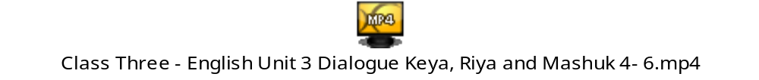
Look at thevideo and think about it.

Slide 7
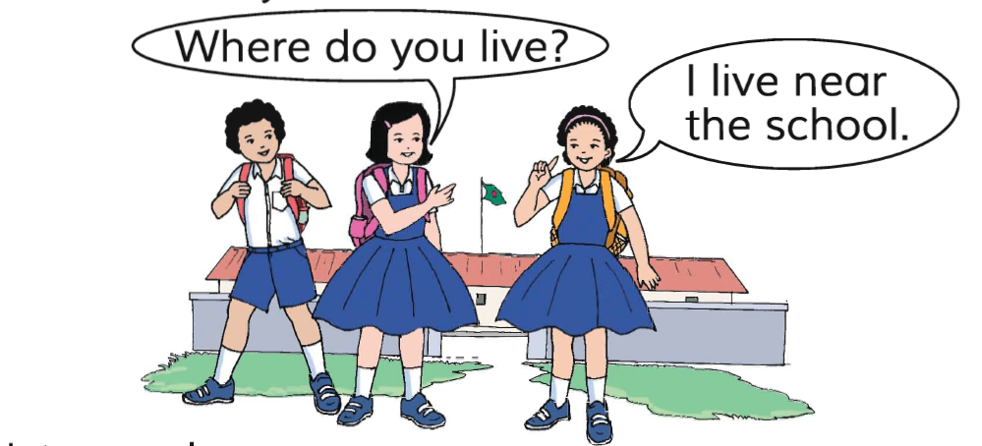
Now listen to me.

Slide 8
Now repeat with me.

Slide 9
Now repeat with me.
Where do you live?
I live near the market.

Slide 10
Now everybody say loudly.

Slide 11
Assesment
Everybody say it individually

Slide 12
Everybody ask one another.

Slide 13
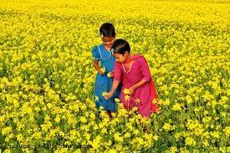
THANK YOU

