Slide 1

WELCOME

Slide 2
INTRODUCTION
MD RANA HAMID
ASSISTANT TEACHER
MOESHPUR GPS
SUBJECT:ENGLISH
CLASS :3 DATE:07.03.2018

Slide 3
LEARNING OUTCOMES:
SPEAKING:6.2.1 TALK ABOUT PEOPLE AND OBJECTS.
WRITING:8.1.3 WRITE SENTENCES FROM THE BOX OR MODEL

Slide 4
Today’s lesson: Where is it?

Slide 5
TEACHER’S ACTIVITIES:
FIRSTLY:TEACHER WILL SHOW TWO PICTURES ABOUT PREPOSITION
SECONDLY :TEACHER WILL ASK ,WHERE IS UMBRELLA AND THE MAN?

Slide 6
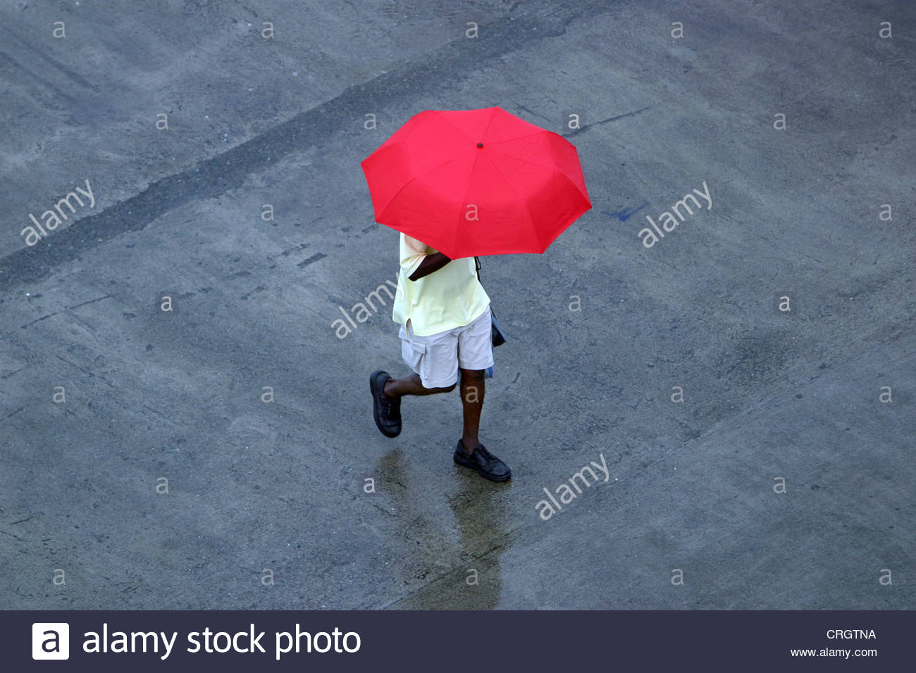
ABOVE

Slide 7
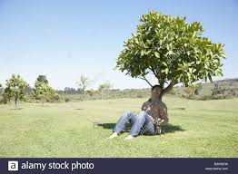
UNDER

Slide 8
PAIR WORK
GROUP-1 STUDENTS WILL SEE THE PICTURE
GROUP-2 WILL DO THE SAME WORK

Slide 9
EVALUATION
BY ASKING QUESTION :
WHERE ISTHE UMBRELLA?
WHERE IS THE MAN?

Slide 10

THANKS

