Slide 1
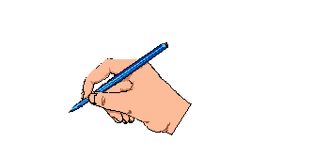


Slide 2
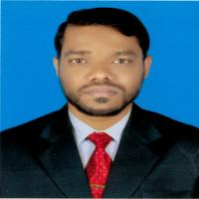
Presenting for you
Lesson Contacts:
Class: one
Subject: English For Today
Unit: 30
Numbers
Lesson: 1-3
Page: 60
Md Emran Hossen
Assistant Teacher
Kattali Nurul Haque Chowdhury Government Primary School
Pahartali, Chattogram.
01819-893135
emran81hossen@gmail.com

Slide 3
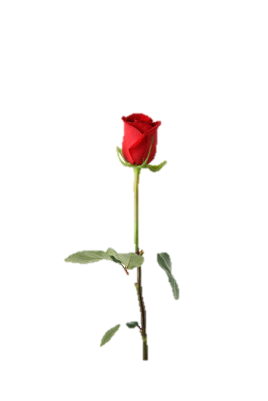
Learning Outcomes:
Students will be able to……
Listening: 1.1.1
Speaking: 1.1.1, 1.1.2, 1.1.3
Reading: 1.2.1

Slide 4

How are you students? How is your health?
Lets enjoy a video.

Slide 5


Slide 6
Now recite the rhyme
1, 2,3,4,5
Count the fish from 1 to 5.
Today we will sing the alphabet song. Do you want to sing with me?
Lets enjoy a audio song.

Slide 7

Listen attentively.
Come in front and sing the song.
Now sing the song with me.
Now sing with your pair.

Slide 8
a
b
c
d
e
f
g
h
i
j
k
l
m
n
o
p
q
r
s
t
u
v
w
x
y
z
Now i know my a, b , c
Next time sing along with me.

Slide 9
a
b
c
d
e
f
g
h
i
Now say the alphabets.
j
k
l
m
n
o
p
q
r
s
t
u
v
w
x
y
z

Slide 10
Say the alphabets in order.
a
i
h
f
c
d
b
j
e
g

Slide 11


What’s this?
This is a pencil.
pencil
p
পে
= পেনসিল

Slide 12
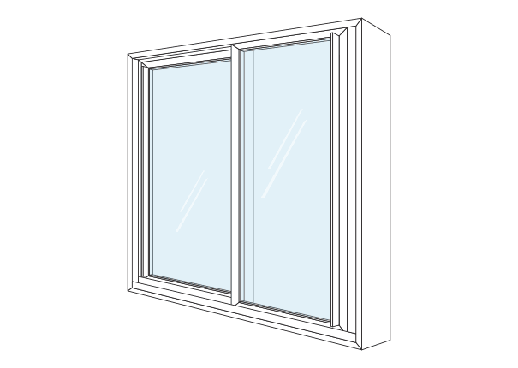
What’s this?
This is a window.
window
w
জা
=জানালা

Slide 13
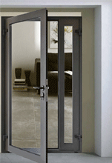
What’s this?
This is a door.
door
d
= দরজা
দ

Slide 14

What’s this?
This is a book.
boor
b
= বই
ব

Slide 15
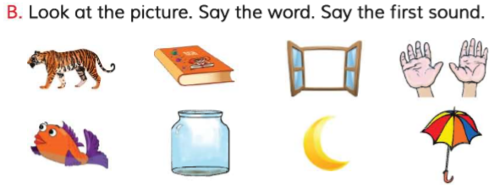
Open your book at page 60 and see the activity B.

Slide 16
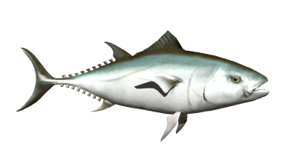
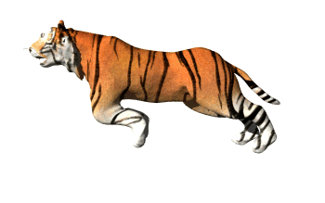
Look at the picture. Say the first letter and sound.
t
f
Tiger = বাঘ
Fish = মাছ
টা
ফি

Slide 17
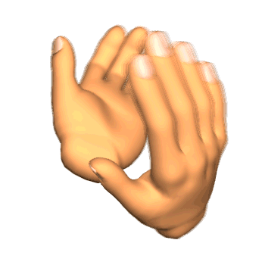

Look at the picture. Say the first letter and sound.
h
Umbrella = ছাতা
Hand = হাত
u
হে
আ

Slide 18
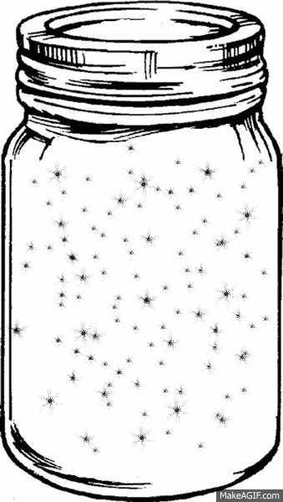
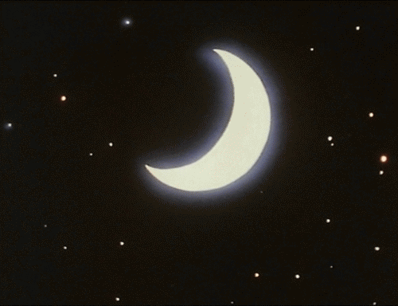
Look at the picture. Say the first letter and sound.
j
m
Jar = বয়াম
Moon = চাঁদ
জা
মু

Slide 19
Match the first letter with the word of the picture.
f
u
h
t
b
w

Slide 20
What’s this?
Say the first letter and sound.
ap
T

Slide 21
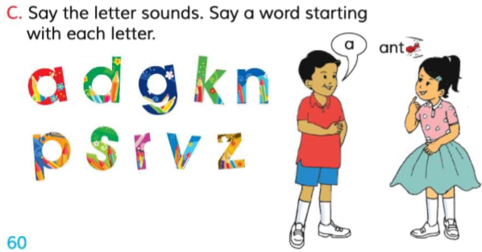
Now see the activity C.

Slide 22

I will show a letter you will say a word starting with
the letter.
d

Slide 23
Anyone indicate a letter, other one will say a
word starting with the letter.
Pair work

Slide 24
Ok, close your book. Now we are going to play a game.
Raise your hand if you can say a word with any letter.
a
b
c
d
e
f
g
h
i
j
k
l
m
n
o
p
q
r
s
t
u
v
w
x
y
z

Slide 25



