Slide 1

WELCOME

Slide 2
Identity
Samiul Islam
M.A, M.Ed.
Assistant Teacher
Halimunnessa Chowdhurani Memorial Girls’ High School,
Mymensingh
Class : Nine
Subject : English 1st Paper
Unit – 7, Lesson – 4
Title : The beginning

Slide 3
Learning outcomes :
By the end of the lesson student will be able to –
Know some new words
Able to give answer of MCQ.
Ask and answer the question.
look at a picture and ask and answer questions.
Able to write a paragraph.

Slide 4
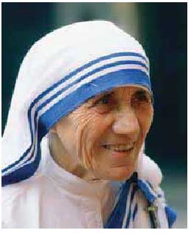

Slide 5
To days Lesson –
‘‘THE BEGINNING’’

Slide 6
Introducing with
the new words

Slide 7
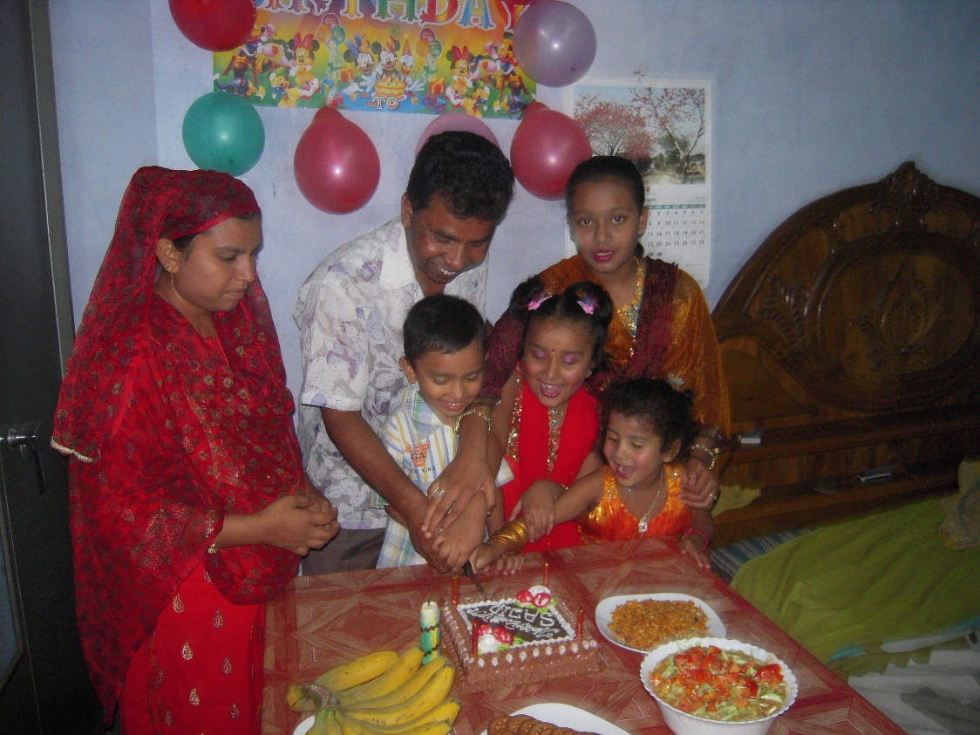
siblings -
Mother
Father
They are their children
each of two or more people with the same parents. a brother or sister

Slide 8
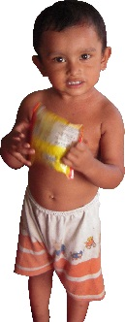
Tiny-
Very small
He/ She is a tiny baby

Slide 9
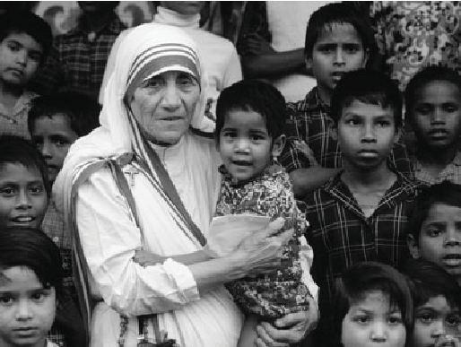
Nun-
a woman living in a female religious community who was promised to serve God all her life
She is a nun

Slide 10
Open your Book page at - 91
Read silently
and answer the MCQ

Slide 11
1. What does ‘servant of humanity’ mean in the text?
a) becoming a slave. b) to work in other people’s house.
c) to be oppressed by others. d) to serve the needy.
2. Why did Mother Teresa want to be a missionary? Because she heard
a) the voice of her neighbors discussing it.
b) a voice in her dream.
c) a voice within herself.
d) the voice of her parents talking about it.
3. Mother Teresa set out to join the missionary of the Sisters of Loreto in the year
a) 1927. b) 1928. c) 1929 d) 1930.
4. Mother Teresa took her first vows at the age of
a) 18. b) 19. c) 20. d) 21.
√
√
√
√

Slide 12
B. Read the text in A again and answer the questions in one or two words or in a sentence if necessary.
1) Where did Mother Teresa’s ancestors come from?
2) Where was her father’s home?
3) Why did she want to become a missionary?
4) What makes her different from other girls at such an early age? What words and expressions are used in the text to describe this difference?
5) What did Mother Teresa do in the first seventeen years in India?

Slide 13
Answer –
Albania.
Skopjw Mecidoni.
She wanted to become a missionary.
A ‘’voice from within herself’’ makes her different from other girls at such an early age. Love and serving for humanity to the poorest of the poor's are used to express the love of Christ in the text to describe the difference.
From 1931 to 1948, Mother Teresa taught geography and catechism at St. Mary’s High School in Kolkata then Calcutta.

Slide 14
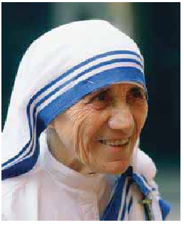
C) Look at the picture and talk about her in pairs. Take the help of the questions given below.
1) How old is she? Why do you think so?
2) What is she wearing?
3) How has she worn it?

Slide 15
Write the description of ‘‘Mothers Teresa’s’’ physical features in your exercise book.

Slide 16
Evaluation
Brief the short speech about the beginning of Mother Teresa

Slide 17
To be a noble man you need not to born a Educated or aristocracy family. Your actives make you noble .

Slide 18
Home work :
Write paragraph on ‘‘Mothers Teresa’’

Slide 19
Thank you

