Slide 1
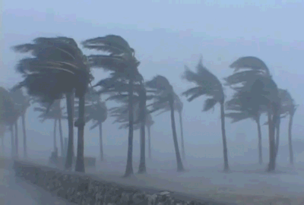
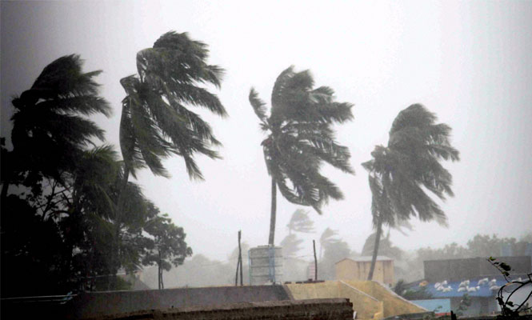
Welcome

Slide 2
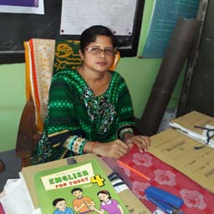
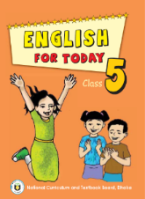



Identity
Subject : English
Class : Five
Unit : 24
Lesson : 2-3
Lesson Tittle: Cyclone Aila
Time : 45minutes
Date : 0/0/2019
Popi Mondal
Head Teacher
Kobirajbari Govt. Primary School
Email ID: popi.pt72@gmail.com

Slide 3
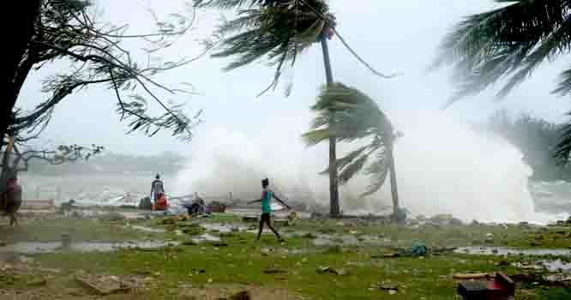
To protect themselves from Cyclon Aila.
You are right. It’s one kind of natural disasters named cyclone Aila.
Why are these people running?
What can you see in the picture?
A cyclone is a very large tropical strom which causes the wind to blow at a high speed.

Slide 4



Let’s enjoy a video.

Slide 5
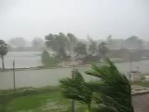

Slide 6


Today we are going to read the story ‘The experience of Babul and his family about…
Class : Five
Subject : English
Date : 0/0/2019
Cyclone Aila

Slide 7
Learning Outcomes
Students will be able to-----------
Listening:
1.3.1 recognize which words in a sentence are stressed.
3.4.1 understand statements made by the teacher and students.
4.2.1 understand and enjoy simple stories.
Speaking:
1.1.1 Say words, phrases and sentences with proper sounds and stress.
6.2.1 talk about people, objects, events etc.
Reading:
1.5.1 read words, phrases and sentences in the text with proper pronunciations, stress and intonation.
1.7.1 read paragraphs, dialogues stories, letters and other texts.

Slide 8
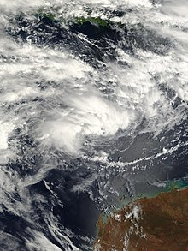
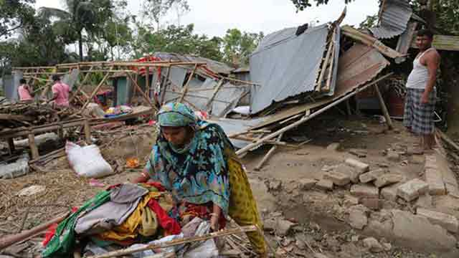
Let’s see some pictures.
Cyclone Aila took place on 25 May, 2009 in the southern part of Bangladesh.

Slide 9
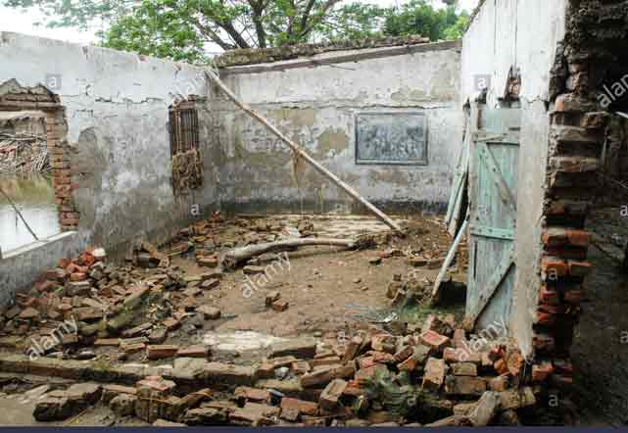
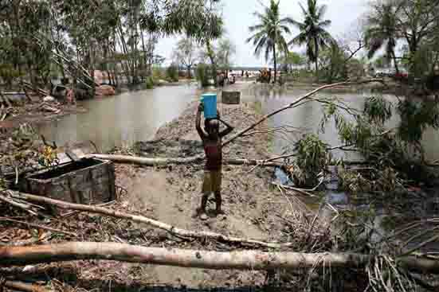
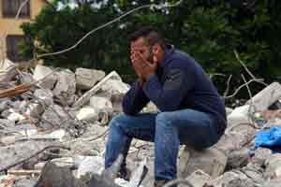
Look at the pictures and think alone.
It caused heavy loss of life and property.
What was the effect of Cyclone Aila?

Slide 10




Individual Work
When did Cyclone Aila take place?
What was the effect of Cyclone Aila?

Slide 11
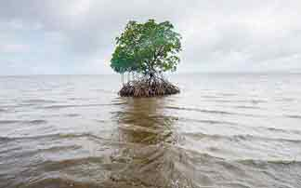
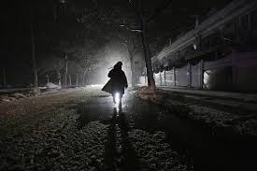

Key Word
Island
A land surrounded by water
Terrible
Something that creates fear.

Slide 12
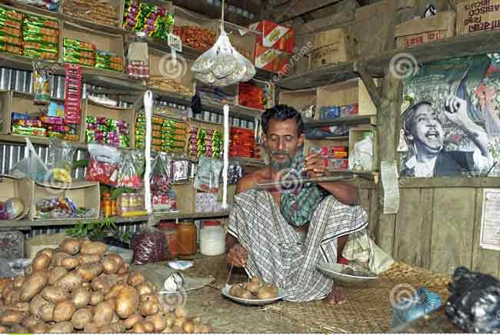
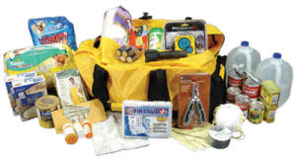

Key Word
Grocery shop
A shop where daily necessary
products are sold.
Emergency kit
The bag used in emergency.

Slide 13



Time : 10 minutes
Teacher’s Reading
Dear students,
open your book at page 95. Say after me.

Slide 14
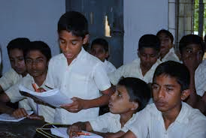
Individual Work
Time : 5 minutes
A
Dear students, open your book at page 95 and read the text loudly.

Slide 15
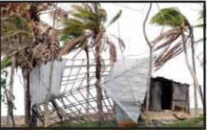
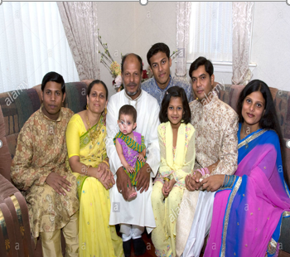
Look at the picture and read the statements.
Grandmother
Grandfather
Father
Mother
Nipa
Babul
Babul and his family live on the island of Dublar Char.
Life is good for the family now, but that wasn’t true after
Cyclone Aila. Babul doesn’t rember Cyclone Aila, but his
parents often talk about that terrible night in 2009.

Slide 16
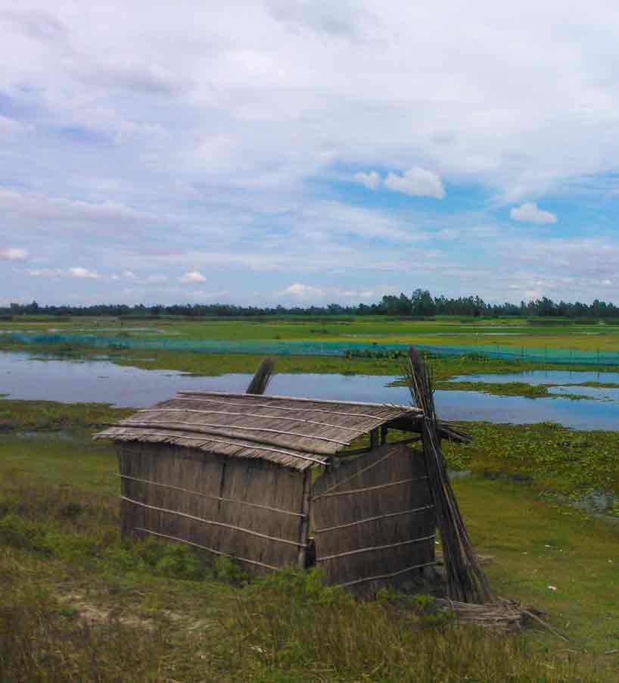
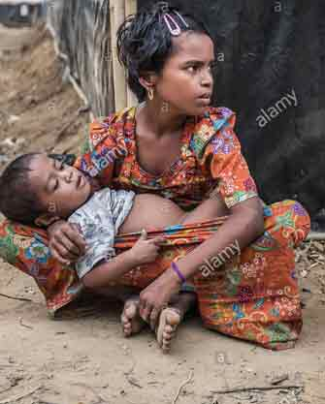
Look at the picture and read the statements.
Babul’s father had a grocery shop and his mother worked in a fish farm. They had a small house that they shared with Babul’s grandparents. Babul was just a baby, but his sister Nipa was six years old.

Slide 17
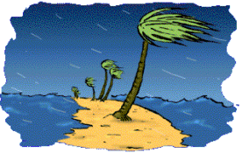
Look at the picture and read the statements.
Babul’s father told him what happened that day. There was light rain in the morning on 25 May.

Slide 18
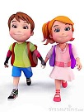
Pair Work
Time : 5 minutes
Say ‘True’ for correct statement or ‘False’ for incorrect statement.
Babul can recall the Cyclone Aila.
b) The Cyclone Aila took place in 2009.
c) Babul’s father had a medicine shop.
d) The name of Babul’s sister is Rina.
e) Babul and his family live in Dhaka.

Slide 19

Group Work
Say five sentences about Cyclone Aila.

Slide 20
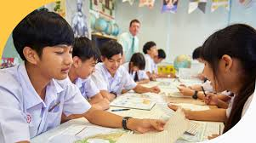


Silent Reading
Dear students, read the text silently.

Slide 21

Evaluation
Answer the following questions.
What did Babul’s father have?
When did Cyclone Aila take place?
What is the name of Babul’s sister?
Where do Babul and his family live?

Slide 22

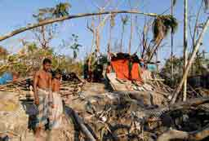
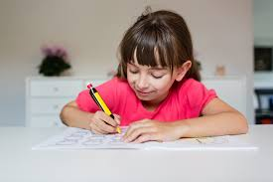
Home Work.
You will write the after effect of Aila in three sentences.

Slide 23
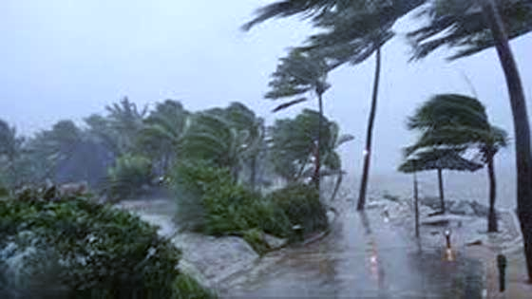
Thank you.

