Slide 1
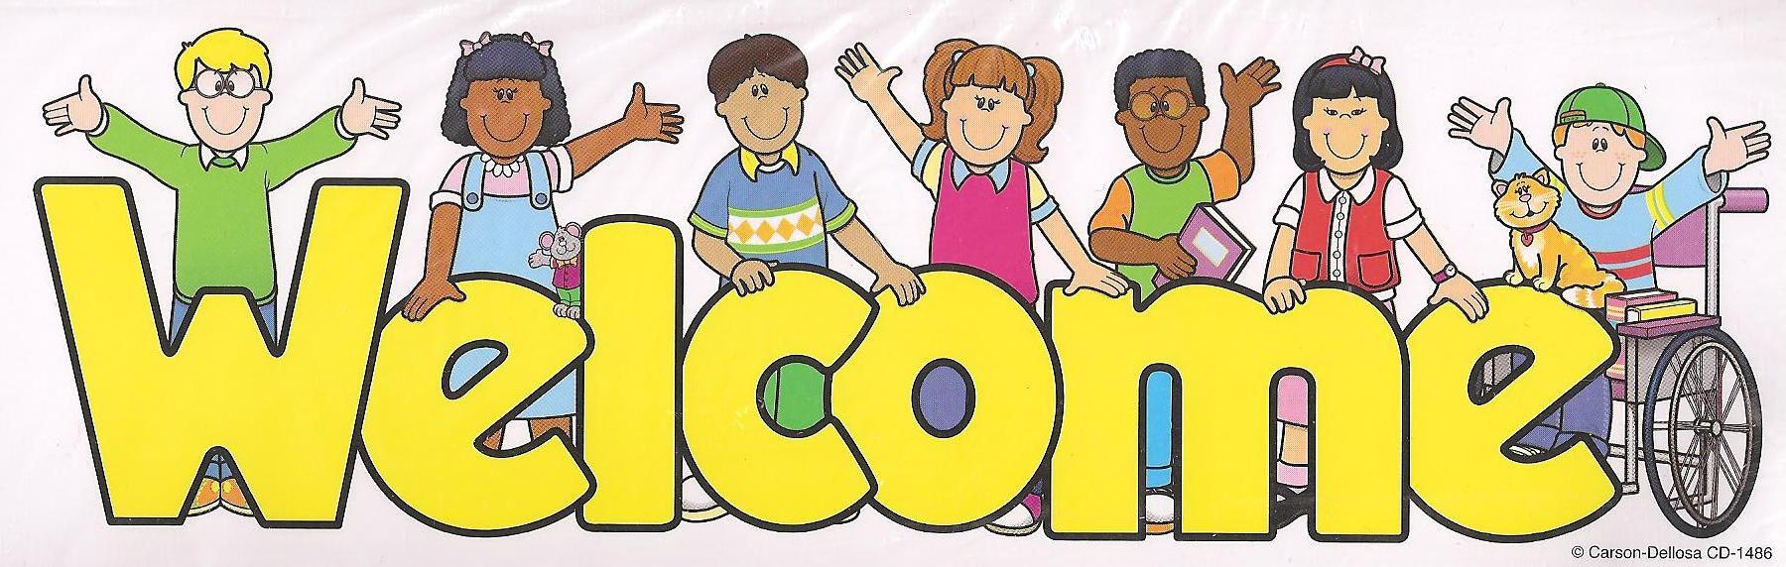


Slide 2

My dear students,

Slide 3

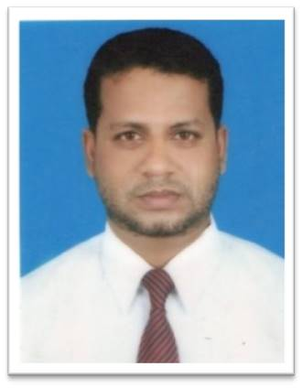
Teacher’s Identity
Md. Taj Uddin
Assistant Teacher (English)
Bangladesh Navy School & College Chittagong

Slide 4
Introduction to the lesson
Class: Four
Unit: 40
Title: A Garment Worker’s Day
Class Duration: 45 Minutes
Total Students: 80
Present Students:
Absent Students: 04
Date: 22/09/2019

Slide 5
Learning outcomes
By the end of the lesson students will be able to-
recognize sound differences in the context of words.
say words, phrase, and sentences with proper sound, stress and intonation.
read words, phrase and sentences with proper sound, stress and intonation.

Slide 6
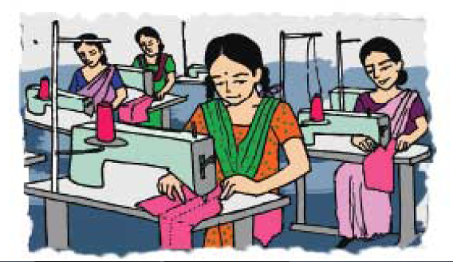
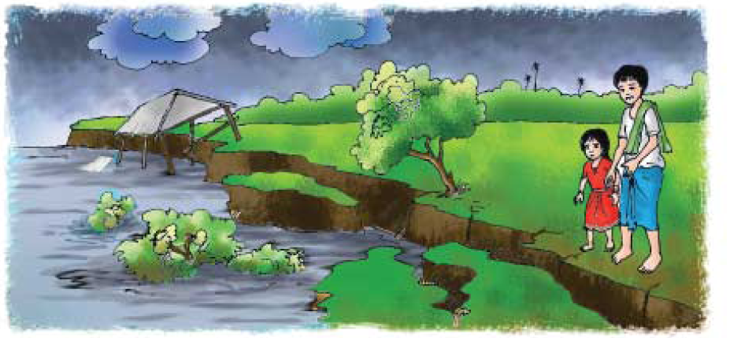
Let’s look at the pictures
What do you see in the pictures?

Slide 7
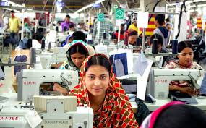
Declaration of today’s lesson
A Garment Worker’s Day

Slide 8
My Dear Students,
Please, take your English Text Book and open at 80.
A garment’s worker day

Slide 9
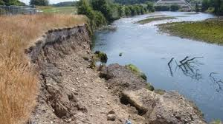
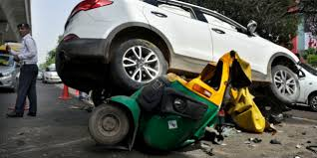
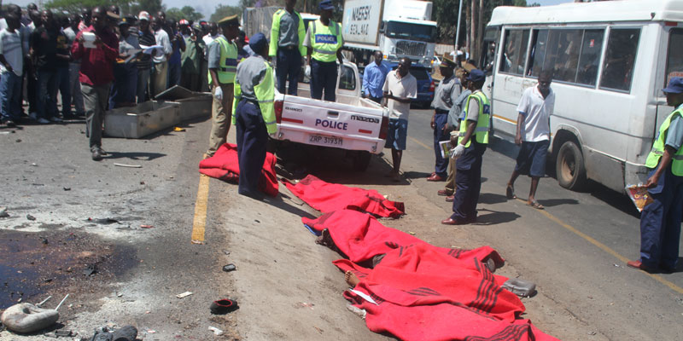
Let’s learn some new words.
Worker
River Erosion
Accident
Died

Slide 10
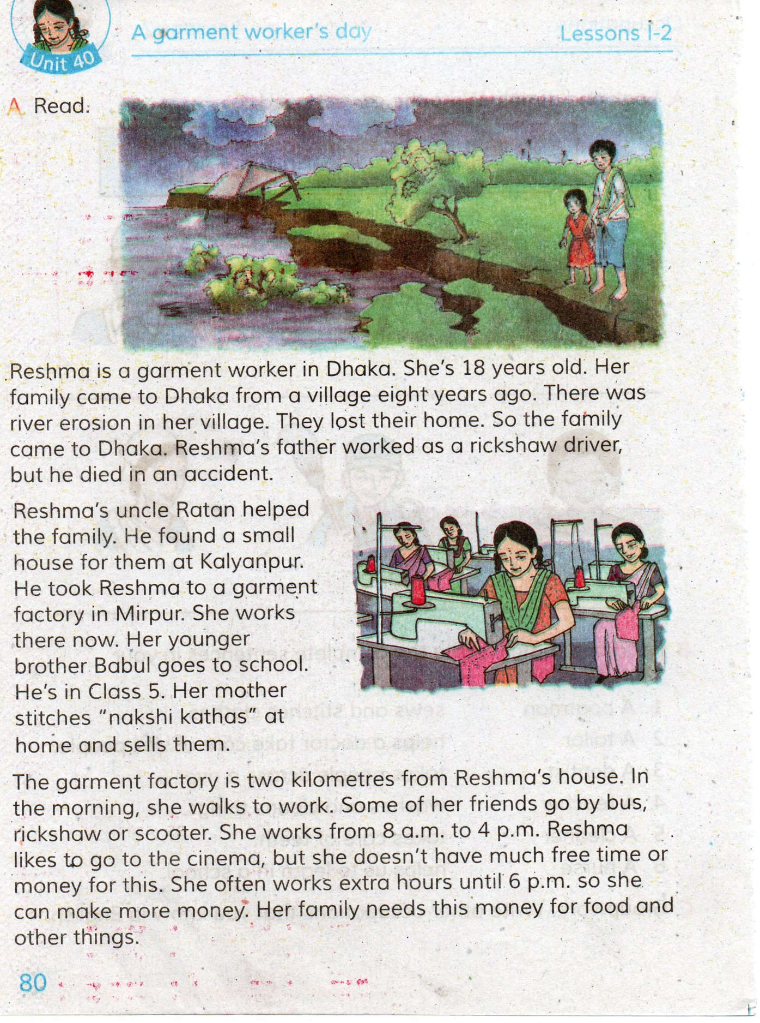
Teacher’s loud reading

Slide 11
Group work
Rose
About Reshma’s parents
Lotus
About Reshma’s work time
Sun-flower
About Reshma’s Childhood.

Slide 12
Pair Work
Topics for Pair Work
Write 5 other names of professions.
Write 5 sentences about your father’s profession.
How should we behave with a person like Reshma?

Slide 13
Fill in the blank
Evaluation
1. There was river -----------------in his village.
2. They lost their ------------------.
3. He died in an----------------------.
erosion
home
accident

Slide 14
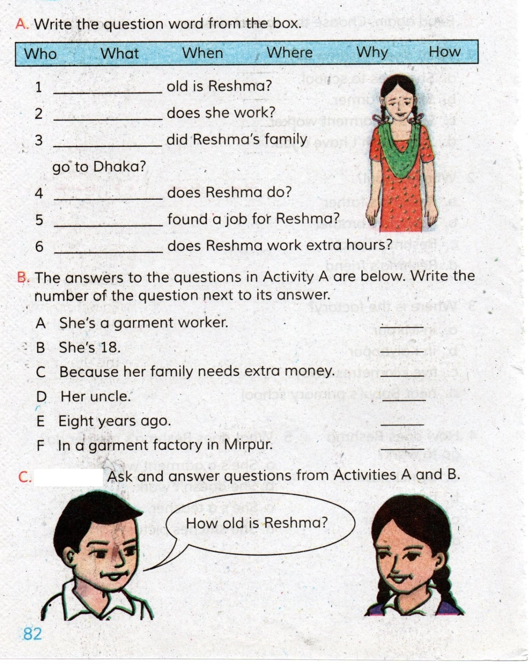
Homework

Slide 15

Goodbye, See you tomorrow.

