Slide 1
সকলকে শুভেচ্ছা

Slide 2
Presented by
Tangira Khanom
Asst .Teacher comt and ICT
Shahi Mohalla Mohammadia Alim Madrasah
Mobile no 01622236455 .Email. tangiralovely@gmail.com
Class Seven
Subject :English 2nd paper
Lession plan - Sentence

Slide 3
Out come
Able to learn
Definiton of sentence
Kinds of sentence ,structure and example
Make sentence

Slide 4
A
E
P
N
LETTER
A
P
E
N
WORD
Z
A
B
Y
Alphabet
X
C
W
V
D
U
E
T
F
S
G
I am a student
R
SENTENCE
Q
H
P
I
O
J
N
K
M
L

Slide 5
student
Sentence Definition:
A sentence is a word or group of words that must expresses a complete idea or sense or meaning and that may consists of a subject and a verb.
Also it may have an object or a complement and the words must be order properly.
যে শব্দ বা শব্দ সমষ্টি দ্বারা সম্পূর্ণ অর্থ প্রকাশ পায় এবং যা সাধারণত কর্তা এবং ক্রিয়া দ্বারা গঠিত তাকে sentence বা বাক্য বলা হয় ।
Example: - We practice Math everyday. (Here we is subject, practice is verb, Math is object and everyday is adverb)
Basically there are two parts of a sentence: (একটি Sentence এ মূলত দুটি অংশ থাকে)
Subject ( We )
and
Predicate (practice English everyday )
Predicat
am
I
a
subject

Slide 6
predicate
Subject: A subject of a sentence is a person or thing about which something is said or written.
Predicate: And the Predicate that says what the Subject does.
যে ব্যক্তি বা বস্তু সম্পর্কে কোনকিছু বলা বা লিখা হয় তাকে Subject বা কর্তা বলে ।
যা subject বা কর্তা সম্পর্কে বলে বা করে বা লিখে তাকে Predicate বলা হয় ।
In the above example ‘We’ is subject and ‘practice English everyday’ is Predicate. A sentence usually starts with a subject and then predicate comes.
predicate
subject
sentence

Slide 7
In some case like order, advice or request subject is not mentioned. It is user stood. Example: - (You) Keep quite. - (You) Take care of your health. - (I) Thank you. And sometimes sentence starts with the predicate and then subject comes. Example: - Long live Bangladesh - Down went the Titanic.

Slide 8
যা subject বা কর্তা সম্পর্কে বলে বা করে বা লিখে তাকে Predicate বলা হয় ।
In the above example ‘We’ is subject and ‘practice English everyday’ is Predicate. A sentence usually starts with a subject and then predicate comes.
Structure of a Sentence: According to structure, sentences are of three types.
Kinds of Sentence: Sentences can be classified into five categories, according to their meaning or function.
Kinds of Sentence
Assertive Sentence
Interrogative Sentence
Imperative Sentence
Optative Sentence
Exclamatory Sentence
Simple Sentence
Complex Sentence
Compound Sentence

Slide 9
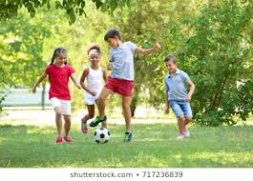
Assertive Sentence:
An assertive sentence is a simple/general statement or assertion, either affirmative or negative.
কোনো সাধারণ বিবৃতি বা বক্তব্যকে Assertive Sentence (বিবৃতিমূলক বাক্য) বলে
Pattern: Subject + verb + object/complement/adverb/adjective
Example: -English is an International Language. (Affirmative) -We do not do bad things. (Negative) -Everybody should know English. (Modal auxiliaries)

Slide 10
Interrogative Sentence:
An interrogative sentence asks question about a person or thing(s). It always ends with a note of interrogation a.k.a. question mark (?).
There are two ways to form an interrogative sentence.
I. Beginning with helping or auxiliarie verbs (am, is, are, was, were, have, has, had)
or
modal auxiliaries (shall, should, will, would, can, could, may, might, etc.). Example: - Do you have your assignment ready? - Does he speak English? - Did she work abroad? - Should I go there? - Can you hear the sound? - Don’t you want any food? (Negative)

Slide 11
2. Beginning with some specific words like who, which, what, when, where, why, how, whom, how much, how many, etc. [These are known as ‘WH’ questions.] Example: - How is your business going on? - Who fixed the computer? - Whom do you support? - What are you expecting from me?
- What time is it now? - How many people have died there?

Slide 12
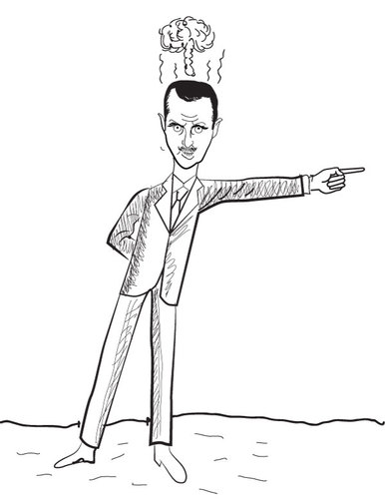
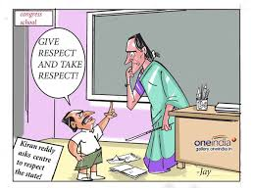
Imperative Sentence:
A sentence that expresses a request, command, order, advice, suggestion, etc. is an imperative sentence. In an imperative sentence, the subject is usually unexpressed; it is understood rather.
Pattern: Subject (Invisible) + verb + object / where Example: - Take care of you. - Give me the pen. - Do it now. - Be honest. - Come here - Never tell a lie - Do not laugh at other's helplessness. - Let him go there.
Caution: You must do your duty. (It is an assertive sentence, not an imperative sentence.)

Slide 13
Optative Sentence:
Wish, desire, prayer, etc. are expressed by the Optative sentence
Pattern: May + Assertive Example: - May you live long. - May Allah bless you. - Wish you all the best. - Long live Bangladesh. (Can be formed without ‘may’)

Slide 14
Exclamatory Sentence:
Exclamatory is a sentence which expresses strong/sudden feeling or emotion like surprise, pain, delight, anger, disgust, etc.
Pattern: Alas/ Hurrah/ Bravo/ What/ How etc. + Others Example: - Hurrah! Our cricket team has won the series. - Alas! He has failed the competition. - Bravo! You have done a great job. - What a talented girl she is! - How sweetly the cuckoo sings! - What a wonderful land Bangladesh is! - Were I a Super Hero! - What a pity! - Fantastic! - What an idea! - Put that down now! - Leave the package at the door. - Walk softly, please.

Slide 15
Structure of a Sentence:
According to structure, sentences are of three types. 1. Simple Sentence. 2. Complex Sentence. 3. Compound Sentence.
I. Simple Sentence:
Simple sentence is structured with only one subject and one finite verb.
Simple sentence has only one independent clause.
Pattern: Subject + finite verb + complement Exmaple: - Bangladesh is a populated country - Life is not a bed of roses - Human is the superior in this planet.

Slide 16
2. Complex Sentence:
A sentence consisting of one principal clause and one or more sub-ordinate clause(s) is a complex sentence.
Example: - If you work hard, you will shine in life.
(Here, ‘if you work hard’ is sub-ordinate clause
and
‘you will shine in life’ is main or principal clause.)
Sub-ordinate clause begins with conjunctions like who, which, that, when, how, where, while, if, whether, because, since, as, though, although, till, until, unless, before, after, so that, whenever, wherever, whoever, whatever, etc.
Example: - I know where he lives. - I do not know what his name is. - While there is life there is hope. - We eat so that we can survive.

Slide 17
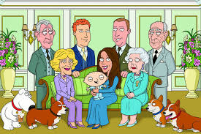
3.Compound Sentence :
A sentence having more than one principal clauses, linked by one or more coordinating conjunctions, preceded by a comma, is called compound sentence.
Conjunctions that are used in compound sentences are and, but, or, for, nor, also, however, moreover, thus, so, therefore, else, still, as well as, accordingly, otherwise, yet, not yet, but also, either or, neither nor, on the contrary, etc.
Example: - Respect others, and others will respect you. - He loves us, but he does not show it.

Slide 18
Class work
find out sentence :-
I have a pen .
Do not run in the sun .
May Allah bless you .
He is poor ,but honest .
Alas! I’m undown .
Write the predicates in the blank .
It ---------------
Honesty ----------
We ------------
Allah --------

Slide 19
Home work
Give definition of the sentence ?Kinds of it and definition with example .
What is assertive sentence ? Kinds of it and definition with example .

Slide 20
ALLAH HAFIZ

