Slide 1

WELCOME TO YOU ALL

Slide 2
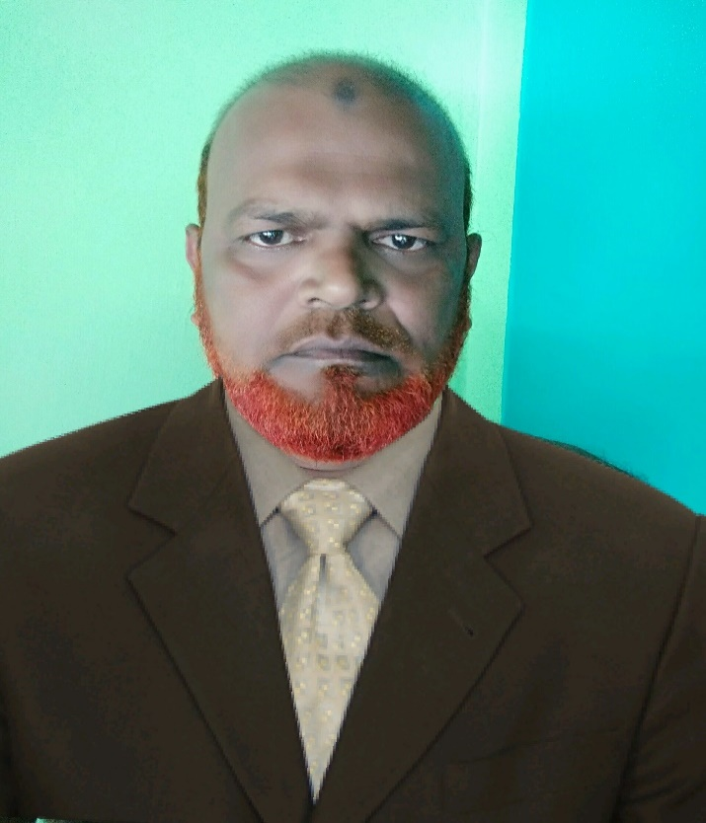
Teacher’s Identity
MD.KHALILUR RAHMAN
ASS.TEACHER ,
ATGHARIA HIGH SCHOOL
HARIPUR,THAKURGOAN.
Phone: 01718911086

Slide 3
Class :Eight
Subject- English 2nd Paper

Slide 4
1.He eats a mango
2.Mother cooks food
3.Rice is eaten in our country
4.My pocket has been picked

Slide 5
Voice Change
Active voice- passive voice

Slide 6
LEARNING OUTCOME
1.Student's will be able to change voice .
2.They will be able to use voice in practical life

Slide 7
How easy and interesting
Voice change is!!!

Slide 8
Let Us Introduce With 24 Operators Of English First
Operators
To be verb
modal
May , might , must , shall ,will , would , can , could,
Should , dare, used to, ought
Am , is, are, was, were, have, has ,do , did ,does ,need

Slide 9
Fundamental rules of voice change
Rule - 1
The places of subject and object are interchanged
main verb is changed into past participle form with a to be verb
AS FOR EXAMPLE:
Kamal likes apples.
Apples
are liked
by kamal

Slide 10
Sentence with operator
Rule - 2
Passive voice with an operator
If verb present
If verb past
use
use
Was , were
Am , is , are

Slide 11
Past Verb
Was , Were
Am, Is ,Are
Operator
Passive
Machine
Operator +Be
Present Verb

Slide 12
Kamal Likes Apples.
Apples
Liked
by Kamal
are
He Employs A Servant.
is
A Servant
Employed
by Him

Slide 13
My mother washes my clothes.
My clothes are washed by my mother
Kannan beats Ravi.
Ravi is beaten by Kannan.
We celebrate the Golden Jubilee of our school.
The Golden Jubilee of our school is celebrated by us.

Slide 14
They killed the enemies.
The enemies
were
killed
by them
He wrote a letter.
A letter
written
by him
was

Slide 15
were discovered
Thomson discovered the electrons.
The electrons
by Thomson
A car knocked down the child
The child
was knocked down
by a car.
The people gave a grand welcome to the president.
The president was given a grand welcome by the people.

Slide 16
IF A SENTENCE CONTAINS
ANY OPERATOR
RULE - 3
VOICE OF A SENTENCE WITH OPERATOR
be
use
After operator

Slide 17
Kamal will play the match.
The match
played
by Kamal
will
be

Slide 18
Rahim ate rice
Passive
machine
Rice was eaten by Rahim
Rice is eaten by Rahim
Rahim will eat rice
Rice will be eaten by Rahim
Rahim eats rice

Slide 19
GROUP WORK
CHANGE VOICE OF THE FOLLOWING IN GROUP
We shall over come the trouble.
They will give us some help.
They will not teach him swimming.

Slide 20
RULE 4
VOICE OF A SENTENC WITH VERB+ING/CONTINUOUS TENSE
karim is eating a mango
EATEN
ING LEAVES VERB AND ADD WITH BE
karim
is
ing
a mango
eat
A mango
is
be
ing
eaten
by karim
BE
BY

Slide 21
Thomson is writing the examination.
The examination is being written
by Thomson.
They are building a new house.
A new house is being built by them.
Rani is singing a song.
A song is being sung by Rani.

Slide 22
RULE - 5
VOICE OF A SENTENC OF PERFECT TENSE
kaarim has eaten a mango
EATEN
EN LEAVES VERB AND ADD WITH BE
Karim
has
eat
en
a mango
A mango
has
be
en
eaten
by karim
BE
BY

Slide 23
He has completed the course.
The course has been completed by him.
She has posted the letters already.
The letters have been posted by her already.
They have released the result already.
The result has been released by them already.

Slide 24
PAIR WORK
CHANGE THE FOLLOWING IN PAIR
They will discuss the matter tomorrow.
Mrs. Elizabeth taught us grammar last year.
The people beat the thief.

Slide 25
EVALUATION
CHANGE THE FOLLOWING SENTENCES IN PASSIVE VOICE
1.Karim writes a letter.
2.The people elected him.
3.Mother will cook food.
4.She is helping karim.
5.She has made a car

Slide 26
HOME WORK
1.The people elected him.
2.I received the prize.
3.Ramu told many stories.
4.They enjoyed the tour very much.
5.She posted the letter yester day.
6.Every one appreciated him.
7.The director released the stamp.
8.Pieter saved Holland.
9.Rama killed Ravana.
10.The party missed the train.

Slide 27


THANK YOU ALL

