Slide 1

Good morning Students

Slide 2

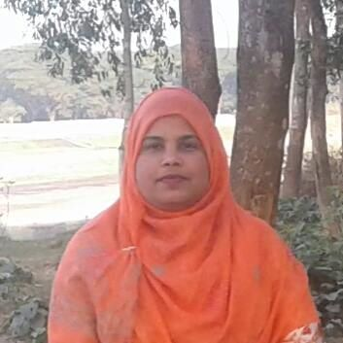
Taslima Akter
Assistant Teacher (ICT)
Edward Institution,Mymensingh.
Class - Seven
English 1st paper
Unit -5
lima809603@gmail.com

Slide 3
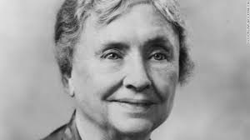
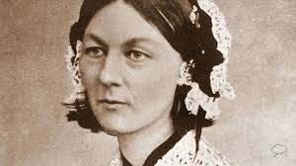
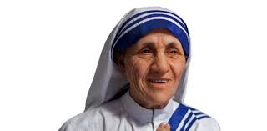
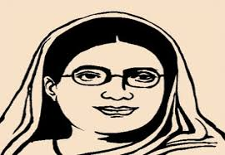
These people are writers and social workers who kept contribution in different sphere in society.
Helen keller
Florence Nightingale
Mother Teresa
Begum Rokeya

Slide 4

Today’s Lesson--
Begum Rokeya

Slide 5
Learning Outcomes--
Completing this text Ss will be able to—
Read and summarize the text
Ask and answer the questions
Write a short paragraph

Slide 6
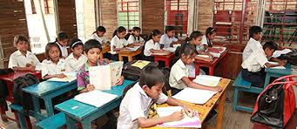
Reading Text

Slide 7
She was born in 1880 at village pairabondh in Rangpur.
She was married in 1896 who was a Deputy Magistrate of Bhagalpur.
She learnt Arabic and Persian as medium of education and communication.
She learnt Bangla and English from her eldest brother.Her husband was also encouraged her. She was died in 1932.

Slide 8
Group work
Write a short paragraph about her in simple words.

Slide 9
Evaluation
1.Who was Begum Rokeya?
2.Where is Bhagalpur?
3.What was her father?
4.When did she marry?
5.What did she believe?

Slide 10
Home work
Write a short paragraph about another
personality whom you know.

Slide 11
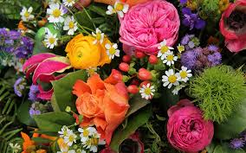
Thank You very much

