Slide 1
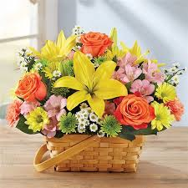
Good Morning Students

Slide 2
Introduction
Taslima Akter
Assistant Teacher (ICT)
Edward Institution, Mymensingh.
Mobile-01749835130
Class-Six
English 1st paper
Unit-2
Lesson- 5
Duration-45minutes
Email- lima809603@gmail.com

Slide 3
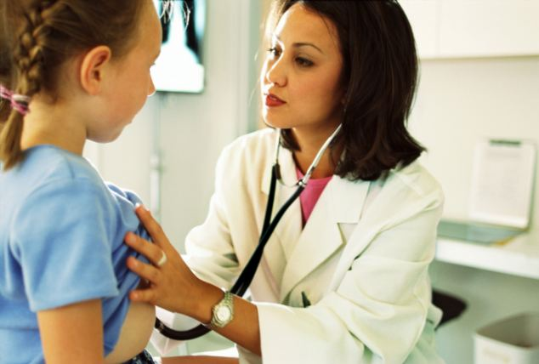
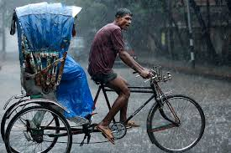
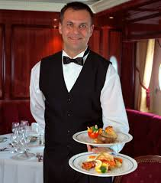
What can we see the pictures ?
Rickshaw puller
Doctor
Waiter

Slide 4
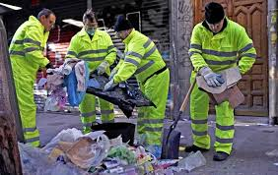
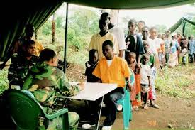
A cleaner cleans our street and our environment regularly.. . .
When one person helps others, in return
the other person usually says “ Thank You’’

Slide 5
Today’s lesson---
Thanks for your work

Slide 6
Learning outcomes
By the end of the lesson we will be able to ----
talk about the people, places and familiar objects in the life of workers.
- ask and answer the questions
read and summarize the text
Write a short paragraph

Slide 7
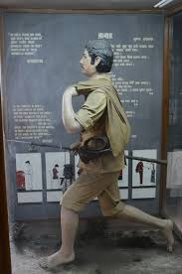
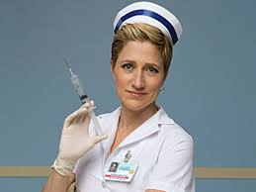
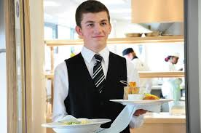
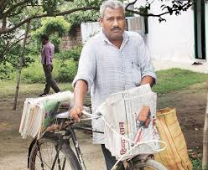
Look and say. Use suitable words from the box to describe the occupation of each person below.
postman
Nurse
Waiter
Newspaper hawker

Slide 8
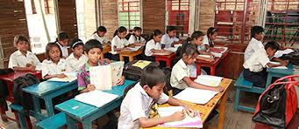
Reading

Slide 9
Group work
Think of a person who helps you live well.

Slide 10
Evaluation
1.What time does Bulbul wake up?
Ans: Bulbul wakes up 5 am.
2. What does a nurse do?
Ans: A nurse serves the patients .
3.What does a rickshaw puller do?
Ans: A Rickshaw puller takes people from one place to another.
4. What does a postman do?
Ans: A postman delivers money,parcels etc to people.
5.What does a cleaner do?
Ans: A cleaner cleans our houses,streets and offices etc.

Slide 11
Home work
“Think of a person who works in your area to help you live well. Write a short composition on this person.”

Slide 12
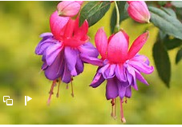
Thank you

