Slide 1

Welcome

Slide 2
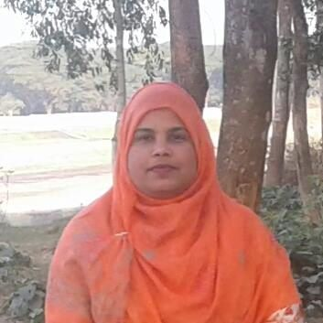
Taslima Akter
Assistant Teacher(ICT)
Edward Institution,Mymensingh.
Class -Six
English 1st paper
Lesson- 3
lima809603@gmail.com

Slide 3
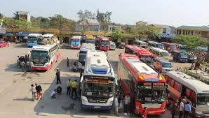
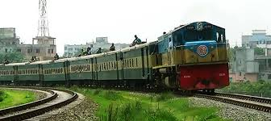
What can we see in the pictures?

Slide 4
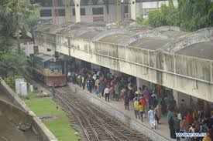
Topday’s Topic--
At a railway Station

Slide 5
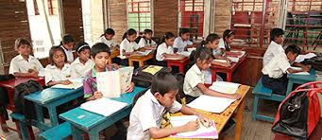
Silent reading

Slide 6
Learning Outcomes
By the end of the lesson students will be able to-
Read and summarize the text.
Talk about people,places and familiar objects in short and simple sentences.
infer the meaning of the words.
write short paragraph ,letter and composition.

Slide 7
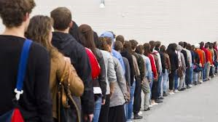
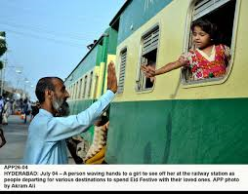
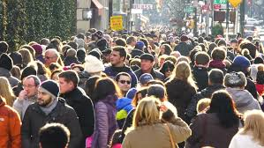
Word meaning
Key words
Queue
Line
See off
Good bye
Crowded
Gathering

Slide 8
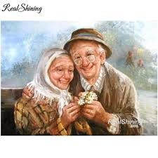
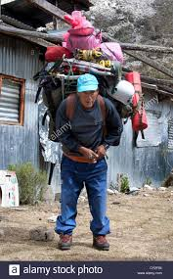

Key words
Word meaning
Couple
Pair
Heavy
Weighty
Luggage
Baggage

Slide 9
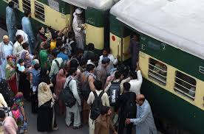
Group work
Look at the picture and write about it in simple words.

Slide 10
Home work
Write about a fair what things you saw and what were happening.

Slide 11

Thank you very much

